Slide 1
Collaboration Across Incarcerated Settings: Working with Probation and County Jails
Idalia Gomez
Stephanie Ruiz-Lemus
Alison Wales

Slide 2
Introductions
Notes:
Introduce self and what professional background/experience
Small group:
Ask each person to share their name, organization, and an incarcerated setting they would like to collaborate with.

Slide 3
Objectives
Identify 2 promising strategies in building capacity to serve incarcerated survivors.
Describe ways their organizations/agencies can engage and reach out to different incarceration facilities/systems, including probation.

Slide 4
Overview
Share the experience of Santa Barbara Rape Crisis Center and North Coast Rape Crisis Center’s work in incarcerated settings
World Café: How do we work with different settings in different ways?
Action: What is one step you can take to support survivors in incarcerated settings?

Slide 5
Working with Santa Barbara County Jail
Notes:
Santa Barbara County Jail
· Established a MOU
· Met with PREA Coordinator to discuss collaboration
· Provided in-service to PREA Coordinator
· PREA Coordinator provided in-service & tour to advocates regarding the facility
· Established guidelines to services provided to incarcerated survivors

Slide 6
Keys to Success
Formalized relationship – MOU
Championess/partnership of the PREA Coordinator at the jail

Slide 7
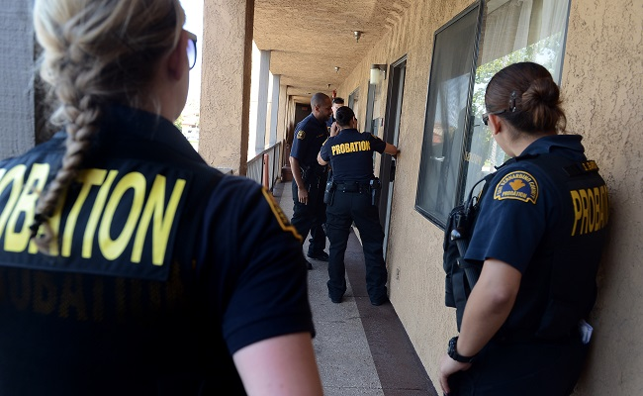
Working with Santa Barbara Probation Department
Notes:
· Applied & Received a grant to provide services at their department
· Represent Victims of Crime through Community Correction Partnership Committee
· Met with Probation Department to provide in-service & receive training
· Provide services on-site

Slide 8
Keys to Success
Resourced/funded project
Leveraging existing relationships (as advocates for victims of crime)
Training = Relationship building

Slide 9
Juvenile Hall
Mental Health Collaboration
Providing Services to Males
CSEC Complexities
Changing of MOU’s
Notes:
Collaboration with mental health
Difficulty getting to meet with kids (still jail mentality)
Leadership on board but not translating to on the ground staff
MOUs—with PREA parts
Relationship building—partners and personalities
Boys being abused—being abused by women

Slide 10
Keys to Success
Building of Individual Relationships
Clear MOU
Can be detailed
Can be more broad
Developed Relationship
with Mental Health
Do What You Say You Will Do!

Slide 11
MOUs Development
Developed MOU with Mental Health, Probation and Juvenile Hall jointly to provide services to comply with PREA.
Difficulties
CSEC

Slide 12
World Cafe
10 minutes each facility/setting
Brainstorm:
How could we increase our connection to this setting to serve survivors of sexual assault?
What would we need to do that?

Slide 13
World Cafe
County Jails
Probation Departments
State Prisons
Fire Camps
Youth Detention Centers
Notes:
Set up room with a large poster paper for each of these sites, then have the participants chose a first one, 10 minutes to brainstorm, then move to another setting—conversations/brain storm builds on each other.

Slide 14
Questions?

Slide 15
Contact Information
Idalia Gomez idalia@sbrcc.net
Stephanie Ruiz-Lemus stephanie@sbrcc.net
Alison Wales alison@ncrccpc.org

