Slide 1
This Web Presentation Will Begin Soon
This facilitation guide and presentation are
available for you to use and brand with
your organization’s logo and tagline.

Slide 2

Confidentiality, Privilege, Mandatory Reporting and Centers
Notes:
This is your opportunity to welcome your audience and start the presentation. If you are going to record the web conference this is where you will start the recording and let your audience know they have the option to leave if they chose to not be recorded.
This training was developed for entry level participants in your local community or partnering organizations.
Welcome to today’s presentation It Impacts Us All: Sexual Assault 101

Slide 3

VALOR.us
Follow Us
twitter.com/valor_us_
facebook.com/WeAreValorUS
instagram.com/_valorus/
The content of this training was developed by ValorUS supported by funding awarded by Victims of Crime Act Victim Assistance Formula Grant Program and Services Training Officers Prosecutors (STOP) Violence Against Women Formula Grant Program funds (TE19-22-1578) through the California Governor’s Office of Emergency Services (CAL OES). The opinions, findings, and conclusions in this publication are those of the author and not necessarily those of Cal OES. Cal OES reserves a royalty-free, nonexclusive, and irrevocable license to reproduce, publish, and use these materials and to authorize others to do so.
Notes:
VALOR ACKNOWLEDGMENT:
THIS SLIDE MUST BE KEPT AND READ IN YOUR PRESENTATION.
The material in this presentation was researched and created by ValorUS (VALOR) for the use of all California Rape Crisis Centers for purpose of training their community and community partners.
VALOR is a national organization committed to advancing equity and ending sexual violence. Through leadership, prevention, and advocacy, we are fearlessly pursuing a world free from violence where the dignity of every person is valued and respected.
VALOR’s mission is preventing and ending sexual violence by advancing equity and eradicating oppression.
You can find them on their website at Valor.us and on social media as listed on this slide.

Slide 4
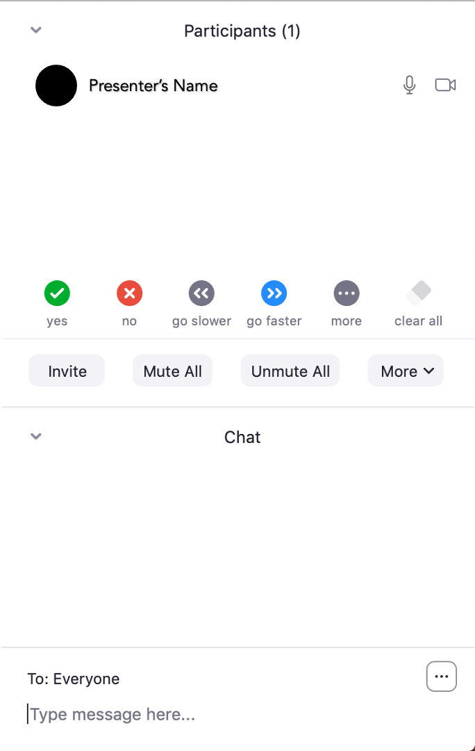
How To Use Zoom
Text chat
PowerPoint Slides
Polling Questions
Phone
Closed Captioning
Web Conference Guidelines
(hand raising)
Notes:
OPTIONAL SLIDE IF DOING A WEB CONFERENCE
Do a quick run through of web conference/Zoom use- (if you feel this is necessary)
We have the text chat- please feel free to write your questions or reactions as well as responses to some text chat questions we may have. If you have joined now, please introduce yourself, your pronouns, organization and what's the weather like in your neighborhood?

Slide 5
Upcoming Event/Web Conference
Insert your upcoming events and activities for your organization.
Notes:
Insert your upcoming training/event/activities/web conferences

Slide 6
Meet the Presenter(s)
Name
Pronouns
Title
Organization
Name
Pronouns
Title
Organization
Notes:
Introduce yourself and hand it over to your presenter if different than

Slide 7
Learning Objectives
Define sexual assault and the continuum of sexual violence.
Understand the truths and perceptions of sexual violence.
Understand how to support survivors of sexual violence through referrals and resources.

Slide 8
Icebreaker
What is your superpower
and why?
Notes:
Ask the breakout room question
Copy paste the questions in the chat
If web conference: Allow participants to respond verbally or in the chat.
If in person: Allow time for participants to respond.

Slide 9
Trauma-Informed Care Warning
This content may impact you and could trigger feelings of concern, emotions, and/or physical response:
Step away if you need
Turn down sound
Reach out for support

Slide 10

What is Sexual Assault?
Sexual assault is any type of unwanted sexual contact or behavior that occurs without the consent of the person. Sexual assault occurs when a person is forced, coerced, or manipulated into any unwanted sexual activity.
Notes:
Ask your participant to describe in their own words what sexual assault is. They can us the chat or raise their hand.
Sexual assault is any type of unwanted sexual contact or behavior that occurs without the consent of the person. Sexual assault occurs when a person is forced, coerced, or manipulated into any unwanted sexual activity.

Slide 11

Types of Sexual Violence and Assault
Notes:
Notes: There are many different types of sexual violence and assault. It can be verbal sexual harassment, rape or forced sexual activity, unwanted touching, and exposure to sexual images. Take the time to have a discussion about the different types of sexual violence and assault. You can use the chat (if virtual) or have your participants raise their hand to verbalized what sexual violence is in addition to rape.

Slide 12

Sexual Violence Continuum of Harm
Notes:
Notes: Advocates often think about sexual violence as being along a continuum of harm. This image shows that continuum and how words can slide into actions and then physical violence--but this is all violence. From words to rape --this continuum of harm impacts individuals and communities.

Slide 13
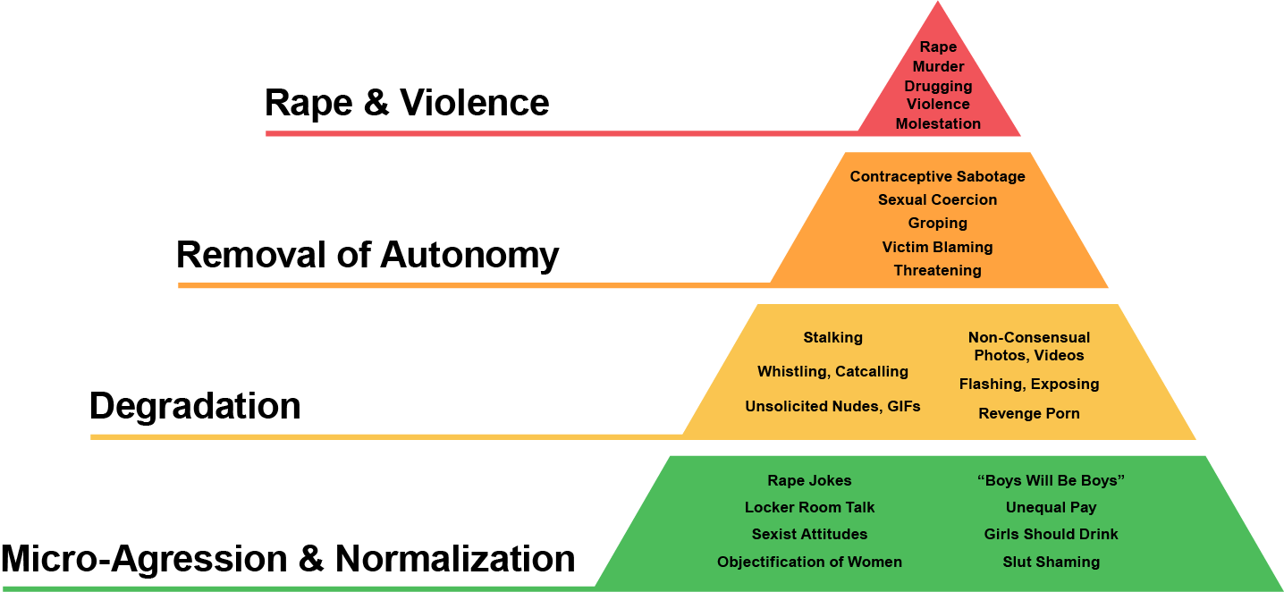
Rape Culture
Notes:
Resource: https://www.marshall.edu/wcenter/sexual-assault/rape-culture/
Similar to the continuum it moves from seemingly innocent behavior into harassment and assault.
What is the “Rape Culture?”
Rape Culture is an environment where sexual violence against women is normalized, justified, excused in media and pop culture, and where rape is prevalent. It’s embedded in the way we think, speak, and is perpetuated through the use of misogynistic language, the objectification of women’s bodies, and the glamorization of sexual violence, thereby creating a society that disregards women’s rights and safety. Rape Culture affects every woman even women who have never been raped. It is rooted in patriarchal beliefs, power, and control.
This pyramid shows how explicit acts of sexual violence are supported by a larger number of removals of autonomy, degradation, and normalization
These experiences of oppression feed and in some ways condone the explicit use of sexual violence in our community.
Rape culture is the cultural norms that condone, legitimize and glorify sexual violence. This is often linked to violence inflicted by men against women as part of the accepted behavior in society.

Slide 14
Chat question
What can you do to eradicate the continuum of harm and rape culture?
Notes:
You can use the chat for your participants to respond or raise their hands.

Slide 15

Prevalence of Sexual Violence
Image sourced from www.cdc.gov/violenceprevention/sexualviolence/fastfact.html.
Notes:
Image source from https://www.cdc.gov/violenceprevention/sexualviolence/fastfact.html.
According to the CDC more than 1 in 3 women has experienced sexual violence involving physical contact during her lifetime and nearly 1 and 4 men experience sexual violence involving physical contact. It is believed that these numbers are much higher as many do not report their abuse.

Slide 16
Impact of Sexual Violence
Individual impact (physical, psychological, etc.)
Community impact
Societal (financial consequences, etc.) – Estimated lifetime cost of rape in California is $163,800 of an adult, and $227,700 of a child. The national average is $122,461 per victim.
Notes:
Sexual violence impacts us all in some way whether directly or indirectly. It impacts the individual, their family, the community, their work or school. And in the state of California the financial impact is roughly $163,800 for an adults lifetime and $227,700 for an individual who experienced sexual violence as a child The national average is slightly lower at $122,461 per victim in a lifetime.

Slide 17
Just the Facts
Fact: Anyone can experience sexual violence – no matter their profession, gender, gender identity, sexual orientation, race, ethnicity, class, age, or ability.

Slide 18
Just the Facts
Fact: Consent is a freely given, clearly stated “yes.” Silence is not consent. Being drunk or drugged and unable to understand or speak is not consent. Being passed out or unconscious is not consent.

Slide 19
Just the Facts
Fact: Previous sexual conduct, including previous consent to sex, is not consent for sex right now. If she kissed you yesterday, that doesn’t mean she wants to kiss you today.

Slide 20
Just the Facts
Fact: Rape is never the victim’s fault.
It is a crime of violence and control
that stems from the perpetrator’s determination to exercise power over another. Neither a person’s clothing or behavior are invitations for unwanted sexual activity. Forcing someone to engage in non-consensual sexual activity is rape, regardless of the way that person dresses or acts.

Slide 21
Just the Facts
Fact: A person under the influence
of drugs or alcohol can’t consent to sexual activity. If consent isn’t given,
it is rape.

Slide 22
Just the Facts
Fact: Most rapes are committed by someone the victim knows. For both completed and attempted rapes, about 8 in 10 offenders were known to the victim. Rape can be committed within any type of relationship, including in marriage, in dating relationships, or by classmates, acquaintances or co-workers.

Slide 23
Breakout Session 1
How does sexual violence affect us all?
How does it affect your life and our community?
Why we should all care about it?

Slide 24
Consent Is:
Given Freely – Saying yes without manipulation or pressure.
Enthusiastic – Only do stuff you WANT to do, not things that you feel you’re expected to do.
Specific to an Action – Saying yes to one act (i.e. kissing or making out) does not mean you have said yes to other acts (i.e. oral sex or anything else).
Informed – Having been given all the information. For example, if someone says they’ll use a condom and then they don’t, there isn’t full consent.
Reversible – Anyone can change their mind about what they feel like doing, anytime. Even if you’ve done it before, and even if you’re both naked in bed.
Notes:
Have an open discussion of what consent is and is not.

Slide 25

Consent
Notes:
Play the Tea video simply click the image
Here is the link to the video on YouTube: https://www.youtube.com/watch?v=fGoWLWS4-kU&t=1s

Slide 26
Breakout Session 2
What is it you can do to get involved in ending sexual violence?
How can it be integrated into your daily work? Community work?
Notes:
This can be done in person on in a web conference:
Give your participant about 10-15 mins to discuss these 3 questions in small groups then bring back for a larger discussion.

Slide 27

Four L’s of Response
Learn
Learn about sexual violence, prevalence, and impact.
Link
Link the survivor to community resources.
Listen
Listen to the survivor, don’t judge, be someone that is supportive and believes them.
Lead
Be a leader among your own community by starting conversations about how to prevent violence in your own circle.
Notes:
Overview of the 4 L’s

Slide 28
Learn about Sexual Violence
Talk with experts (Rape crisis centers, VALOR)
Read information and
fact sheets
Ask questions
Notes:
You are already taking the first steps to ending sexual violence by taking this training. But is important to continue to learn. Our organization will continue to provide information, resources and answer any question you have. We encourage you to also check out VALOR’s website for additional information and trainings available.

Slide 29
Listen to the Survivor
Listen without planning out what your response is – Be Present
Don’t interrupt
Don’t add your own experiences or make it about you
Say: It is not your fault
Say: What do you need?
Say: What do you want to do?
Notes:
If you are a friend or family member of a survivor it is important to listen, without interruption. Allow them to tell their story in their own words without adding your own experience or making it about you. Validate their feeling and let them know they it is never their fault. Let them tell you want they need or want you to do if anything.

Slide 30
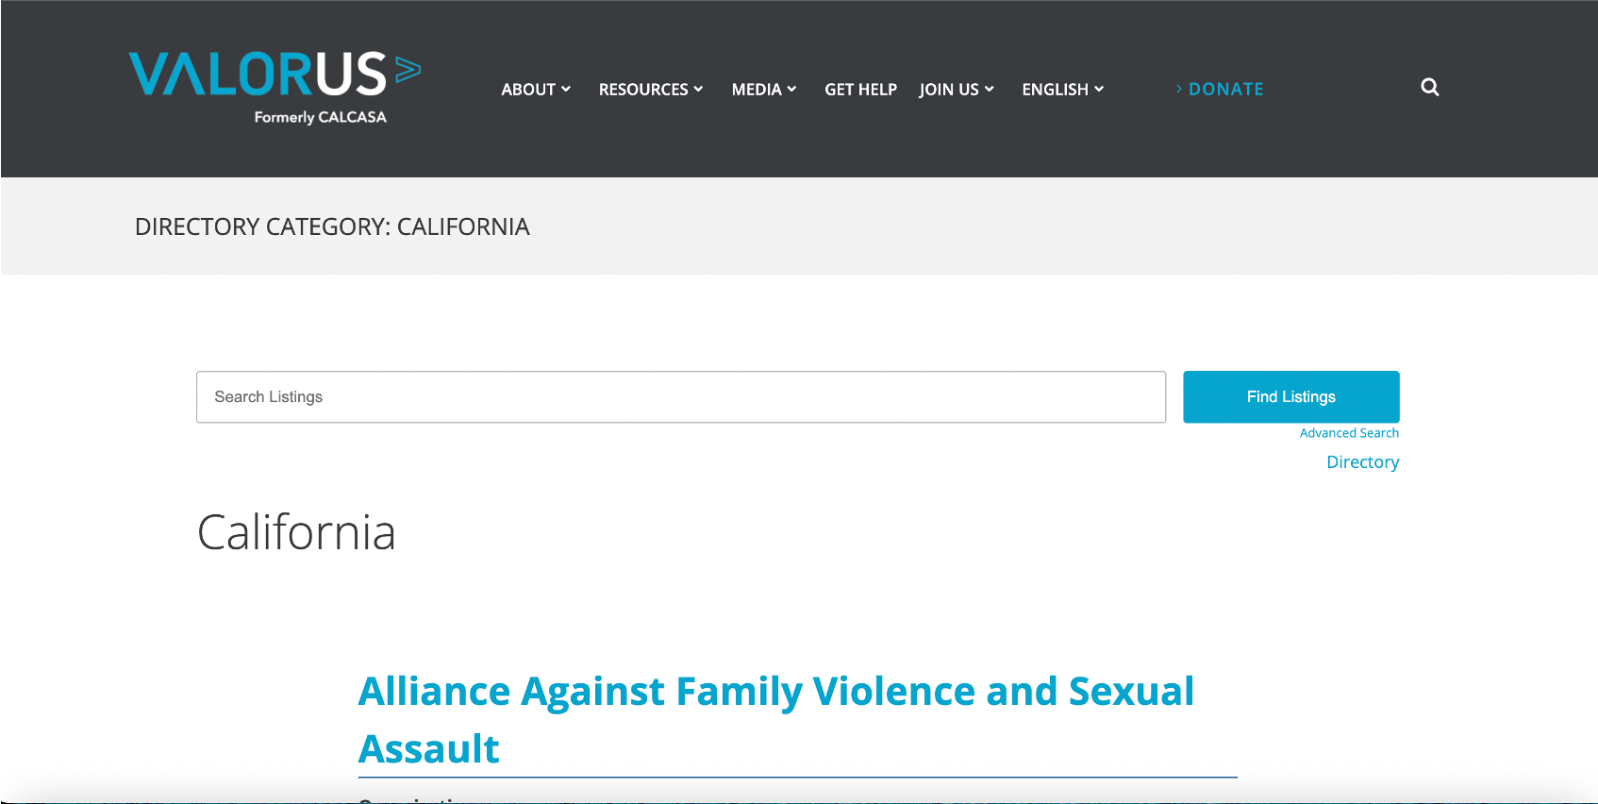
Link to Sexual Violence Resources
Local Sexual Assault Agencies,
www.valor.us/get-help/wpbdp_category/california
work on education, prevention and response to
sexual violence across the continuum of harm.
Notes:
Link them survivor to resources. You can find a list a local center across the state of California on VALOR’s webside.

Slide 31
Link to Resources
Link to a local advocate who can talk about options and consequences
  www.valor.us
Contacting law enforcement is an option - that will start a police investigation
Forensic exam can gather evidence that might disappear after time
Notes:
You can link to a local advocate who can talk through options and consequences as well as supporting them with law enforcement and the forensic nurse and exam.

Slide 32
Lead The Way In Your Own Community
Identify what sexual violence
looks like in your community
Talk about how to prevent violence within your own communities
Be a resource to those who need help/guidance
Get involved by volunteering and taking action
Notes:
And finally get involved in you community and become a leader. Identify what sexual violence looks like in your community. Talk about how to prevent it within your own circle and community. Be a recourse for those who need help and get involved by volunteering and taking action.

Slide 33
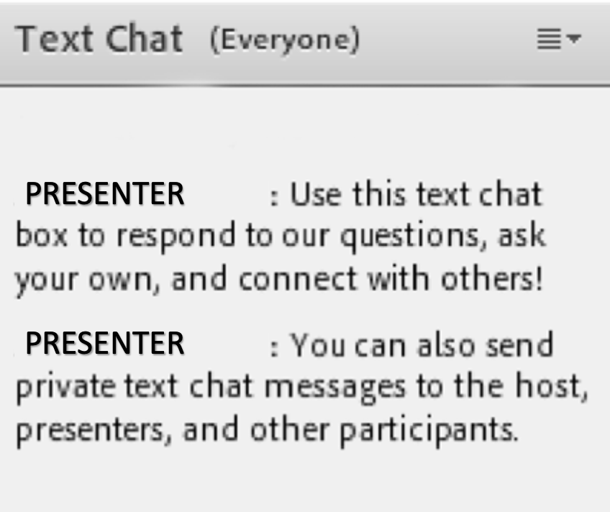
Since sexual assault impacts us all, what are your next steps in addressing and preventing sexual violence in our communities?
Use the Text Chat feature
to answer the question.

Slide 34
Questions?
Use the Text Chat feature or the raise your hand function to ask questions.

Slide 35
Local Resources and Your Services
Provide your participant with resources available in your community
as well as services that your organization can provide and to whom.

Slide 36
VALOR.us
Follow Us
twitter.com/valor_us_
facebook.com/WeAreValorUS
instagram.com/_valorus/
The content of this training was developed by ValorUS supported by funding awarded by Victims of Crime Act Victim Assistance Formula Grant Program and Services Training Officers Prosecutors (STOP) Violence Against Women Formula Grant Program funds (TE19-22-1578) through the California Governor’s Office of Emergency Services (CAL OES). The opinions, findings, and conclusions in this publication are those of the author and not necessarily those of Cal OES. Cal OES reserves a royalty-free, nonexclusive, and irrevocable license to reproduce, publish, and use these materials and to authorize others to do so.
Notes:
VALOR ACKNOWLEDGMENT:
THIS SLIDE MUST BE KEPT AND READ IN YOUR PRESENTATION.
Thank you to ValorUS for creating this material and presentation You can find them on their website at Valor.us and on social media as listed on this slide.

Slide 37
Thank you!!
Add your organizational branding and contact information here.
Contact Name
email address and/or phone

