Slide 1
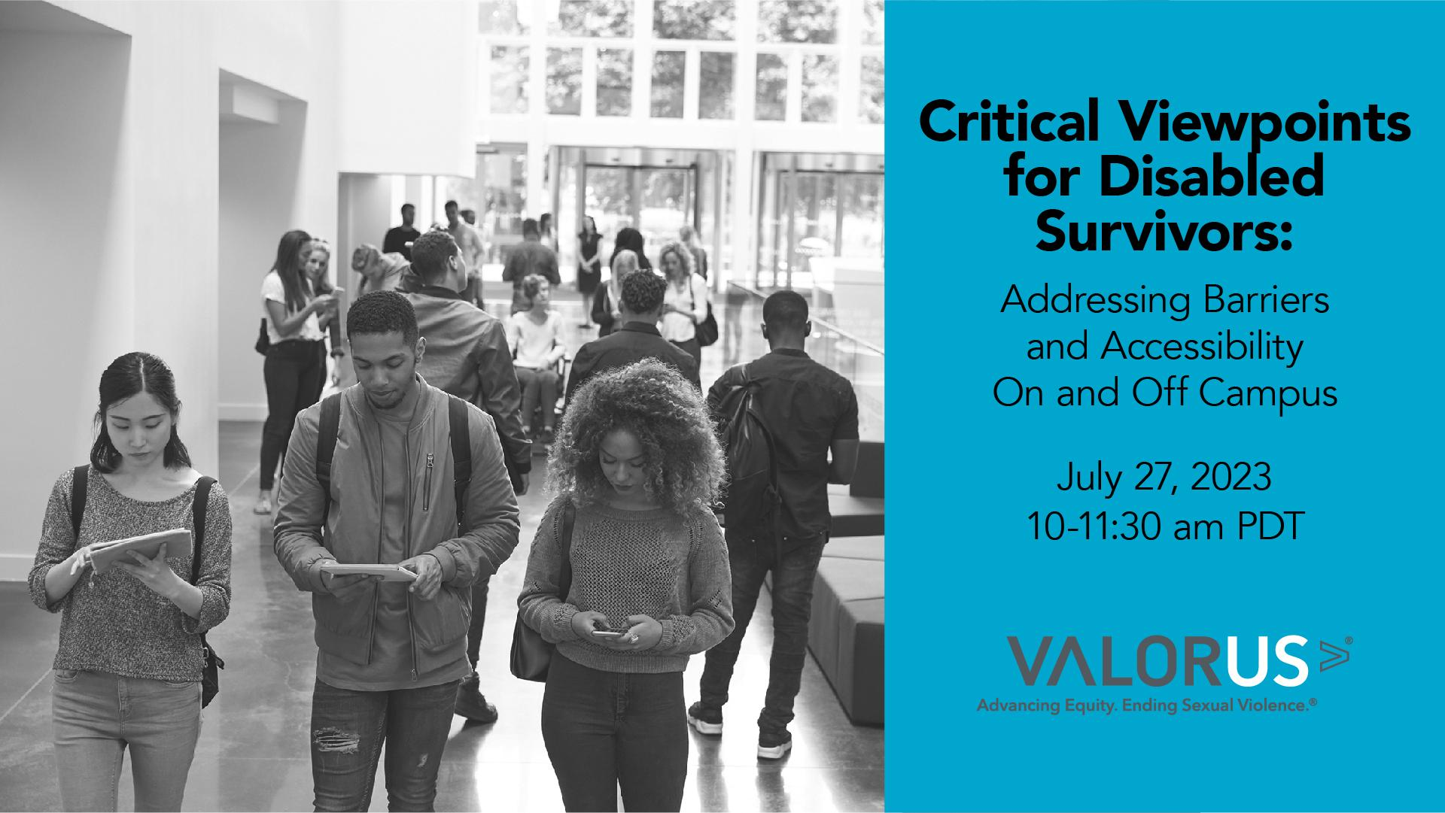

Slide 2
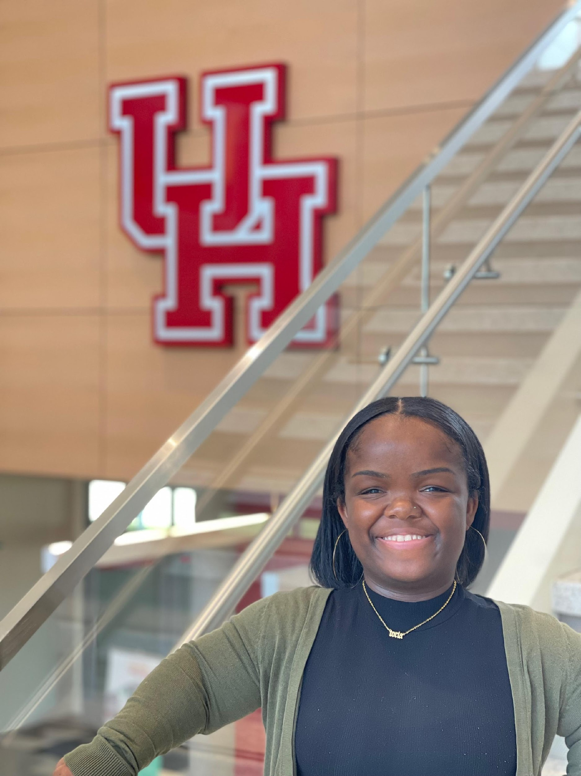

Meet Your Presenter
Toria Jones
Sexual Misconduct Support Services Manager,
University of Houston (she/her)

Slide 3
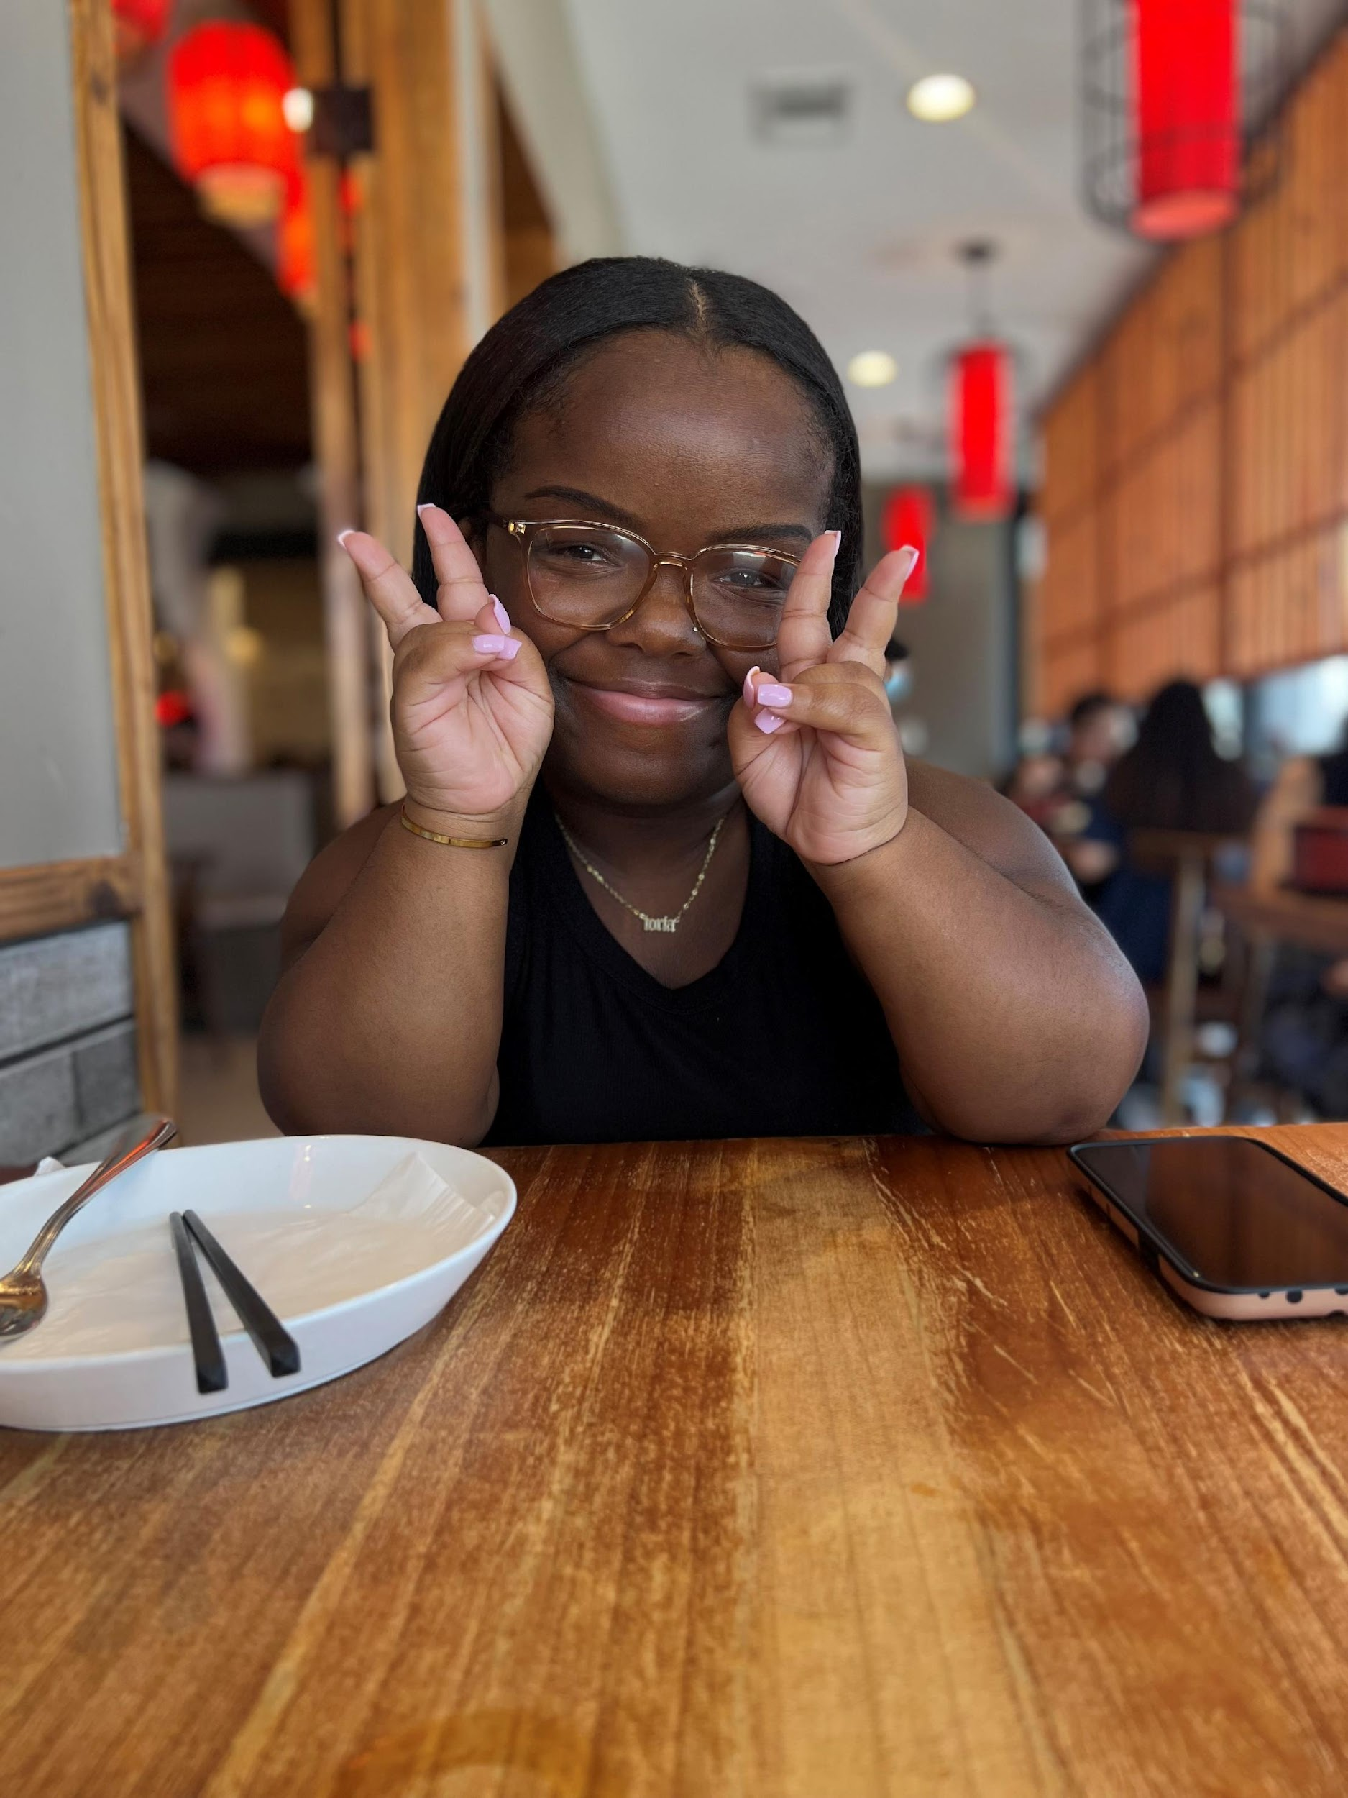
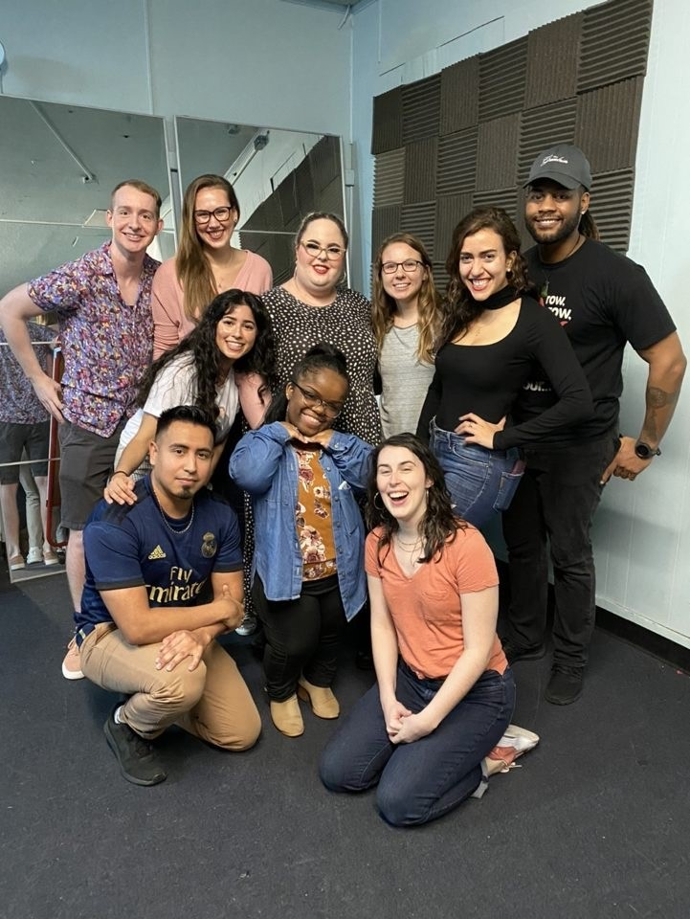
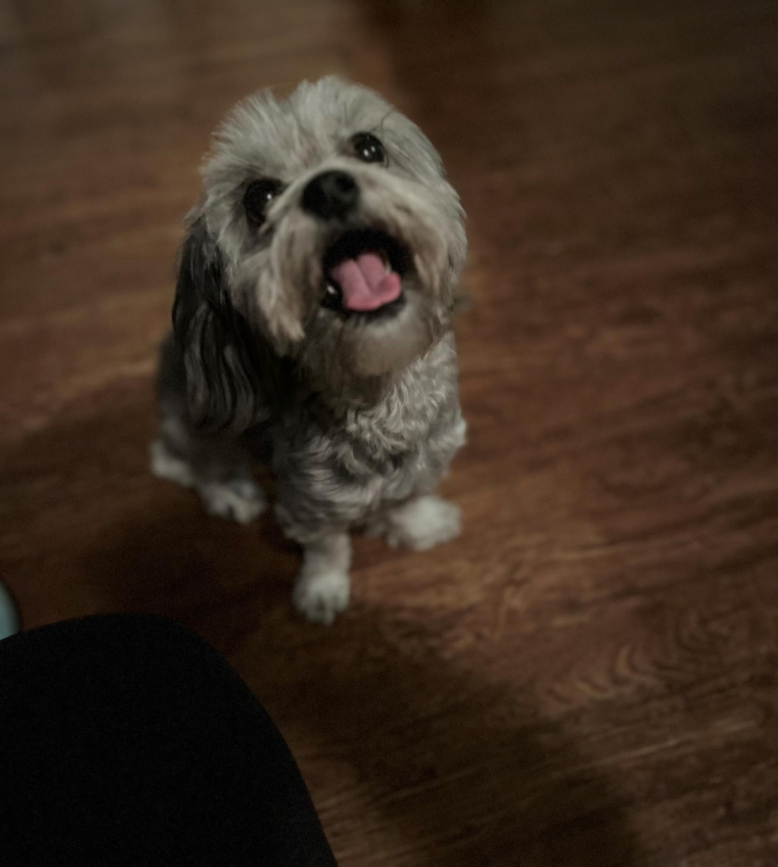
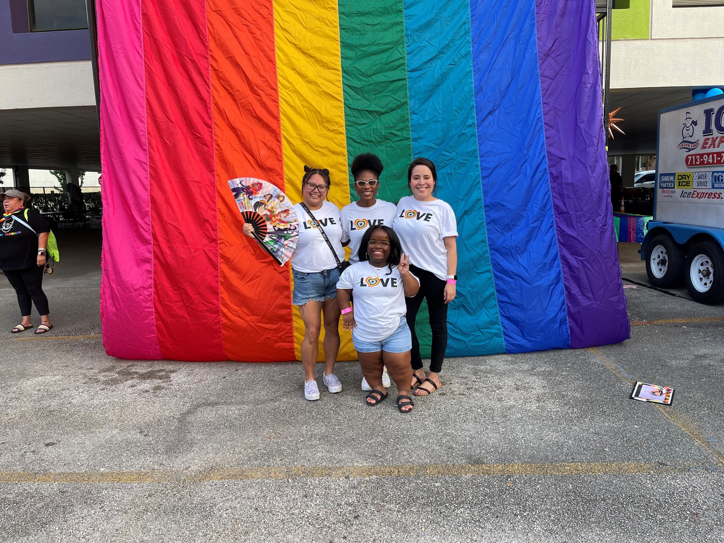
Who Am I?
Daughter, Sister, Friend, Aunt, Advocate, One with all the jokes.
Black Woman with a Disability
Dog mom
Fun Fact: I do improv on the side
Notes:
Where is everyone from? Feel free to write in the chat where you are from, your role, and what you hope to gain from this session.

Slide 4
OBJECTIVES
EXAMINE BARRIERS TO REPORTING/ACCESSING SERVICES FOR BOTH ON-CAMPUS AND COMMUNITY. DEVELOP STRATEGIES FOR ADVOCATES TO EXPAND SERVICES AND PROGRAMS FOR DISABLED POPULATIONS.
PROVIDE HISTORICAL CONTEXT THAT AFFECTS OUR PERCEPTIONS OF THE DISABILITY COMMUNITY.
DEFINE DISABILITY AND DISTINGUISH THE DIFFERENCES BETWEEN PEOPLE FIRST-LANGUAGE VERSUS IDENTITY FIRST LANGUAGE.

Slide 5
Content Warning:
I encourage everyone to please take care of yourself.
Notes:
There will be mention of difficult topics throughout this session so I want to make sure everyone takes care of themselves. Whatever that may look like for you, I hope you do what you need to take care.

Slide 6
WHAT IS DISABILITY?
A disability is any condition of the body or mind (impairment) that makes it more difficult for the person with the condition to do certain activities (activity limitation) and interact with the world around them (participation restrictions).
(Center for Disease Control and Prevention, 2023)

Slide 7
Categories of Disabilities
Physical
Cognitive or Intellectual
Sensory
Mental
It is important to note, not all disabilities are visible (physical) and those experiences are equally valid.

Slide 8
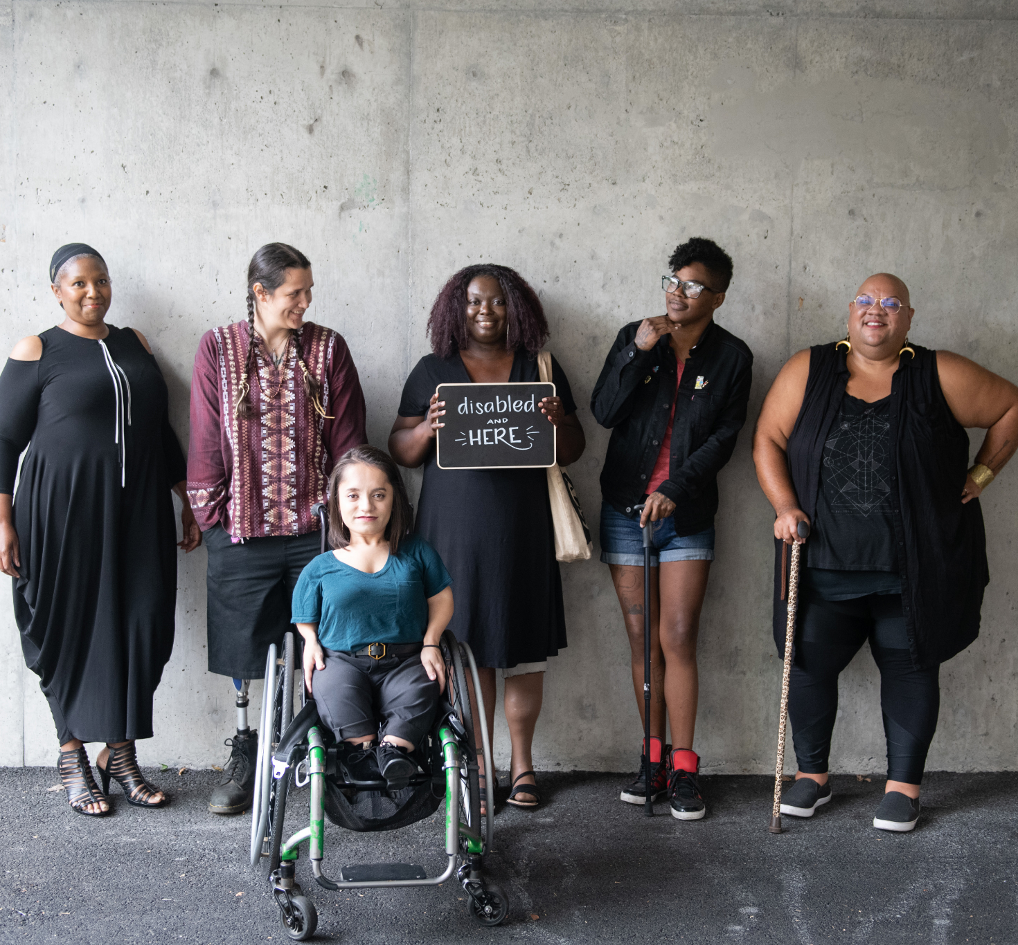
Can you list some disabilities you've
heard of?
Please use the text chat feature to answer the following question.
Photo Credit: Disabled and Here
Notes:
What are some disabilities you've heard of? Feel free to add them to the chat.
https://affecttheverb.com/gallery/disabledandhere/dahgroup/

Slide 9
Obsessive Compulsive Disorder
Traumatic Brain Injury
Paralysis
Arthritis
Attention Deficit Hyperactivity Disorder
Dwarfism
Dyslexia
Down Syndrome
Blindness or Low Vision
Anxiety
Cerebral Palsy
Post Traumatic Stress Disorder
Spinal Cord Injury
Depression
Spina Bifida
Epilepsy
Autism Spectrum Disorders
Dementia
Hearing Loss or Deafness
Tourette Syndrome
Multiple Sclerosis
Muscular Dystrophy
Notes:
You might see some on this list that you didn't know was considered a disability. You might see some that you experience yourself. Disability is such a wide ranging community and is not limited to just physical disabilities. It is also important to note that not all disabilities are physical. Disabilities can be unseen which is called invisible disabilities. It's important to not invalidate those experiences and provide accommodations to those as well.

Slide 10
Disability is all around us...
Disability is not always something a person is born with. A disability can occur at any point in someone's life.
An accident
Due to an illness
Aging
As a result of violence
27% of adults in the US have some type of disability.
(CDC, 2023)
Notes:
It’s important to be mindful that survivors who enter our space whether it is on campus or in the community, they might present with a disability as a result of violence.

Slide 11
Identity First Language
Please use the polling feature to answer the following question.
Do you use people first language or identity first language?
People First Language
versus
Notes:
Now we are going to launch a poll about language use. For those of you that are unfamiliar with these terms. Identity first language would be saying “Disabled Person” as a descriptor. People first language would be saying that before they are disabled they are a person, “Person with a disability”
Let’s launch the poll.
(options are Identity first, disability first, both, neither, Help, I don’t know!)
This is a little bit of a trick question. They are all correct, because it depends on the individual.
There are different preferences when it comes to choosing between people-first language or identity-first language. Some individuals prefer to be identified as disabled as a way of taking ownership of the term. On the other hand, some individuals prefer to be seen as a person first before their disability. It is crucial to respect the choice of the person you are communicating with. In this presentation, I will be using both terms interchangeably, and it is perfectly okay for you to do the same. If you are unsure about what language to use when meeting with a disabled person, it is acceptable to ask. Also ask yourself if the descriptor is necessary. Will it help accommodate for their access needs? Are you using it in a way that they could feel has a negative connotation.

Slide 12
DISABILITY IS NOT A BAD WORD!
Notes:
Many in the disability community are advocating for taking ownership of the word "disability" to reduce shame and raise awareness. Disability has often been overlooked or pushed aside, but disabled individuals are saying "We want you to see it". By acknowledging disability we are acknowledging everything that comes with it including accessibility, rights, advocacy. This is similar to the concept of "color blindness". Ignoring someone's race also means ignoring their experiences and rights. It's important to acknowledge and accept differences to create a fair and inclusive society.

Slide 13
DISABILITY HISTORY
1700's
Industrial Revolution
Dangerous working conditions
Poor medical facilities
Battles leaving people with permanent disabilities
Subjects of public mockery and scorn
20th Century
1907 Immigration Act
Ugly Laws
Institutionalization
Sterilization
Freak Shows
Hitler's Master Race/Eugenics
Roman Empire
Similar attitudes to the Greek
Considered disability inferior
Monstrum = monster = Disability
Mark of God's wrath
Father decided if a disabled child lived or died
Middle Ages
Disabled people were outcasts and homeless beggars
Considered evil, punishment for sins
Institutions were developed
Greek Empire
Mostly obsessed with human perfection
Rise of Christianity
Sympathy and pity increased
Renaissance
Increase in religious influence
The treatment of disabled folks has changed due to the introduction of medical care and institutionalization.
1800's
Wanderers, beggars
The number of people who were unhoused helped developed new policies
Social and moral changes brought training schools for disabled people
Source - https://sailhelps.org/a-brief-timeline-of-the-history-of-disabilities-the-shameful-treatment-of-people-with-disabilities/
Notes:
Throughout history, disability has unfortunately been viewed in a negative light. People with disabilities were often seen as unworthy, isolated from society, and even ridiculed. These harmful perceptions still exist today, and contribute to ableism which affects the lives of disabled individuals. It's extremely concerning that these negative attitudes towards disability can put people at risk of violence. It's important for society to shift its perception of disability towards one of acceptance and inclusivity.
Note in case anyone asks:
1907 Immigration Act - People found by an examining surgeon to be mentally or physically defective affecting their ability to earn a living were not permitted to enter the country often even with family members.There was a fear of making the US a country of defectives.
Ugly Laws - late 1860’s until 1970’s several American cities had Ugly Laws making it illegal for persons with “unsightly or disfiguring” disabilities to appear in public. The goal of that law was to preserve the quality of life for their communities (desirability).
Institutionalization - these facilities were not focused on rehabilitation or therapy, it was meant to isolate, restrain, and control disabled individuals. People with disabilities were often mistreated, abused, malnourished in these facilities. (i.e. Willowbrook Institution in New York).

Slide 14
Forced Sterilization in America
A process or act that renders an individual incapable of sexual reproduction. (Human Rights Watch, 2011)
Eugenics is at play.
Women with disabilities are vulnerable to forced sterilization under the guise of medical care or the consent of caregivers/parents/guardians.
Not only is this an example of erasing disability but also removing autonomy from the individual.
National Women's Law Center

Slide 15
“We have seen more than once that the public welfare may call upon the best citizens for their lives. It would be strange if it could not call upon those who already sap the strength of the State for these lesser sacrifices, often not felt to be such by those concerned, in order to prevent our being swamped with incompetence. It is better for all the world if, instead of waiting to execute degenerate offspring for crime or to let them starve for their imbecility, society can prevent those who are manifestly unfit from continuing their kind.”
Notes:
This quote is in reference to the Buck v. Bell Supreme Court case.

Slide 16
WHAT IS ABLEISM?
A system that places value on people's bodies and minds based on societally constructed ideas of normality, intelligence, excellence, desirability, and productivity. These constructed ideas are deeply rooted in anti-Blackness, eugenics, misogyny, colonialism, imperialism, and capitalism.
This form of systemic oppression leads to people and society determining who is valuable and worthy based on a person's language, appearance, religion, and/or their ability to satisfactorily [re]produce, excel and "behave".
You do not have to be disabled to experience ableism.
-Talila A. Lewis
Notes:
All of the examples I have provided has lead to this definition of ableism. You may or may not have heard of this term. There’s various versions of how ableism is defined but I found this definition more powerful and really captures the full scope of what disabled activists work for. This quote is by Talila Lewis, a writer and disability activist.

Slide 17
Instead of this... | Use this...
Handicap or handicapped, special needs, differently abled | Disabled or disability, person with a disability
Suffers from | Living with
Confined to a wheelchair | Uses a wheelchair, wheelchair user
Crazy, psycho, dumb, "they are so bipolar" | Wild, frustrating, annoying, difficult.
Fall on deaf ears, turn a blind eye, blind leading the blind. | "You didn't hear me", Overlooked, ignored, missed, lost
Lame | Bad, unpleasant, awful, boring.
Normal, Healthy | Able-Bodied, Nondisabled
Dwarf | Person with Dwarfism, Little Person
Tone Deaf | Out of touch
"OMG, I am so OCD" | Meticulous
Ableist Language
It's important to be aware that ableism can often be hidden in our society, and one of the ways it can sneak into our systems is through the language we use. It's crucial that we pay attention to the words we choose to ensure that we're not perpetuating harmful attitudes or stereotypes towards individuals with disabilities.
Notes:
One of the ways we all participate in ableism is in our language.

Slide 18
Americans with Disabilities Act (ADA)
A federal civil rights law that prohibits discrimination against people with disabilities in everyday activities. The ADA prohibits discrimination on the basis of disability just as other civil rights laws prohibit discrimination on the basis of race, color, sex, national origin, age, and religion.
Section 504 of the Rehabilitation Act states, “No otherwise qualified person with a disability in the United States…shall, solely by reason of…disability, be denied the benefits of, be excluded from participating in, or be subjected to discrimination under any program or activity receiving federal financial assistance.”
Section 504 of the Rehabilitation Act
Notes:
Under the provisions of Section 504, colleges and universities must not:
limit the number of students with disabilities admitted;
make pre-admission inquiries as to whether or not an applicant is disabled;
use admissions tests or criteria that inadequately measure the academic qualifications of disabled students because special provisions were not made for them;
exclude a qualified student with a disability from any course of study;
limit eligibility to a student with a disability for financial assistance or otherwise discriminate in administering scholarships, fellowships, internships, or assistantships on the basis of disability.
counsel a student with a disability toward a more restrictive career;
measure student achievement using modes that adversely discriminate against a student with a disability; or
establish rules and policies that may adversely affect students with disabilities.
It is important for everyone to be familiar with these laws.

Slide 19
Myths Surrounding Disabilities
Disabled people do not have sexual relationships
Folks with hearing disabilities can read lips
People in wheelchairs are confined to that chair
Disabled people are brave and inspirational
Disabled people are suffering and unhappy
"But you don't look sick"
"You just gotta push past your disability"
Disabled people are helpless and cannot take of themselves
People with mental illnesses are violent and unpredictable
"You are not disabled, you are differently abled"

Slide 20
Please use the text chat feature to answer the following question.
CHAT QUESTION
What are some additional myths you’ve heard surrounding people with disabilities?
How do these myths and stereotypes affect disabled folks when it comes to violence?

Slide 21
What is Sexual Violence?
People with disabilities are 3x more likely than non-disabled people to experience serious violent crimes such as rape and sexual assault.
Trans and nonbinary disabled people are at greater risk.
Someone who forces or manipulates another person into unwanted sexual activity without their consent. (NSVRC)
An estimated 2 in 5 female victims of rape had a disability at the time of their rape.
Disabled women of color are at increased risk due to intersectional systems of oppression and violence.
Sources – VAWNET, NLM
Notes:
Vawnet – a project of the national resource center on domestic violence
NLM – national library of medicine

Slide 22
Disabled Students on Campus
Students without disabilities experienced nonconsensual sexual contact at a rate of approximately 9.4% whereas students with disabilities were at 17%.
Disabled students are often socially isolated due to stigma and lack of inclusion which leaves them vulnerable to abuse.
The same stereotypes and beliefs applied to disabled people in the community is also applied to disabled students on campus.
There are major gaps in reporting sexual violence on campus.
19% of undergrads and 12% of graduate students report having disabilities which is an increase of more than 350% since 1999.
31.6% of female undergrads with a disability were victims of sexual assault compared to non-disabled female undergrads.
Source: National Council on Disability

Slide 23
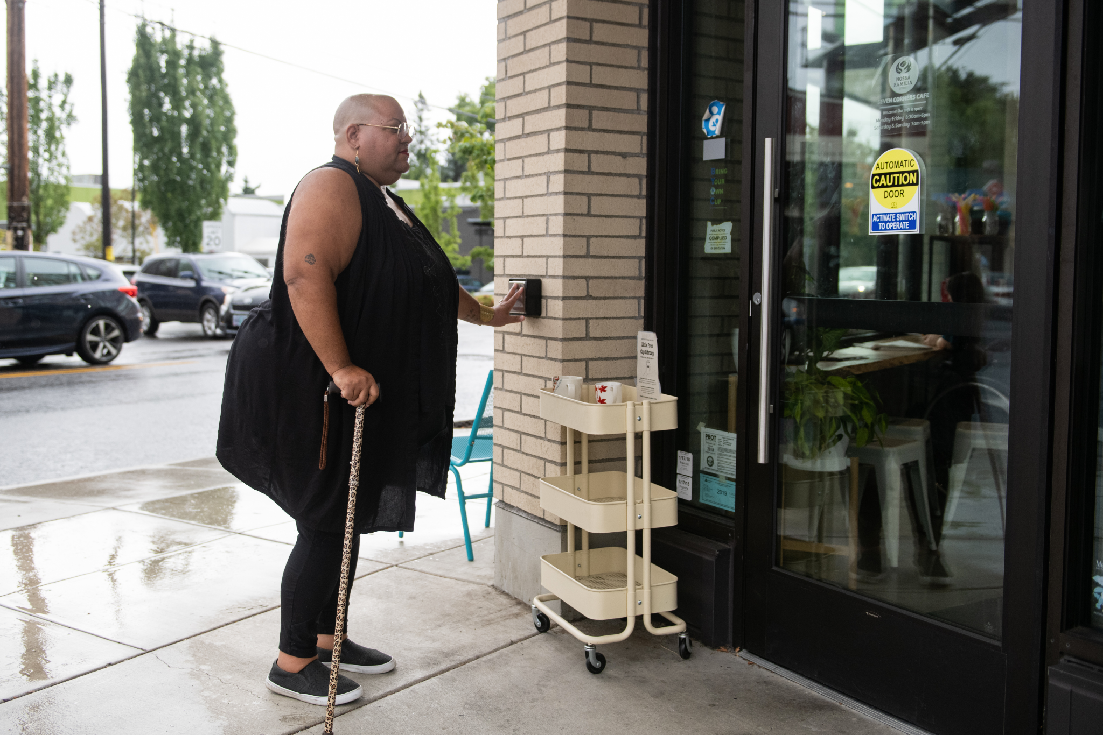
Barriers to Reporting
Isolation
Not being taken seriously
Fear of not being believed
Lack of Accessibility
Lack of Awareness
Lack of education on sexuality
Limited communication
Fear of Institutionalization
Depends on their abuser
Photo Credit: Disabled and Here
Notes:
https://affecttheverb.com/gallery/disabledandhere/cafedoor/

Slide 24
Who are you serving in our agency/department?
Who is missing?
Do you feel equipped to serve disabled survivors?
Are you aware of reporting laws involving people with disabilities?
Is there disability representation in your programming/marketing?
Are disabled voices present?
Is your space accessible? Access to your building?
Is disability included in data collection?
Questions to Consider
Notes:
I really want you all to take a moment and really think to yourself about your department/organization/agency. How can your team address these gaps?

Slide 25
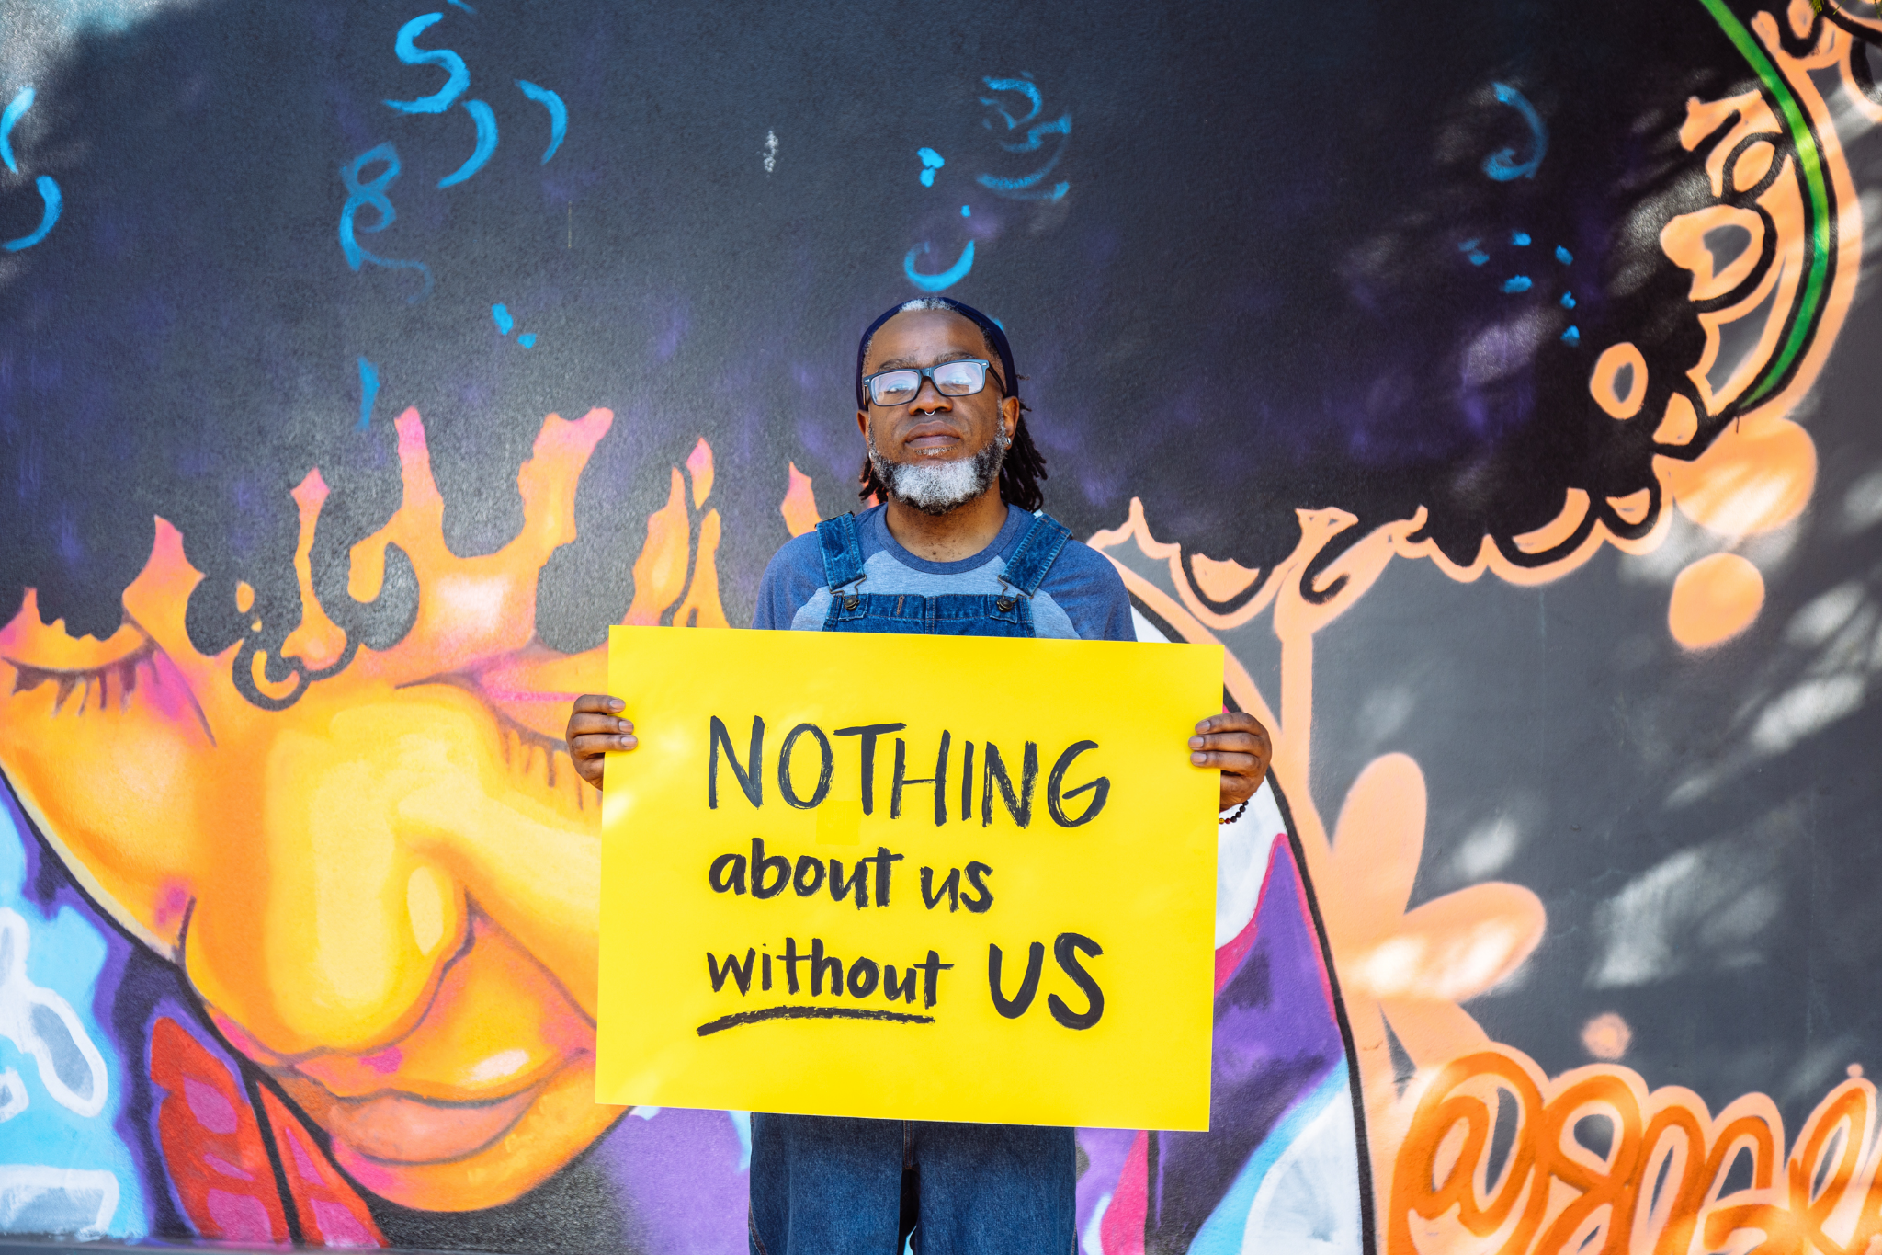
What Can I Do to Help?
Check your own biases.
Don't assume, just ask.
Connect with your local disability service providers.
Connect with your campus's accessibility centers (universities and community colleges).
Connect with disability student organizations.
Hire disabled people.
Prioritize accessibility.
Photo Credit: Disabled and Here
Notes:
Make sure to educate yourself on information regarding disability. Do you know how to reach an ASL interpreter in the event of needing one? Is your programming materials accessible? Are disabled voices present in your meetings (i.e SART, Case Review Meetings)? This is what I mean by prioritizing accessibility. Making sure you can easily access these resources in the event you need them.
https://affecttheverb.com/gallery/disabledandhere/nothingaboutwithout/

Slide 26
What Can I Do to Help?
Train your staff and faculty on serving disabled survivors.
When there's an interpreter present, make sure you are speaking directly to the survivor.
If a caregiver is present, take notice if they are speaking for survivor.
Uplift disabled voices.
Include disability representation in your educational programming.
Continue to learn.
Photo Credit: Disabled and Here
Notes:
Make sure to educate yourself on information regarding disability. Do you know how to reach an ASL interpreter in the event of needing one? Is your programming materials accessible? Are disabled voices present in your meetings (i.e SART, Case Review Meetings)? This is what I mean by prioritizing accessibility. Making sure you can easily access these resources in the event you need them.
https://affecttheverb.com/gallery/disabledandhere/nothingaboutwithout/

Slide 27
Additional Resources
Americans with Disabilities Act (ADA) - https://www.ada.gov/
The Arc - https://thearc.org/
National Council on Disability - https://ncd.gov/resources
National Black Disability Coalition - https://www.blackdisability.org/
Transgender Law Center Disability Project - https://transgenderlawcenter.org/programs/disability-project/
Chronically Academic - https://chronicallyacademic.org/
Association on Higher Education and Disability - https://www.ahead.org/home
National Association of the Deaf - https://www.nad.org/
Disability Visibility Project - https://disabilityvisibilityproject.com/
Notes:
Americans with Disabilities Act (ADA) - https://www.ada.gov/
Easter Seals - https://www.easterseals.com/
National Council on Disability - https://ncd.gov/resources
National Black Disability Coalition - https://www.blackdisability.org/
Transgender Law Center Disability Project - https://transgenderlawcenter.org/programs/disability-project/
Chronically Academic - https://chronicallyacademic.org/
Association on Higher Education and Disability - https://www.ahead.org/home
National Association of the Deaf - https://www.nad.org/
Disability Visibility Project - https://disabilityvisibilityproject.com/

Slide 28
ANY QUESTIONS? COMMENTS?

Slide 29
Thank you!
Email: tjjones5@central.uh.edu
LinkedIn: www.linkedin.com/in/toria-jones

Slide 30



Valor.US
FIND & FOLLOW US
@ValorUS
@ValorUS
/ValorUS
Notes:
pklassen@valor.us

