Slide 1


Slide 2

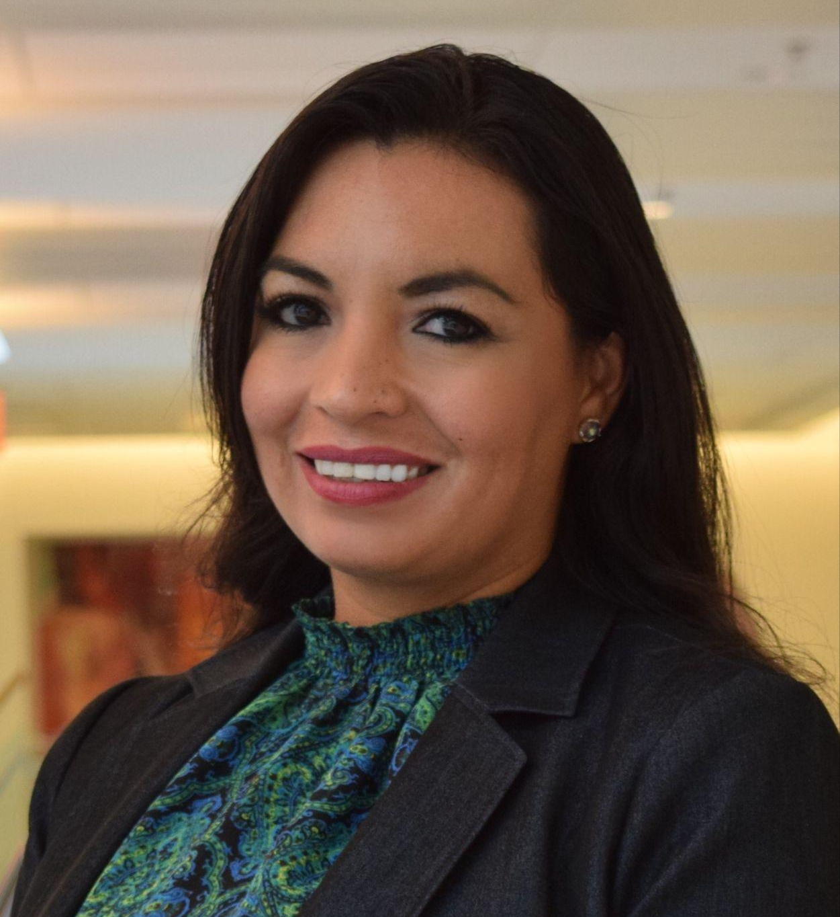
Welcome
Claudia Sibaja (she/her)
Rocio Molina (she/her)
Project Manager
VALOR
Senior Legal Advisor
VALOR

Slide 3
Agenda
Tech overview
Icebreaker
VALOR Policy Framework
2023 Legislation
2024 Policy Priorities

Slide 4
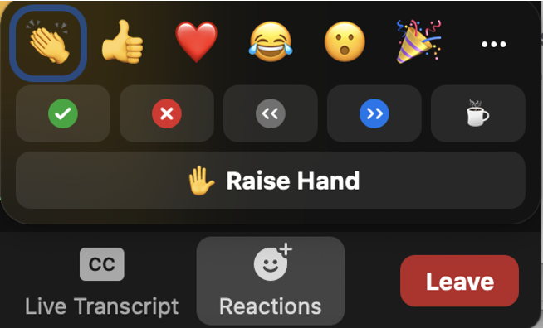


Zoom Use
English Closed Captions can be accessed by selecting the “Show Captions” button
Use the raise hand feature or chat function to ask questions throughout the web conference
Message Claudia and Rocio for technical support

Slide 5
Why are you passionate about policy advocacy?

Slide 6
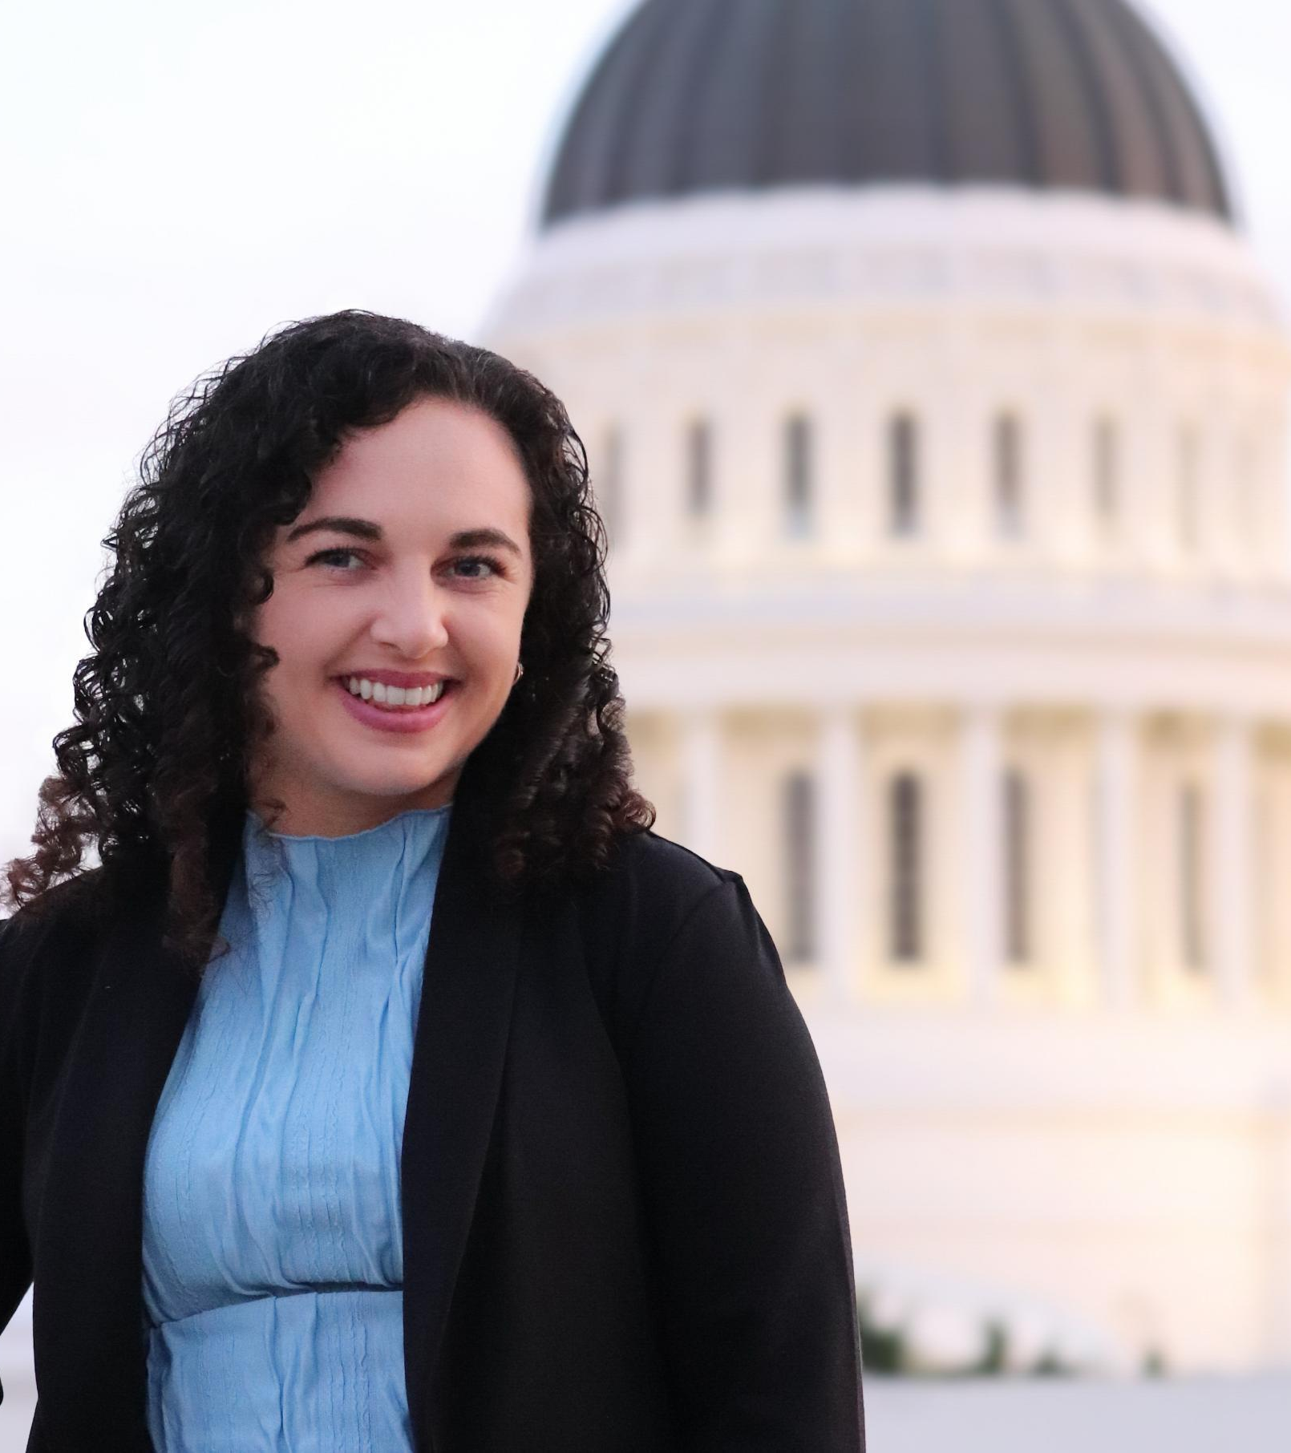
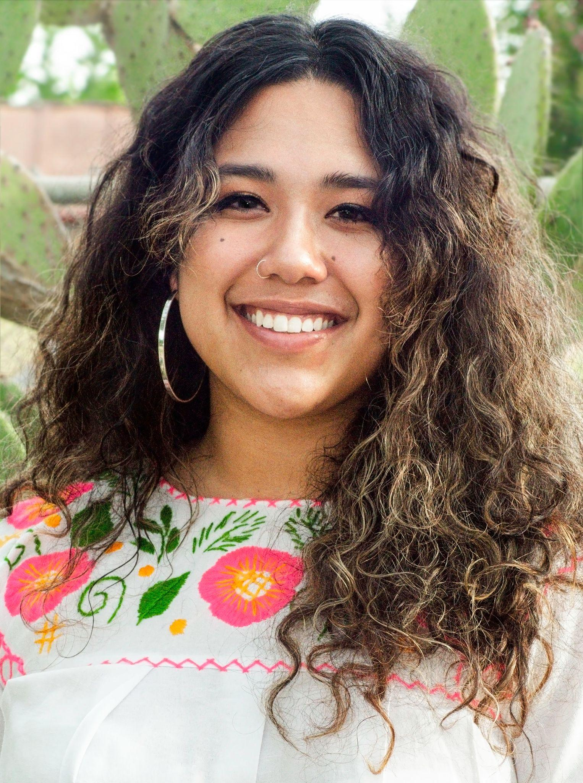
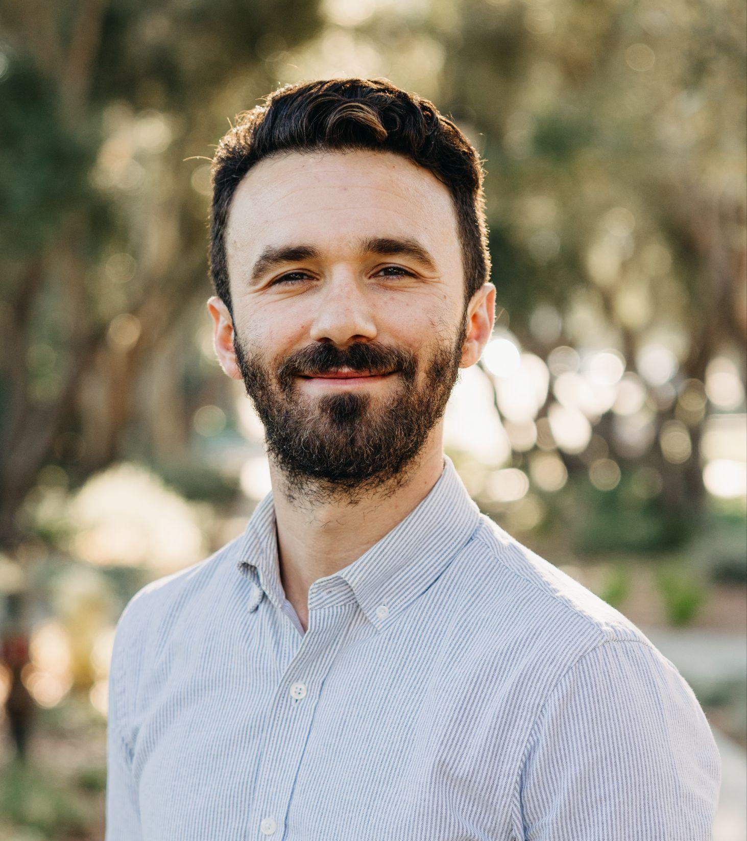
Meet Your Presenters
Grace Glaser (she/her)
Alena Chavez (she/her)
Chris Negri (he/him)
Public Affairs & Policy Manager
VALOR
Program Manager
TEACH (Training in Early Abortion for Comprehensive Healthcare)
Associate Director of Public Policy Strategies
California Partnership to End Domestic Violence

Slide 7
VALOR’s Policy Framework
Focused on advancing equity and ending sexual violence
Alternatives to criminalization
Expanding policy opportunities
Notes:
Grace
Our tagline: advancing equity ending sexual violence provides us with the opportunity to expand our policy framework
Seen call for increased “public safety” which has led to bills enhancing penalties.
This year it allowed us to focus on sexual assault initiatives, but also identify other focus areas where violence intersects, such as reproductive justice

Slide 8
2023 Legislative Wins

Slide 9





2023 SA/DV Prevention Budget Ask
Requested $44 million - 3 parts to ask
  $20 million ongoing funding for domestic & sexual violence prevention grants
  $22 million to support innovative interventions and culturally rooted approaches to end domestic and sexual violence
  $2 million to establish a senior advisor on violence prevention
Champion: Assemblymember Reggie Jones-Sawyer
$2.3 million to continue the Sexual and Domestic Violence Grant program included in the final 2023 budget. This funding will support 46 programs through December 2024.

Slide 10

SB 345 (Skinner) - Protecting Medication Abortion & Gender Affirming Care
California providers who prescribe medications regardless of where the patient is located
Provide gender affirming care and deliver that care regardless of where the patient is located
Bring suit in California against anyone who interferes with a healthcare practitioner’s right to provide care that is legal in California
Protect individuals who are seeking sanctuary in California from abortion-hostile states
Effective: January 1, 2024

Slide 11

AB 452 (Addis) - Justice for Survivors of Sexual Assault Act
Removes California’s civil statute of limitations for child sexual assault
Effective: January 1, 2024

Slide 12

Additional Legislation
Tracked over 40 pieces of federal & state legislation
  AB 933 (Aguiar-Curry) - Protecting Survivors from Weaponized Defamation Lawsuits
  SB 14 (Grove) - Serious felonies: human trafficking
  SB 464 (Wahab) - Sexual Assault Survivor Forensic Bill of Rights
Find English & Spanish documents on our website
Notes:
https://www.valor.us/webconferences/2023-new-laws-and-legislation-web-conference/

Slide 13
2024 Legislative
Priorities

Slide 14


VOCA Budget Request
Requesting $200 million in ongoing funding to backfill the gap in federal Victims of Crime Act (VOCA) funding
Champion: Assemblymember Eloise Gomez Reyes
Formed the California VOCA Advocacy Alliance
Governor’s January budget did not include funding
Stay tuned for advocacy opportunities

Slide 15
Additional Legislative Work
Advocating for prevention funding
Supporting Incarcerated Survivors
Education around alternatives to criminalization

Slide 16
Questions?

Slide 17
Connect With Us
Grace Glaser (she/her)
Alena Chavez (she/her)
Chris Negri (he/him)
VALOR
gglaser@valor.us
TEACH (Training in Early Abortion for Comprehensive Healthcare)
alenda@teachtraining.org
IG: @prolebortionlean
California Partnership to End Domestic Violence
chris@cpedv.org

Slide 18



Valor.US
FIND & FOLLOW US
@ValorUS
@ValorUS
/ValorUS
Notes:
Thank you!

