Slide 1
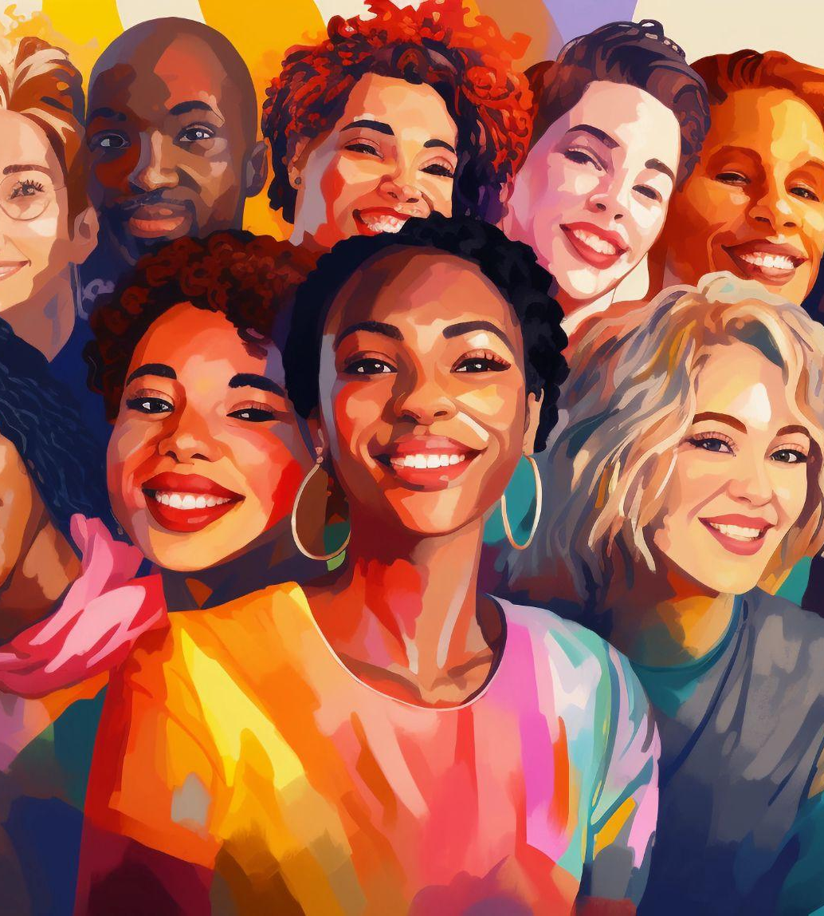
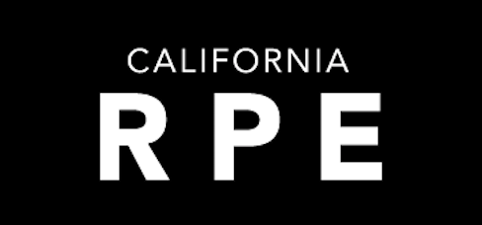
Rape Prevention and Education (RPE) New Staff Orientation
Notes:
Hello! Welcome to the California Rape Prevention and Education Program and to this eLearning series! In this unit you will learn about different frameworks for prevention, the public health application to violence prevention, and comprehensive prevention approaches. This unit will take approximately 30 minutes.

Slide 2

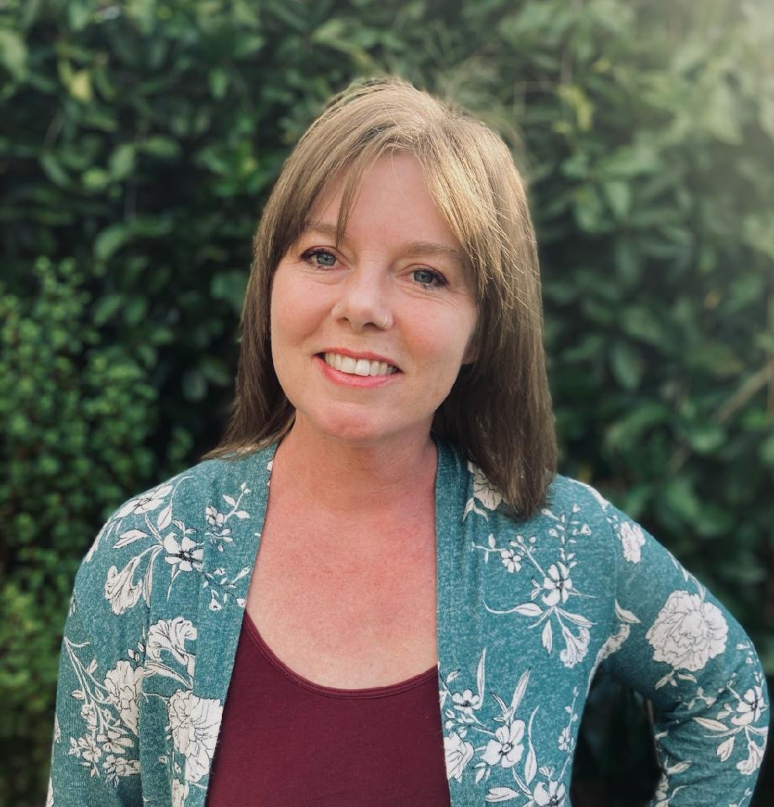
Meet your Hosts and Presenters
Danah Vasquez
Jessie Towne-Cardenas
ella/ellas
Communications Coordinator, VALOR
she/her
she/her
Arboret Group Consulting, VALOR

Slide 3
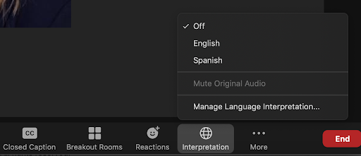
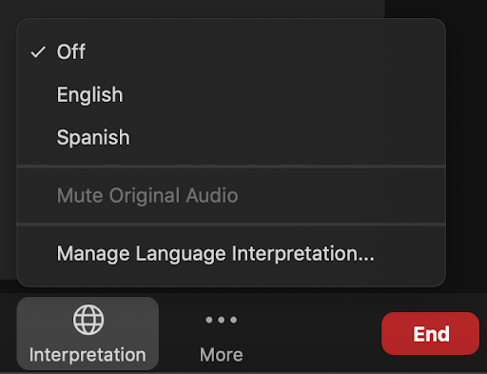
HOW TO JOIN AUDIO
This web conference is offered in English with live Spanish interpretation.
Click on the Interpretation Globe icon at the bottom of your Zoom screen to select a Language.
Spanish interpretation is only available when using Internet audio, “join audio by computer.”
Those dialing in over the phone will only hear English.
If you need to hear the Spanish interpretation, please join with computer audio only.

Slide 4
Funding Disclaimer / Descargo de responsabilidad de financiación
This training is supported by the California Department of Public Health (CDPH), Injury and Violence Prevention Branch, Rape Prevention and Education (RPE) Program, through funding from the Centers for Disease Control and Prevention (CDC), National Center for Injury Prevention and Control (Cooperative Agreement 5 NUF2CE002501). The opinions and findings of this training are those of the facilitators and not necessarily those of CDPH.

Slide 5
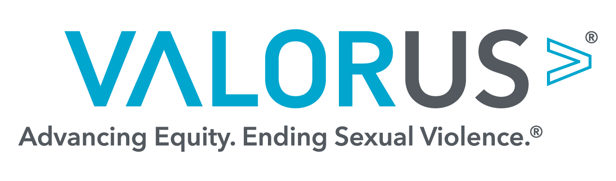
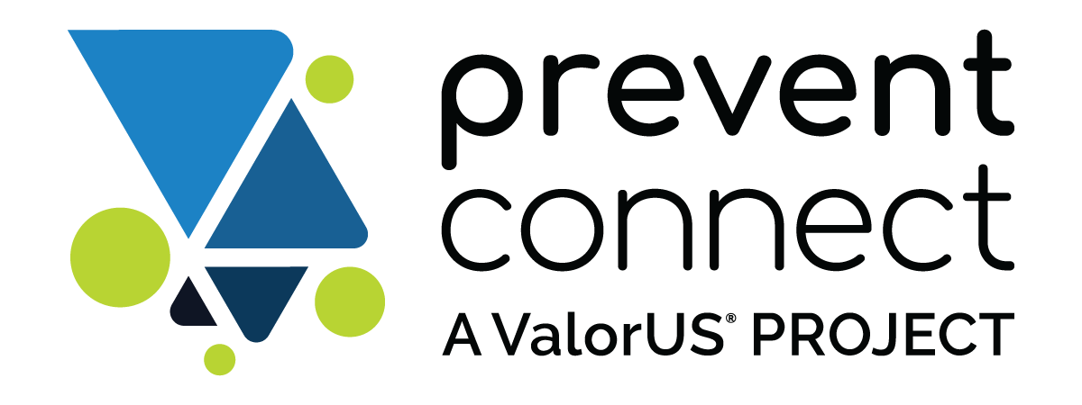
ValorUS®
www.valor.us
PreventConnect
www.PreventConect.org
Notes:
PreventConnect is a national project of ValorUS®. The goal of PreventConnect is to advance the primary prevention of sexual assault and relationship violence by building a community of practice among people who are engaged in such efforts. PreventConnect also builds the capacity of local, state, territorial, national and tribal agencies and organizations to develop, implement and evaluate effective prevention initiatives.

Slide 6
Objectives
Identify and define key areas of RPE Program Fundamentals including prevention, community change, and outcomes.
Identify community engagement approaches and strategies currently applied to the RPE Program.
Identify one (1) area for further study.

Slide 7

Frameworks
social justice
reproductive justice
human rights
feminist organizing
criminal and legal
public health
Notes:
Sexual violence is a public health issue, which is why the Centers for Disease Control and Prevention fund programs to work on preventing it. Public Health has its own approach to addressing sexual violence, which we’ll discuss more in our next module. For now, we’ll just focus on some of the frameworks that have influenced the way that public health, as a field, approaches sexual violence. It is important to note that most of these frameworks center anti-oppression and working alongside populations who have been the most heavily impacted by social norms that perpetuate violence, but we’ll learn more about that later.

Slide 8

Personal Reflection
What is your personal mission?
Does it connect to any of these frameworks?
Notes:
So, how do these frameworks fit together to create the lens of our current movement to prevent sexual violence? Well, as we said before, the public health framework is heavily influenced by feminist organizing and the social justice framework, and many of the risk and protective factors the public health field modifies to prevent violence come from social justice and feminist organizing prevention work. This includes a focus on preventing perpetration, addressing root causes of violence, and community mobilization and multi-sector collaboration and partnerships. Public health as a field has a history of upholding oppressive systems, and those working from a public health framework benefit from knowledge, training, and grounding within a social justice and feminist perspective.
These frameworks give us a lot to consider as RPE practitioners who are utilizing different strategies and perspectives to build programs. As you do your work, we invite you to think about how you can leverage different perspectives to prevent sexual violence. For example, how might criminal legal systems and reproductive justice advocates bridge their perspectives to come together as a community to work on the common issue of sexual violence prevention? Or, how can the history of feminist organizing influence community mobilization today? While we may not have all the answers yet, it is important to integrate the different facets of our movement to implement a holistic approach with the greatest impact.
Take a minute before moving to the next slide to write down your reflections on these frameworks, how they connect, and how they connect to your personal mission and why you’ve chosen to do this work.

Slide 9
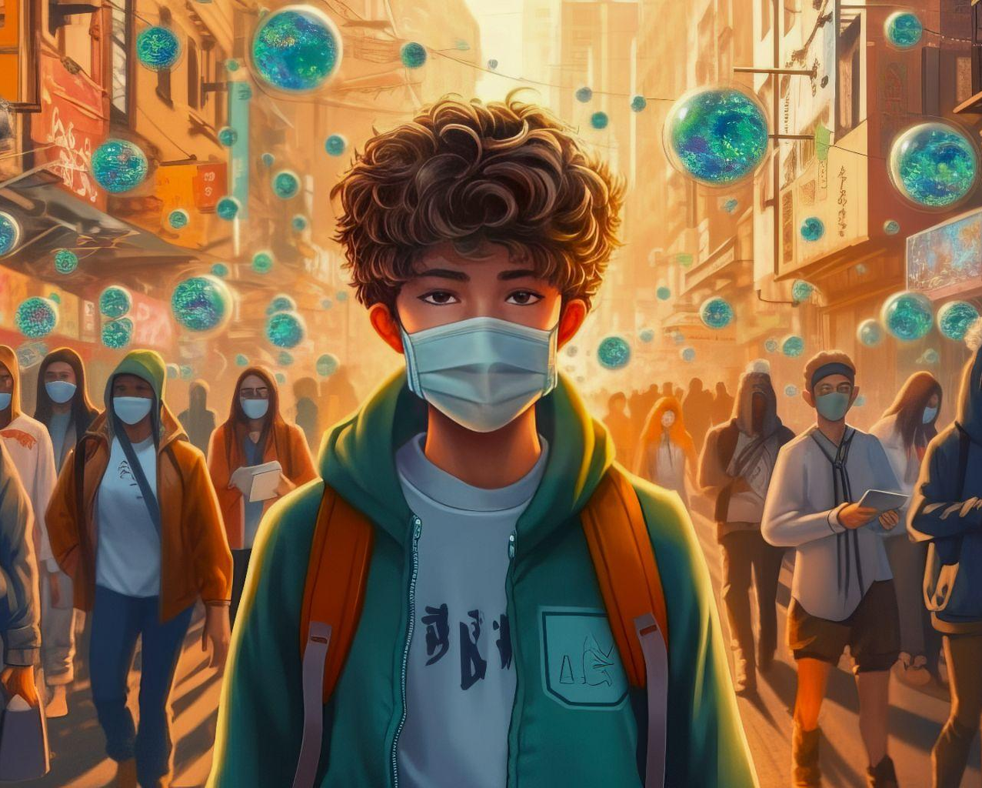
Public Health
Centers for Disease Control. Rape Prevention and Education Program. Retrieved from: https://www.cdc.gov/sexual-violence/programs/index.html
Notes:
The public health perspective views sexual assault and domestic violence through a public health lens, informed by an understanding of the broader health and safety impact of sexual assault and domestic violence. The public health approach is a systematic process that promotes healthy behaviors and environments and reduces the likelihood and/or frequency of violence. The California Department of Public Health, or CDPH, prioritizes prevention strategies that increase health equity and focus on community and population-based prevention through changing social norms, policies, and practices to create a climate free from violence. This is the primary frame RPE subgrantees work from, but it is informed and molded by other frames, particularly social justice and feminist organizing. Sexual and domestic violence prevention began as grassroots social justice and feminist organizing, outside of the realm of public health and its funding.
Centers for Disease Control. Rape Prevention and Education Program. Retrieved from: https://www.cdc.gov/sexual-violence/programs/index.html

Slide 10

The River
Notes:
There’s an old public health parable that we often use to talk about the way we should be thinking about sexual violence. This kind of thinking is often referred to as “upstream thinking.” The story goes like this:
One day, a person is fishing by the river and they see someone being swept downstream. The fisher jumps in to save the drowning person and successfully drags them to safety on the riverbank. Not minutes later, another person comes floating down the river also drowning and calling out for help. The fisher saves this person too, but before they even have a chance to sit down, here comes another person. And then 3 more people. And on and on. The fisher, exhausted and out of breath, can’t possibly go on like this so they run upstream to see why all of these people are falling in the river! When the fisher finally gets upstream, they notice that it’s a disaster zone - unsafe bridges are falling apart, some people are pushing others into the river, etc. It’s not just one issue, but many. The fisher thinks to themself that the only way to save people from drowning in the river is to address these issues to prevent people from falling in in the first place.

Slide 11

What is Prevention?
What’s the difference?
Awareness ≠ Prevention
Notes:
We are the fishers working to keep people from falling in the river.
California RPE programs focus on building skills, changing behaviors, and creating environments that are not conducive to violence occurring in the first place - and that takes a shift in thinking and a lot of creativity! It requires really concentrating your efforts on a specific group of people and those people and systems that surround them. We call this “saturating” and it requires being in trusted relationships with partners, target audience, and really being imbedded in communities, neighborhoods and/or schools. This includes activities necessary to successfully facilitate youth or adult community coalitions to identify the problems and undertake action that educates about the need for lasting change to prevent and reduce SV, collaborating with partners to educate about the need for policy change, and educating the public about existing policies through things like social norms campaigns and social marketing campaigns.
People often get mixed up between awareness and prevention activities.
Awareness brings attention to an issue. It’s like putting up a sign that warns people that the bridge is broken, but not working to repair the bridge. This includes presentations and community events or campaigns that talk about your agency, give facts, give ways to get involved or volunteer, and so on.
Prevention activities are those that change the attitudes, beliefs, and behaviors of individuals, communities, and/or society to prevent violence from happening. Like fixing the bridge or building a new one.

Slide 12
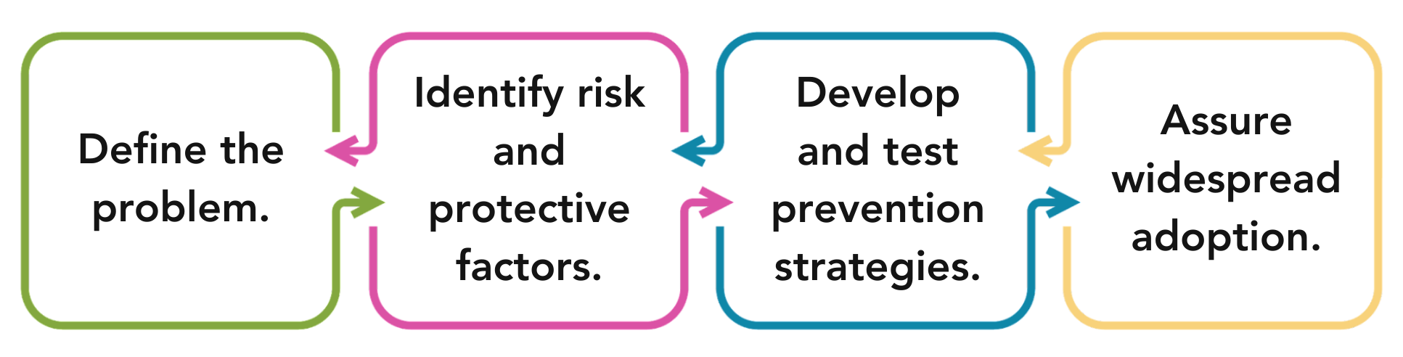
Public Health Approach
Centers for Disease Control and Prevention. About the Public Health Approach to Violence Prevention. Retrieved from: https://www.cdc.gov/violence-prevention/about/about-the-public-health-approach-to-violence-prevention.html
Notes:
The focus of public health is on the health, safety and well-being of entire populations by including strategies to make changes to benefit the largest number of people. Public health draws on multiple disciplines including medicine, epidemiology, sociology, education and others in order to address a broad range of health issues including violence prevention.
According to the CDC, the public health approach is a process that is rooted in the scientific method. It basically implements four main steps:
Define the problem - this is the “who, what, where, when”
Identify Risk and Protective Factors - It is not enough to know about a public health problem. It is important to understand what factors protect people or put them at risk for experiencing or using violence. Using data helps answer these questions to define the problem and identify risk and protective factors. We’ll talk about both of these concepts later in this eLearning series.
Develop and Test Prevention Strategies - Practitioners and Preventionists use the information from the first two steps to develop prevention strategies and activities. Once prevention strategies are implemented, they are evaluated to determine their effectiveness.
Assure widespread adoption - Effective strategies are then implemented and adopted more broadly. Communities are encouraged to implement strategies based on their own community’s needs to and then continuously assess whether the strategy is a good fit with the community context and achieving its goal of preventing violence.
Centers for Disease Control and Prevention. About the Public Health Approach to Violence Prevention. Retrieved from: https://www.cdc.gov/violence-prevention/about/about-the-public-health-approach-to-violence-prevention.html

Slide 13
Risk and Protective Factors
Social Ecological Model | Risk Factors | Protective Factors
Shows how factors influence different levels | Characteristics or conditions that increase the risk of violence | Characteristics or conditions that reduce the risk of violence
Societal – Laws, Systems, Media | Social norms that support male superiority and entitlement Weak health, economic, gender, education and social policies | Laws and policies that promote access to healthcare, education and financial security
Community – Neighborhoods, Schools, Organizations | Poverty and lack of employment opportunities General tolerance of sexual violence from the community | Community support and connectedness Coordination of increasing access to resources
Relationship – Relationships with Family, Partners, and Peers | History of family violence or unsupportive family environment Adherence to traditional gender role norms | Connection with caring, supportive adults Family dynamics and skills to resolve conflict
Individual – A Person's Attitudes and Beliefs | Aggressiveness and acceptance of violence and prejudice Hypermasculinity and lack of empathy | Empathy and concern for others Emotional health and connectedness
Centers for Disease Control and Prevention. Veto Violence Principles of Prevention Guide. Retrieved from: https://vetoviolence.cdc.gov/apps/pop/assets/pdfs/pop_notebook.pdf
Notes:
An important part of public health’s approach to violence prevention is identifying risk and protective factors and then using program activities to increase protective factors that prevent violence and reduce risk factors that contribute to violence. A risk factor is a characteristic or condition that makes it more likely that violence will occur and protective factors are characteristics or conditions that might protect people from experiencing violence. Characteristics can include individual behaviors ( actions that you can see) while conditions usually involve systems and social environments (invisible structures upheld by beliefs).
So, how do risk and protective factors apply to sexual violence? Let’s break it down.
First, there are risk and protective factors for the likelihood that someone will experience sexual violence (public health calls this victimization) and risk and protective factors for the likelihood that someone will cause sexual violence (public health calls this perpetration). In RPE, we focus on preventing someone from causing sexual violence - we’ll explain more about what we mean in a moment.
Second, risk and protective factors exist at each level of the SEM - societal risk factors, community risk factors, relationship risk factors, and individual risk factors. For example, hyper-masculine behavior is an individual risk factor for causing sexual violence whereas societal norms that support male entitlement, like the gender wage gap, is a societal risk factor. See the difference? BUT, there is a long list of risk factors, and not all of them are quite as clear as the example we just gave. One reason, is because not all risk factors cause sexual violence, as the name might lead you to believe. For example, drug and alcohol use is on the list of individual risk factors for experiencing violence, but that doesn’t mean if someone gets drunk that their behavior caused their own assault, it just means that there is a relationship between alcohol and sexual violence. It also might be interesting to know that each risk factor doesn’t have an opposing protective factor - “sobriety” isn’t included in the list of protective factors, for example. This distinction is important, because if our programs begin telling people to stay away from drugs and alcohol to avoid being assaulted, it can dilute our message and come across as blaming people for experiencing violence. Instead, our prevention programs work to eliminate societal risk factors, like oppression and harmful social norms, and increase access to protective factors, like supportive community relationships and emotional health. Protective factors help us know what behaviors to encourage and what environments to create so that we can eventually live in a world where sexual violence doesn’t happen in the first place.
When discussing risk and protective factors, we must be careful not to blame people for their own victimization or place the burden on individual behaviors. Historically, prevention has focused on individual choice and behavior as the sole contributor to health and safety at the expense of people with marginalized genders, people of color, and people with low income. But what we know that the influence of the environment, neighborhoods, and social norms within which people live dominate the behavioral choices people can make. For example, we tell people they need to eat healthy food and stay away from fast food to avoid diabetes. However, in many communities with high rates of diabetes, people often don’t have access to markets with affordable fresh foods and fast food is what is available and affordable. Similarly, poverty is a risk factor for sexual violence, but we cannot blame survivors for living in poverty. Instead, we emphasize system reforms to decrease poverty and increase access to resources for everyone.
What other examples can you think of?
Centers for Disease Control and Prevention. Veto Violence Principles of Prevention Guide. Retrieved from: https://vetoviolence.cdc.gov/apps/pop/assets/pdfs/pop_notebook.pdf

Slide 14
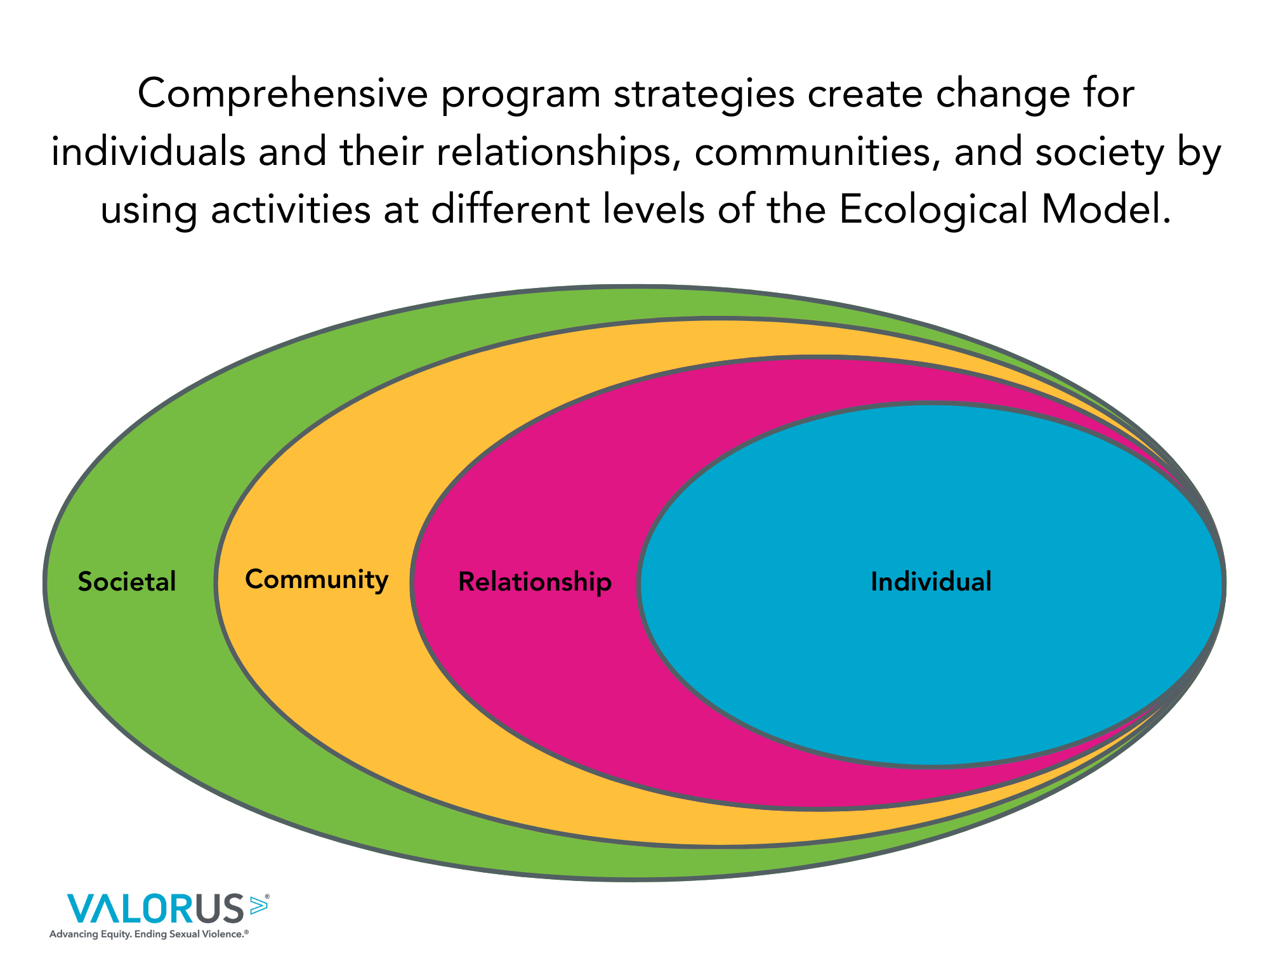
Social Ecological Model
Comprehensive program strategies create change for individuals and their relationships, communities, and society by using activities at different levels of the Social Ecological Model.
Centers for Disease Control and Prevention. Veto Violence Principles of Prevention Guide. Retrieved from: https://vetoviolence.cdc.gov/apps/pop/assets/pdfs/pop_notebook.pdf
Notes:
As we mentioned in the previous slide, CDPH RPE programs are comprehensive primary prevention programs. Remember the social ecological model from unit 1 which encourages us to think about interrupting violence at various levels, or spheres, of influence including societal, community, relationship, and individual levels? The influences in life that cause sexual violence are spread throughout different contexts, therefore, preventing sexual violence requires complex and comprehensive strategies. The RPE program requirements make our programs comprehensive by including program activities that address the different levels of the SEM. We’ll look at an example in a moment, but first let’s talk about what we mean by “spheres of influence.” People don’t exist in bubbles. We are surrounded, influenced by, and learn from the people, systems, and social norms in each of the spheres in the social ecological model. In this model, the societal level represents social and cultural norms, policies, laws, and institutions that influence the whole population. The community level includes the businesses, organizations, schools, and neighborhoods in which individuals live, work, and play. Moving closer to the center, the relationship level refers to people’s close relationships such as family members, chosen family, friends and other peers, co-workers, coaches, and teachers. And finally, residing in that innermost sphere is the individual and their knowledge, behavior, skills, and beliefs. When we are developing, implementing, adapting, and evaluating our program it is the people within this sphere that we are keeping in mind. This is our target audience. They are the people we are attempting to prioritize in our programs because they are at disproportionate risk of the condition we are working to prevent. In this case, experiencing sexual violence. When our programs are making a change to a policy for instance, we want to think about how that policy will change those people and/or the conditions in which they work, live, or play.
Centers for Disease Control and Prevention. Veto Violence Principles of Prevention Guide. Retrieved from: https://vetoviolence.cdc.gov/apps/pop/assets/pdfs/pop_notebook.pdf

Slide 15
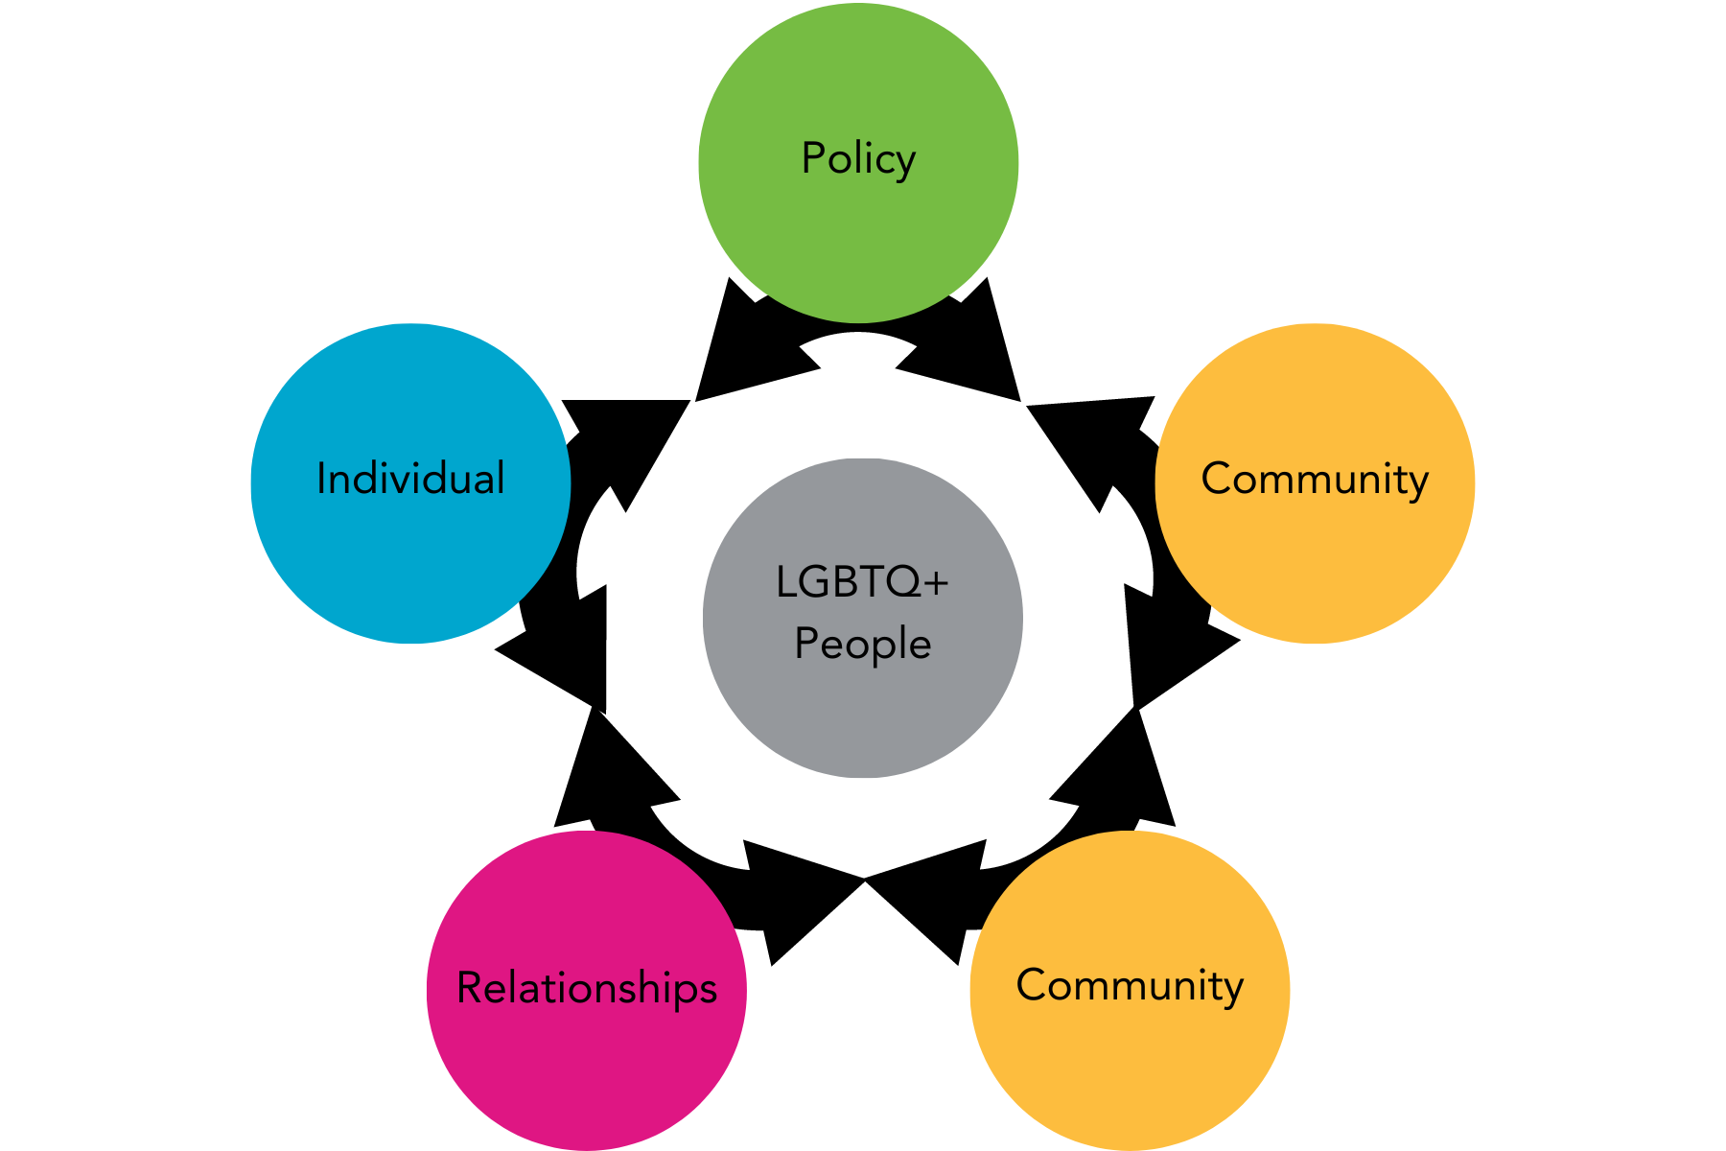
Example: LGBTQ+ Community
Policy: No legal marriage status, inequity in laws.
Community: Businesses refuse services to LGBTQ+ people.
Community: Protests against equal rights.
Relationships: Parents/caregivers break ties with LGBTQ+ youth.
Individual: Unhoused LGBTQ+ youth experience higher rates of violence.
Notes:
Here is a way to think about how certain groups of people are impacted by the spheres of the social ecological model using LGBTQ+ folks as an example. In this example, we also look at how the outer layers of the SEM impact the experience of individuals by influencing the attitudes and beliefs of a society or community. During this example, imagine groups of people with other identities that you may work with or be familiar with and apply the social ecological model to identify the issues that impact them.
Here we go.
Let’s harken back to the time before marriage equality existed in the United States. Before 2015, two people of the same legal gender were not permitted to marry under the law. This, of course, is an issue that existed at the societal level of the SEM because it was a law and influenced the spheres below it. At the community level, we saw businesses refusing service to LGBTQ+ people and community-based protests against LGBTQ+ human rights. At the relationship level of the SEM, we see families - who are made up of the individuals in the community - fall apart because they are unwilling to accept their LGBTQ+ children and family members which often causes LGBTQ+ youth to end up unhoused. Lastly, at the individual level, we see increased rates of homelessness for LGBTQ+ youth, higher rates of sexual violence and abuse, and many other negative health outcomes for the individual. In this case, the law reinforced individual’s treatment of and ability to marginalize and oppress LGBTQ+ people. We see how all of these issues at each level of the SEM work together to influence the health outcomes for our target audience.
While marriage equality became legal in 2015, there still are high rates of sexual violence and negative health outcomes for LGBTQ+ people (especially youth). That’s because changing only one law or policy doesn’t erase all of the other issues happening at other layers of the SEM. So we must continue seek out comprehensive strategies that improve the conditions for communities and promote equity and nonviolence.

Slide 16
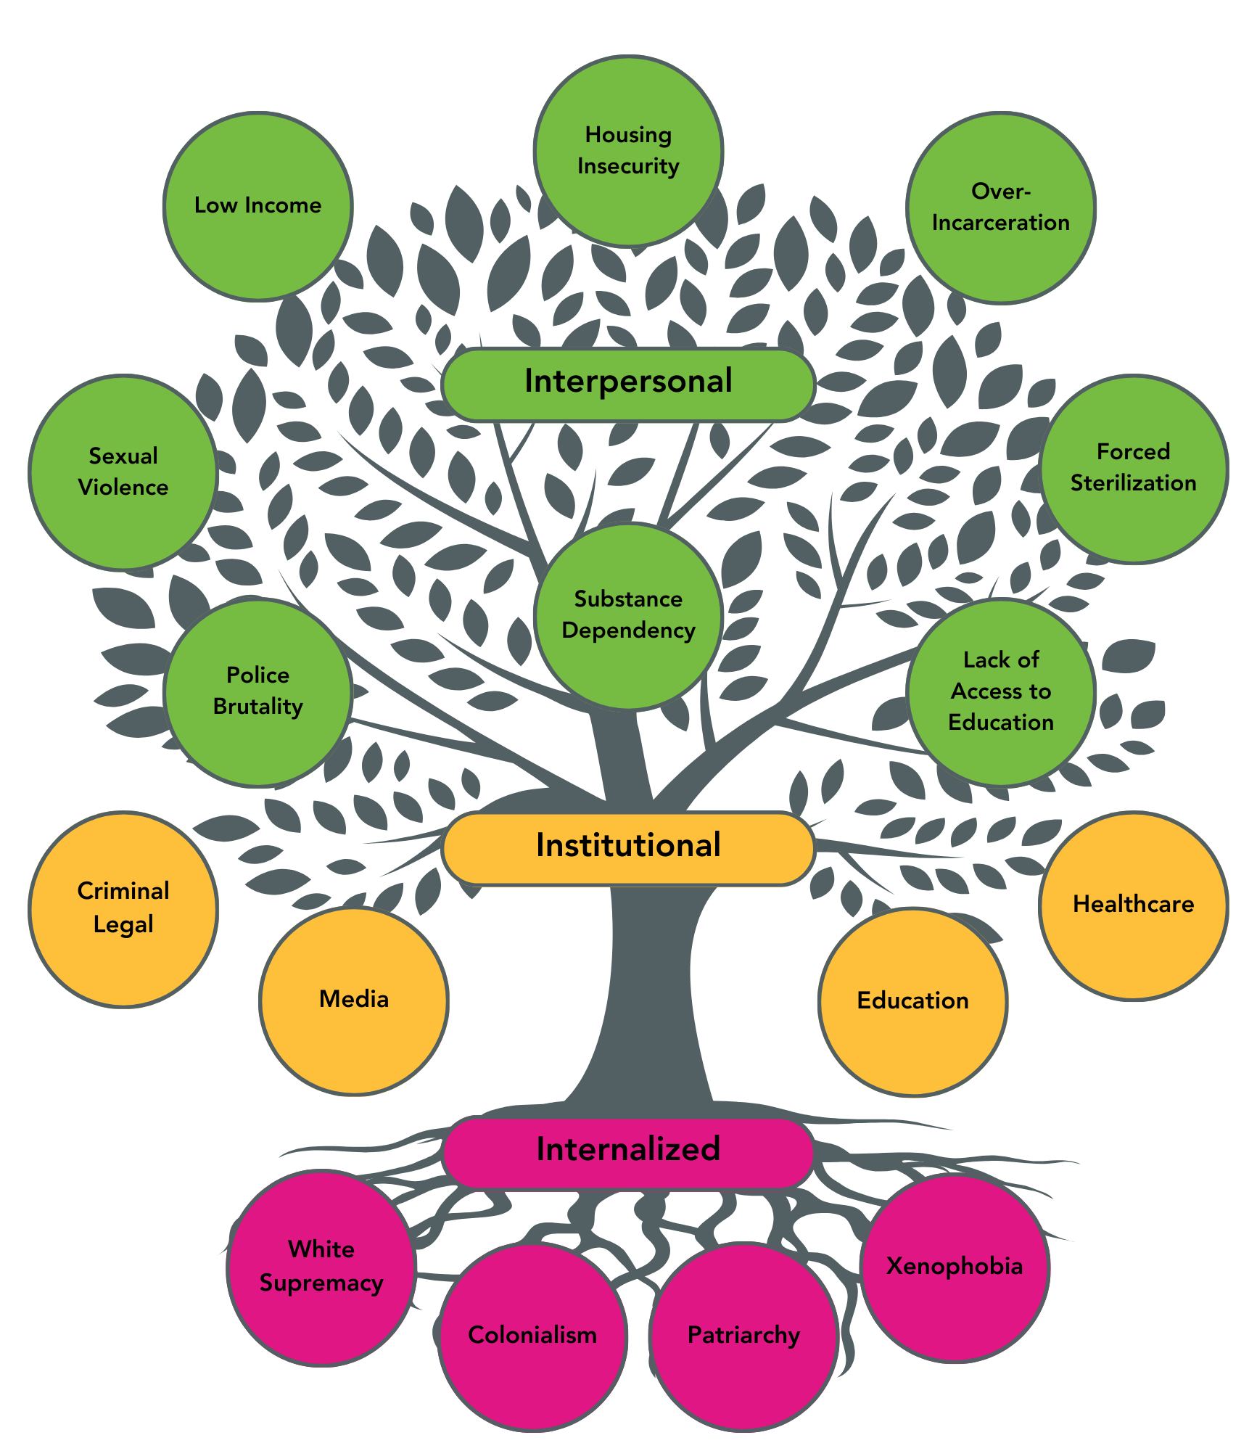
Systems at Work
Interpersonal
Low income
Housing Insecurity
Over-Incarceration
Forced Sterilization
Lack of Access
to Education
Substance Dependency
Police Brutality
Sexual Violence
Institutional
Criminal Legal
Media
Education
Healthcare
Internalized
White Supremacy
Colonialism
Patriarchy
Xenophobia
Notes:
In public health, we think of social problems, like interpersonal violence, as a symptom of underlying causes that normalize a culture which is conducive to violence occurring in the first place. We can think of these symptoms as being at the leaves of this tree. If we keep cutting off branches they will eventually grow back so we have to address the issues at the root of the tree. This is why a primary prevention framework places a strong emphasis on community building and social norms change to address behaviors rooted in sexism, racism, heterosexism and many other attitudes that contribute to violence.
Let’s think about it like this: Institutions are built out of dominant systems and historical context that are often forms of oppression. Invisible systems like white supremacy, patriarchy and colonialism help create the institutions that shape our social behaviors and interpersonal experiences - it is impossible to separate them from each other. Each internalized system, depicted at the tree’s roots, played a big role in producing the systems we work in like education or the criminal legal system, as well as the systems that shape our behaviors and perceptions like the media. All of us grow up in and are impacted by the institutions at the tree’s trunk and that affects how we typically respond to and experience violence. Violence is not distributed equally, nor is it random who is most often impacted. RPE and prevention has an important role to play in dismantling internalized oppression, reforming institutions, and challenging oppressive social behaviors.

Slide 17
Shared Risk and Protect Factors
At the Community Level, Community Support and Connectedness is a Shared Protective Factor that can work to reduce six different forms of violence:
Sexual Violence
Suicide
Youth Violence
Child Abuse and Neglect
Elder Abuse and Neglect
Intimate Partner Violence
Sexual Violence
Suicide
Community Support and Connectedness
Intimate Partner Violence
Youth Violence
Elder Abuse and Neglect
Child Abuse and Neglect
Centers for Disease Control and Prevention. VetoViolence: Connecting the Dots. Retrieved from: https://vetoviolence.cdc.gov/apps/connecting-the-dots/
Notes:
Many of these risk and protective factors also influence health, safety, and other forms of violence and these are called shared risk and protective factors. That means that by identifying and addressing certain risk and protective factors, we can actually improve other areas of health and safety while preventing sexual violence. A clear understanding of these connections can help you plan strategies to prevent many forms of violence at once to increase your program’s impact. For example, access to a supportive and connected community is a protective factor for six types of violence. In our work as preventionists, we may identify ways to increase community support and connection by transforming gender norms such as changing the way families view and assign household duties to create truly protective and inclusive environments.
Centers for Disease Control and Prevention. VetoViolence: Connecting the Dots. Retrieved from: https://vetoviolence.cdc.gov/apps/connecting-the-dots/

Slide 18
Outcomes - Transforming Gender Norms
Short-Term:
Increase in partner and community awareness of SV as a preventable problem for the community
Increase in organizational partnerships and engagement with underserved populations in community collaborations
Medium-Term:
Regular collective actions, mobilization to:
Address patriarchy and intersecting
forms of oppression
Promote and model equitable gender
norms
Long-Term:
Reduction in perpetration and victimization of sexual violence, health inequities, and
discrimination in priority populations to achieve health, racial, and gender equity.
Notes:
What are outcomes? Outcomes identify what we expect to change and for whom as a result of implementing our program strategies. Outcomes may be identified at different levels of the SEM and may be identified as short, medium, or long range outcomes. On the slide, you can see examples of short, medium, and long term outcomes for the RPE Transforming Gender Norms strategy. Notice how they explain the change and not the activity? Also, notice how each of the outcomes build upon one another? For example, increased ability to recognize sexual violence as preventable leads into actions to prevent sexual violence leading to an eventual reduction in sexual violence perpetration.
Be careful not to get your outcomes mixed up with your program activities. Your program activities are the activities you do, like education, social media campaigns, and voluntary policy change, that lead you to achieving the outcomes. For example, mapping safe and unsafe areas in a neighborhood is not an outcome. This is an evaluation activity. The outcome for a mapping activity may be that three areas of the neighborhood have street lights added after being deemed unsafe.

Slide 19

Approaches and Strategies Defined
Notes:
First, let’s get a shared definition of what we mean when we say “approach” and “strategy.” They may sound generally the same but are quite different. An “approach” is a way of doing something or how we do something. A strategy is a clear set of program activities or plan of action to achieve a specified goal. For example, we may use a collaborative approach to conflict resolution by engaging all involved parties. Then, through this collaborative approach, we use a three-step strategy that includes defining the problem, sharing solutions, and deciding on a resolution.

Slide 20
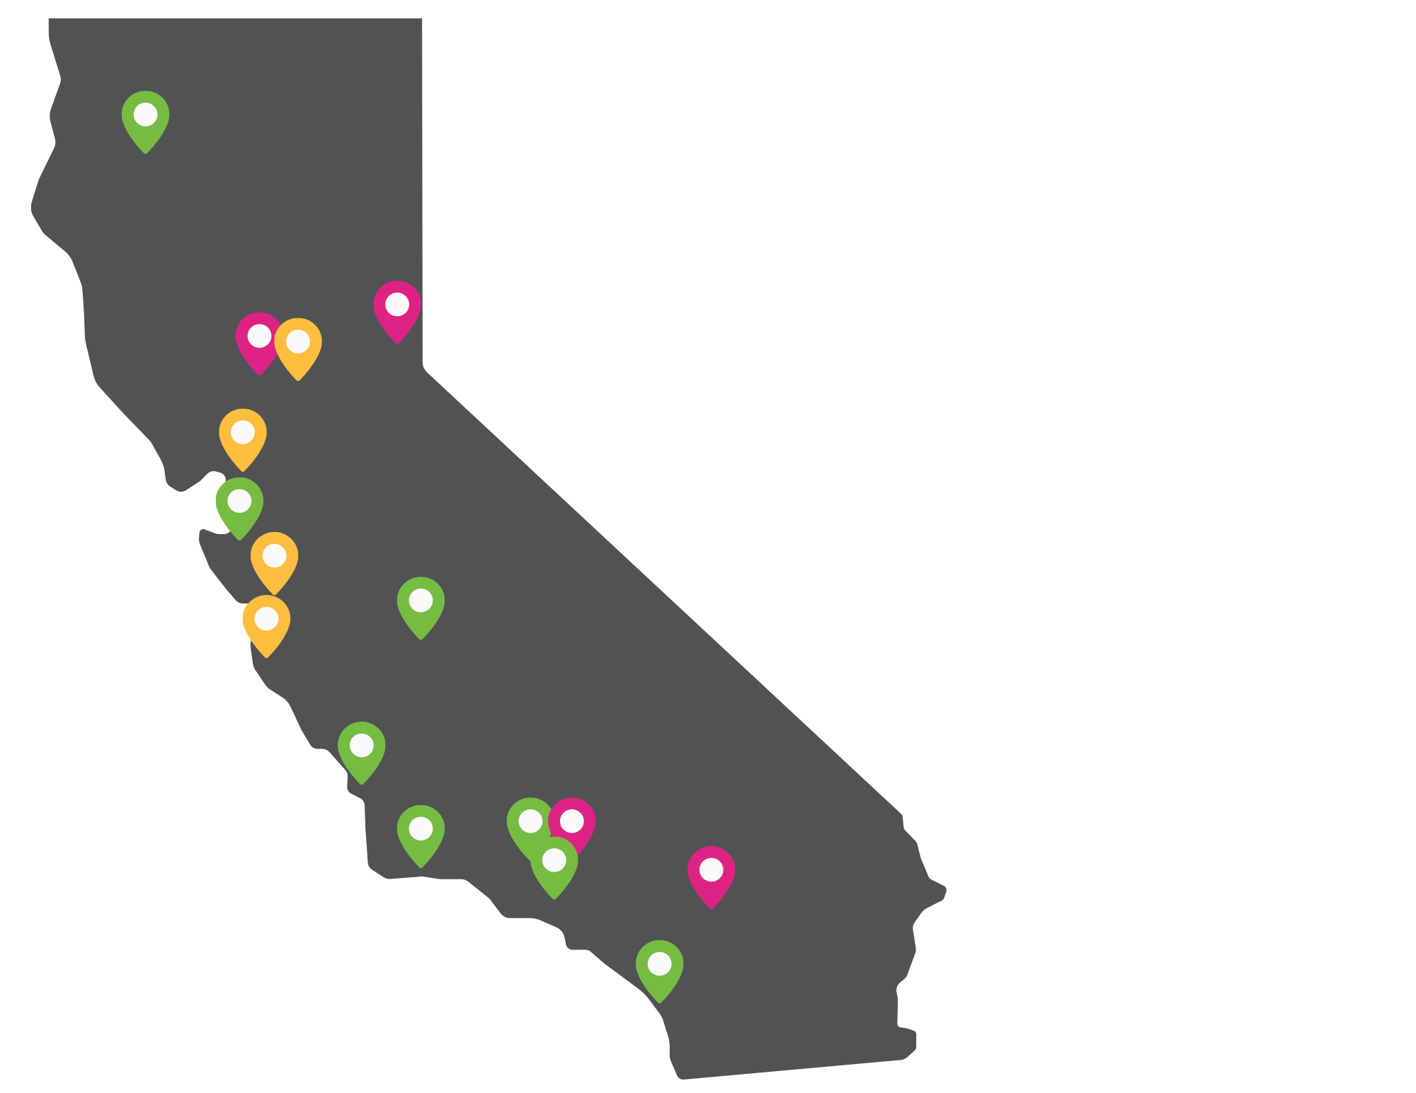
California Department of Public Health (CDPH)
RPE Programs Across California
Approaches:
Community Mobilization
Coalition-Building
Promotores
Notes:
CDPH prioritizes community engagement in sexual violence prevention. Community engagement means that community members, individuals, and groups work together to address issues, solve problems, and make decisions about the issues that affect them. Community engagement requires participation from community members, shared leadership and decision-making, clear communication, and trusted relationships. The approaches identified by CDPH for the Rape Prevention Education (RPE) program are community engagement approaches. These approaches include Community Mobilization, Coalition-Building, and Promotores—we will define these later in this unit. You can see on this map where RPE programs are located in the state and what community engagement approach they’re using.

Slide 21
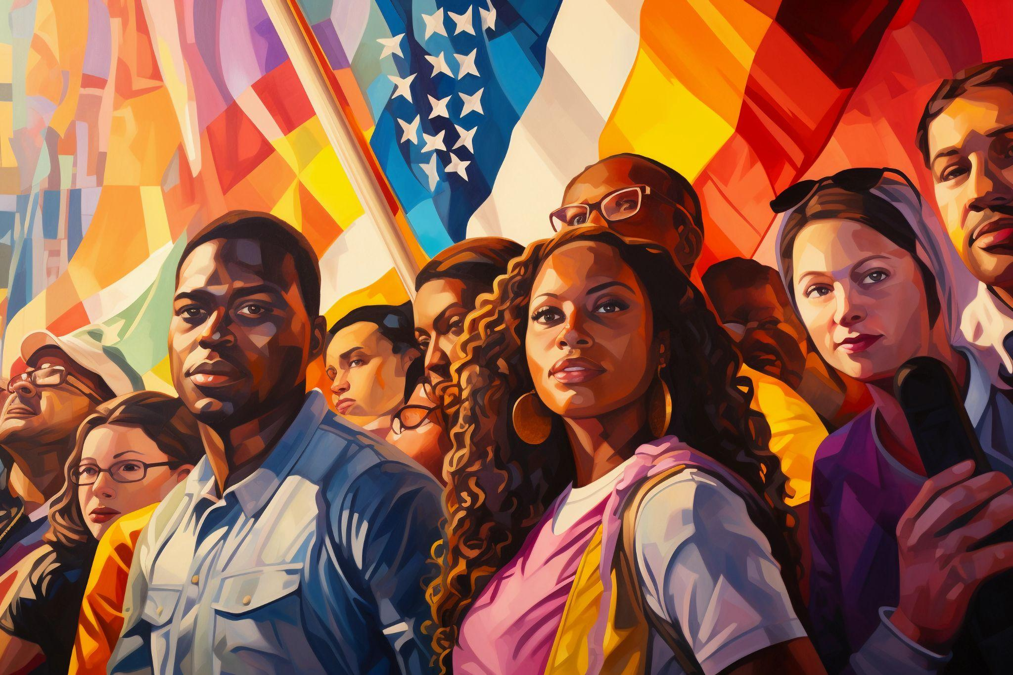
Approaches
Community Engaged Leadership to Advance Health Equity and Build Healthier Communities, National Library of Medicine; 2016.
Notes:
As we discussed earlier, using a community engagement approach means the community is involved in planning and implementing solutions. The benefit of this may seem obvious, but many programs do not involve the community in this way. CDPH and the RPE program acknowledges and honors the knowledge, experience, and history of community residents and trusts their ability to create long-term solutions to their problems. This increases ownership over the problem and solutions. The organization provides support and resources that empower the community to develop and implement the solutions. Community engagement approaches have successfully changed policies and laws, shifted social norms, and created better neighborhoods and environments for all people. One of the most visible forms of community engagement to use as an example would be the civil rights protests that led to changes in laws for people of color or the activism of people with disabilities that led to the American Disabilities Act that led to changes in the physical environment such as ramps and elevators to increase accessibility for people with disabilities among other changes.
Let’s look at the community engagement approaches that the RPE program uses, starting with Coalition Building.
Community Engaged Leadership to Advance Health Equity and Build Healthier Communities, National Library of Medicine; 2016.

Slide 22

Approaches: Coalition-
Building
Prevention Institute & National Sexual Violence Resource Center (2021). A Health Equity Approach to Preventing Sexual Violence.
Notes:
A coalition is an alliance or partnership between different groups, individuals, and organizations. The key to a coalition isn’t just that these different groups come together but that they come together to achieve a common goal or set of goals. It happens most frequently when individuals or organizations share similar goals, values, or interests. Coalitions are often more effective than one organization or individual working on their own because community issues are complex and require comprehensive solutions that one person or organization often cannot accomplish alone.
Addressing health promotion and chronic disease prevention requires including people from diverse backgrounds with diverse experience, skills, and resources.
Prevention Institute & National Sexual Violence Resource Center (2021). A Health Equity Approach to Preventing Sexual Violence.

Slide 23

Approaches: Community Mobilization
Notes:
CDPH defines community mobilization as “a participatory decision-making, community-driven process through which members of a community plan, implement, and evaluate specific actions designed to improve the health and well-being of the community.” In other words, it supports community members in planning and making changes in their own communities. People often go to their social support network like their friends, family, faith community, and/or workplace, when they need help or support. Community mobilization uses this informal structure to create positive change and bring awareness to and prevent violence in communities. Community mobilization programs in the RPE program are informed by the Close to Home Model, which provides support for community members, including youth and adults, to prevent sexual violence through a four-phase process.

Slide 24

Approaches: Promotores
National Institute of Health. Role of Community Health Workers. Retrieved from: https://www.nhlbi.nih.gov/health/educational/healthdisp/role-of-community-health-workers.htm
Notes:
The Promotores model is the final approach used by RPE programs to prevent sexual violence in communities. Though the Promotores model has been used in many places worldwide and throughout history, it is primarily based on a Latin American model that uses peer education and support to reach underserved populations through peer education to increase health and wellness. Promotores are trained health workers who often come from the same community or cultural background as those they are serving. They are often trusted to understand community challenges and to give accurate information because they usually reflect the neighborhood and share the same language, and/or similar life experiences as the people they are working with to provide health education, health services, and/or support individuals or groups in navigating social or health services. You may also hear Promotores called Community Health Workers, Outreach Workers, Lay Workers, or Community Workers.
National Institute of Health. Role of Community Health Workers. Retrieved from: https://www.nhlbi.nih.gov/health/educational/healthdisp/role-of-community-health-workers.htm

Slide 25
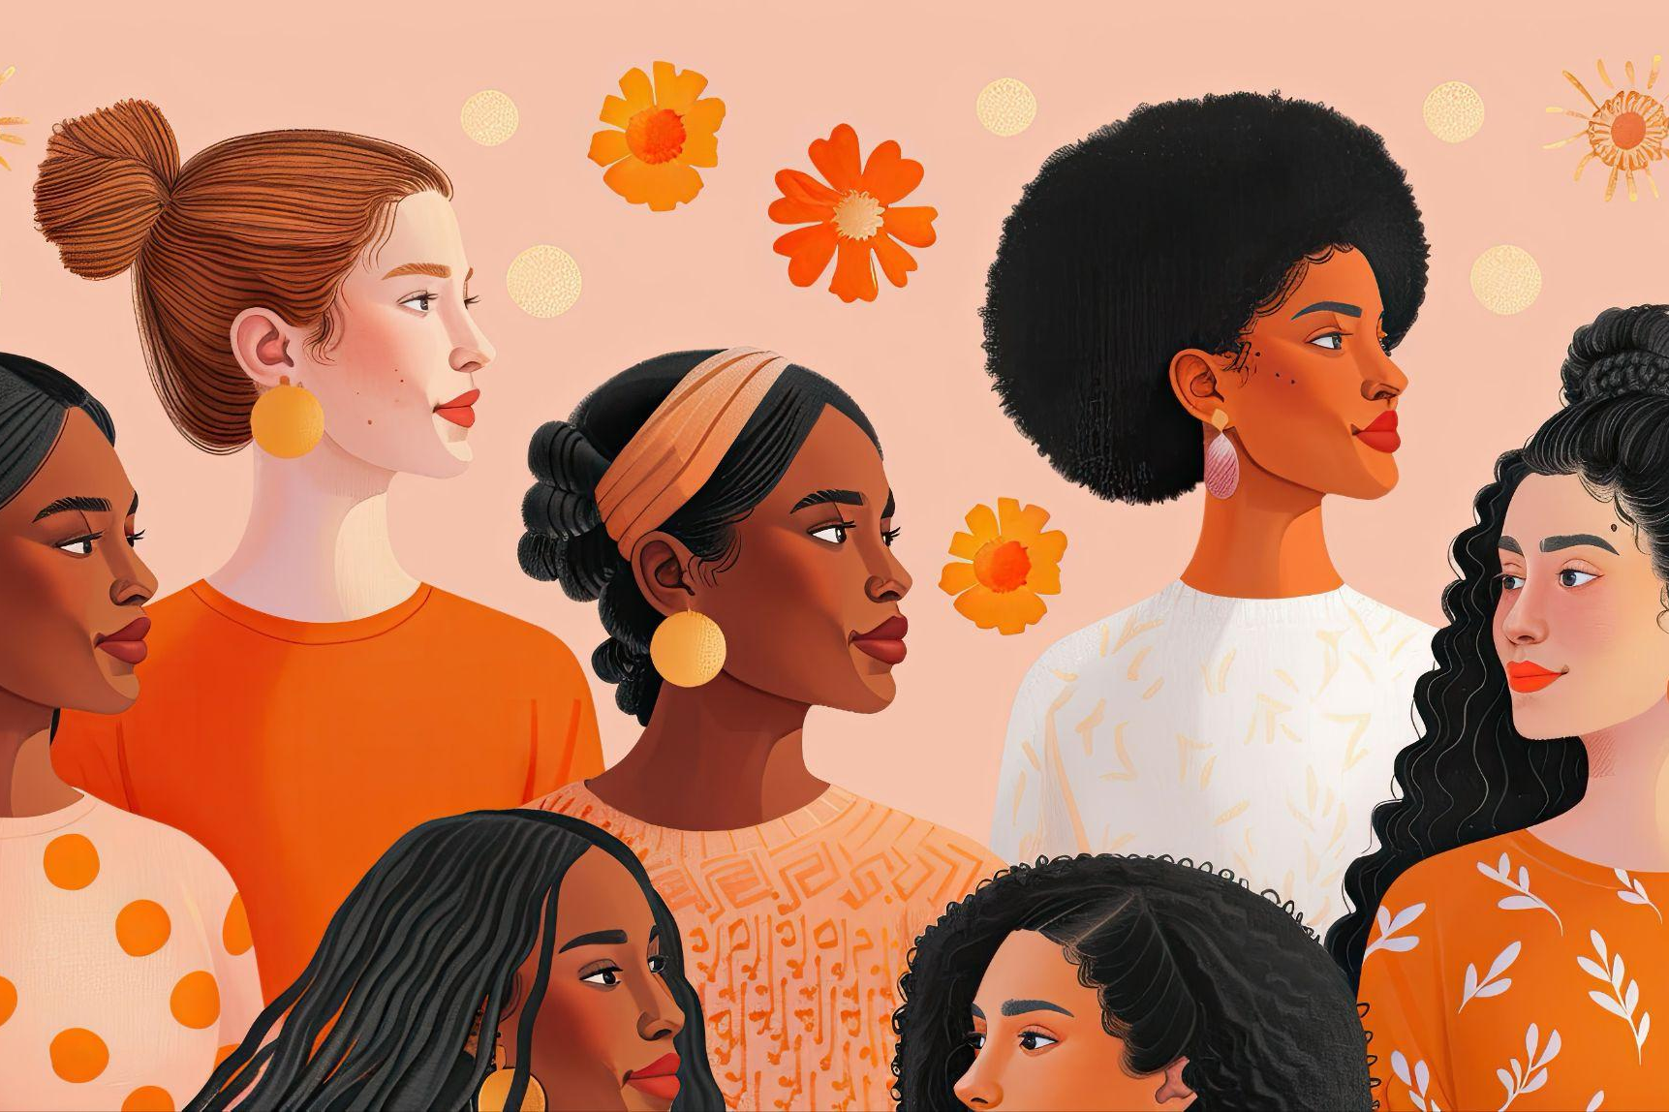
Approaches: Promotores
National Institute of Health. Role of Community Health Workers. Retrieved from: https://www.nhlbi.nih.gov/health/educational/healthdisp/role-of-community-health-workers.htm
Notes:
Promotores often play the roles of support person, educator, mentor, outreach worker, role model, translator, and more. The Promotores model removes barriers, provides culturally and linguistically responsive services, and builds community capacity by empowering residents and families with accurate information about their health and wellness, their rights, and how to access services.
National Institute of Health. Role of Community Health Workers. Retrieved from: https://www.nhlbi.nih.gov/health/educational/healthdisp/role-of-community-health-workers.htm

Slide 26

Community/Societal-Level Prevention Strategies:
Transforming Gender-Norms
Economic Security/
Mobility for Women, Gender-Expansive
People, and Families
Improving Community Environment
Notes:
Using one of these community engagement approaches means the community is involved in planning and implementing solutions. The RPE programs use one of these community engagement approaches to implement a strategy for sexual violence prevention. This means the community is involved in planning and implementing the program activities. These program activities are based on one or more of the following sexual violence prevention strategies. They include Transforming Gender Norms, Economic Security/Mobility for Women, Gender-Expansive People and Families, and Improving Community Environments. The CDC and experts specializing in violence prevention recognize these strategies as effective in building protective factors and reducing risks linked to sexual violence and other related issues. Additionally, they are supported by evidence from previous successful programs and the real-world experiences of community members.
We will discuss these strategies in more detail, but one important point to note is that they affect change at the community and societal levels.

Slide 27
Economic Security/Mobility for Women, Gender-
Expansive People, and Families
Financial struggles and poverty cause stress and can lead to conflict and violence in relationships.
Being financially dependent can make people feel stuck, especially in abusive relationships.
Poverty limits access to education, healthcare, and other resources that help people deal with difficulties in healthier ways.
Economic hardship can disrupt social norms and decrease trust among neighbors.
Notes:
The first strategy is Economic Security and Mobility for Women, Gender-Expansive People, and Families. First, let’s go over a quick description. “Gender-expansive,” in this context, is defined as people who identify as Transgender or non-binary. Economic instability can increase violence in several ways, including:
Financial struggles and poverty cause stress and can lead to conflict and violence in relationships.
Being financially dependent can make people feel stuck, especially in abusive relationships.
Poverty limits access to education, healthcare, and other resources that help people deal with difficulties in healthier ways.
Economic hardship can disrupt social norms and decrease trust among neighbors.
Building economic stability and mobility requires access to full and equal workforce participation for all genders, equal pay for equal work, leadership development and income-generating opportunities, and affordable quality child care or paid family and medical leave.

Slide 28

Economic Security/
Mobility for Women, Gender-Expansive People, and Families
Notes:
RPE programs work in their local communities to educate decision-makers, employers, organizations, and communities on policies and programs promoting economic justice. Some examples of areas for action include supporting the implementation of policies like paid family leave for caregivers to make sure people know about them and are able to access them. This allows people paid time off to care for their dependents and protects them from losing their jobs. We often think of this as pregnancy leave or baby bonding time, but it also covers when a direct family member, such as a parent or spouse, is ill or injured.
Other strategies include improving organizational or workplace policies to include economic opportunity and wealth development through paid leave, retirement accounts with matching funds, mentoring and professional development, and health benefits for employees and their dependents, including dental, vision, and mental health.
Finally, access to education, leadership development, and mentoring programs increases economic opportunity for women and gender-expansive people. It also increases the number of women and gender-expansive people in leadership and decision-making positions, including elected officials.

Slide 29
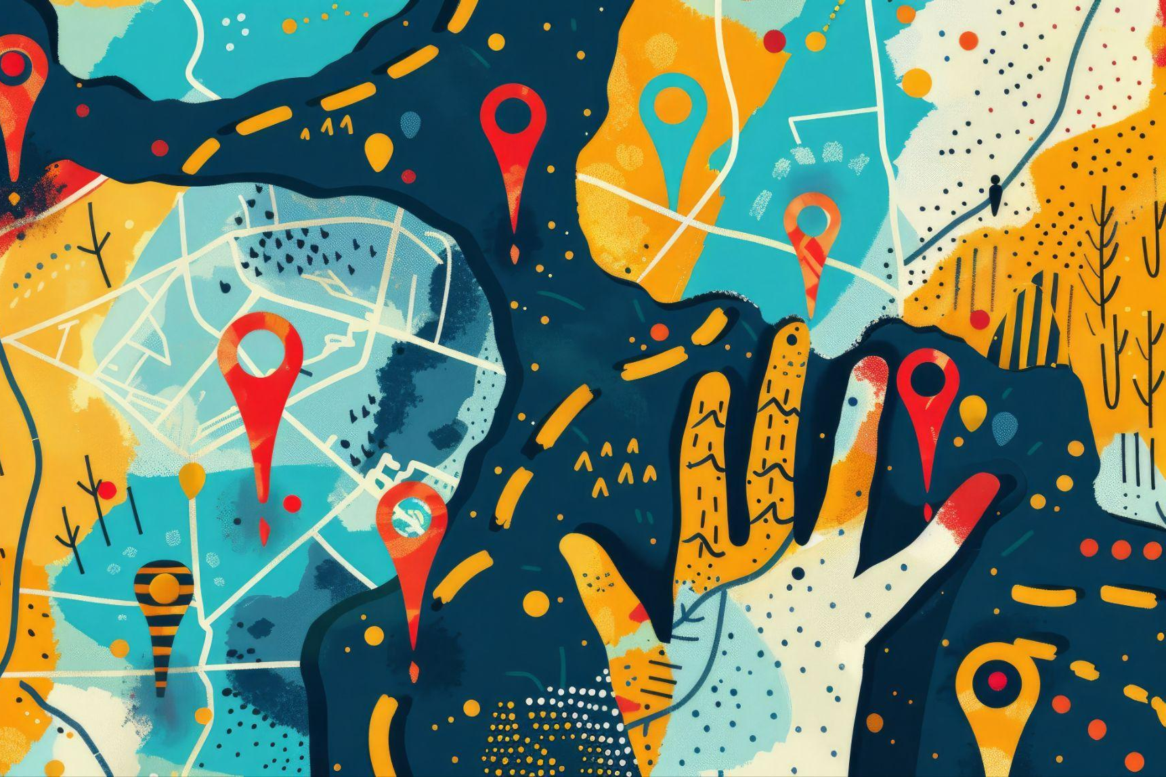
Improving Community Environment
Schlossberg, Jocelyn (2021). UCLA Health: How the curb-cut effect boosts health for everyone. Retrieved from: https://www.uclahealth.org/news/article/how-the-curb-cut-effect-boosts-equity-for-everyone
Notes:
Improving the community environment means we focus on changing the whole community, including policies, social norms, and even the physical environment, in ways that make violence less likely. This can involve things like creating safe spaces for young people, improving access to services for those who have experienced trauma, and reducing the number of alcohol outlets in a neighborhood. These changes can make violence less likely by creating a safer environment and reducing risk factors for violence.
When we look at improving community environments, it’s important to center people at the margins. One hallmark concept that aligns with “margins to center” is the practice of Universal Design. Universal Design refers to when spaces, policies, and practices are intentionally designed to be accessible to those with the least access. Applying universal design in the violence prevention movement means actively considering who has the least access to prevention and intervention services and then deliberately designing policies and practices that center the people with the least access. When we center and invest in people on the margins, we improve conditions not only for them, which is worthy on its own, but it also generally improves social conditions for everyone.
Schlossberg, Jocelyn (2021). UCLA Health: How the curb-cut effect boosts health for everyone. Retrieved from: https://www.uclahealth.org/news/article/how-the-curb-cut-effect-boosts-equity-for-everyone

Slide 30
Improving Community Environment
Healthy Acadia (2023). Restorative Justice as a Tool for Reducing Violence. Retrieved from: https://healthyacadia.org/blog/restorative-justice-as-a-tool-for-reducing-violence#:~:text=Restorative%20justice%20practices%20can%20reduce,of%20community%20safety%20and%20connectedness
Notes:
There are many ways to work with communities to change policies, programs, and the built environment to reduce violence by improving the community environment, but we’ll just give you a sampling. Strategies for change include:
The adoption and implementation of clear voluntary and legislative anti-violence policies, including sexual harassment at schools and workplaces, and creating and implementing clear policies that hold people accountable for relationships, sexual violence, and bullying at schools.
Restorative justice practices can reduce violence by identifying and addressing the underlying causes of harmful behaviors and preventing future harm through rehabilitation and restoration.
Create parks, gardens, and green areas to foster community connection and safety.
Reducing the density of alcohol outlets also lowers the risk of violence, including sexual violence, in neighborhoods.
Healthy Acadia (2023). Restorative Justice as a Tool for Reducing Violence. Retrieved from: https://healthyacadia.org/blog/restorative-justice-as-a-tool-for-reducing-violence#:~:text=Restorative%20justice%20practices%20can%20reduce,of%20community%20safety%20and%20connectedness

Slide 31
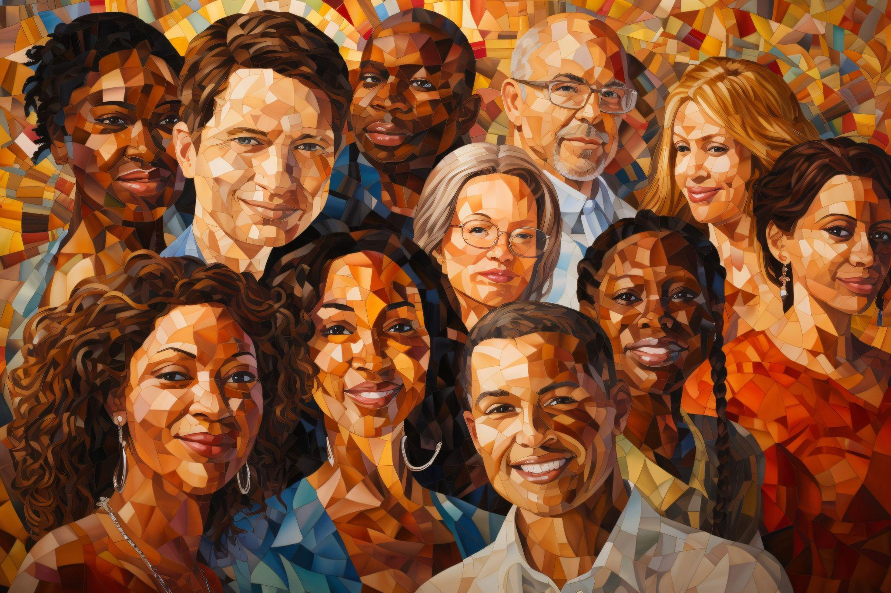
Transforming Gender Norms
Notes:
Gender norms are social expectations about how men and women, as well as boys and girls, should behave and see gender as a binary rather than on a spectrum. Families, schools, media, and other social institutions create and reinforce these norms. They can be unfair and limit people's choices, and they also completely leave out nonbinary, transgender, and other gender-expansive people. But beyond being unfair and limiting, belief in rigid, unhealthy, and/or oppressive gender norms is also a significant risk factor for causing harm and violence.
Some of the ways we may see gender norms playing out as a risk factor are when men and boys believe that they are dominant and should act aggressively or violently when they are angry or need to control a person or situation. We may also see policies like school dress codes that are more restrictive for girls or gender-expansive youth, which may lead to discipline or suspensions at school. They also lead to the absence of and targeting of LGBTQ+ people by not including their stories in health education and history, opening the opportunity for misinformation and scare tactics.
The good news is that gender norms are constantly changing, which means we can influence a change to positive and healthy gender norms that protect against violence.

Slide 32

Transforming Gender Norms
Notes:
Creating community change in this area requires educating the community and decision-makers about the long-term effects of unhealthy gender norms and working with them to change policies, practices, and social norms. Some of these strategies include creating more inclusive school environments through things like inclusive training, training for staff on LGBTQ+ issues, and policies that protect students from bullying and harassment and hold those who cause harm accountable for their behavior.
Sports and athletics are often an area where we see a lot of toxic masculinity at all ages. It can also be a great opportunity to build relationships and community-level changes through things like league policies and trainings for coaches, players, and families. Coaching Boys into Men is one example of a comprehensive program that addresses harmful gender norms, discusses bystander intervention strategies, and strengthens connections to trusted adults.
Some faith communities are also leading change by speaking out against harmful gender norms and changing harmful and discriminatory practices through things like lifting bans on female or LGBTQ+ faith leaders, performing same-sex marriages, and promoting respect and equality among intimate partners.

Slide 33

Combining Approach and Strategy
Notes:
We’ve gone over the community engagement approaches and the strategies that communities use in RPE but you may wonder why it’s important to have both. Combining the right approach and strategy is crucial for positive change because it allows us to address the root causes of violence rather than just treating the symptoms. And it also creates a more sustainable solution. The right approach with a well-thought-out strategy makes the change more likely to benefit the whole community and more likely to stick over time.

Slide 34
What is at least one topic you want to learn more about?

Slide 35
Thank you!
Please fill out the training evaluation

