Slide 1
Notes:
Welcome, everyone and thank you for joining us for today’s training, “Mental Wellness for Survivors in Detention.”
This is a deeply important topic, as clients in detention are often survivors of trauma who face unique mental health challenges. Our goal for today is to provide insights into these challenges and offer strategies to promote mental wellness in detention settings.
As folk are getting settled in, feel free to introduce yourself in the chat. Let us know your name, pronouns, what agency you’re from and your role there!

Slide 2
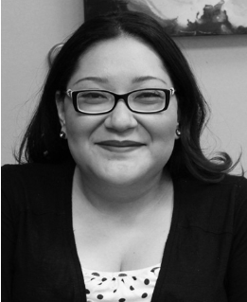
Presenters
Jennica Sinor
She/her/hers
Project Manager
ValorUS
Vanessa Sapien
She/her/hers
Mental Health Program Director
Just Detention International
Leyla Dost
They/them/theirs
Program Officer
Just Detention International
Notes:
Introductions -

Slide 3
Mission:
Preventing and ending sexual violence by advancing equity and erdicating opression.
Notes:
ValorUS is a California-based, national organization and California’s sexual assault coalition committed to advancing equity and ending sexual violence. Our goal is to build dynamic relationships across a diverse range of communities, institutions, and systems, and mobilize our networks of survivors and advocates to influence change. Through leadership, prevention, and advocacy, we are fearlessly pursuing a world free violence where dignity of every person is valued and respected.

Slide 4
JDI’s Work
JDI is a health and human rights organization that seeks to end sexual violence in all forms of detention.​
JDI's Core Goals:​
To hold government officials accountable​
To change public attitudes about sexual violence behind bars​
To ensure survivors get the help they need ​
Notes:
Just Detention International, or JDI for short, is a health and human rights organization that seeks to end sexual abuse in all forms of detention. ​
JDI carries out its mission by: ​
working with corrections officials, rape crisis advocates, and policymakers to make detention facilities safe ​
promoting public attitudes that value the dignity and safety of people in detention ​
and supporting incarcerated survivors of sexual abuse and sexual harassment.

Slide 5
JDI’s Core Principle
Notes:
The fundamental principle behind JDI’s work is that when the government takes away someone’s freedom, it takes on an absolute responsibility to protect that person’s safety. No matter what crime someone may have committed, rape is not part of the penalty.​

Slide 6
Objectives
Develop a basic awareness around the experiences of incarcerated survivors with mental illness
Highlight voices from the field to establish a comprehensive understanding of mental wellness
Explore actionable strategies to provide effective, trauma-informed support for survivors in detention through a mental wellness lens
Notes:
Our objectives for this training are to:
Develop a basic awareness around the experiences of incarcerated survivors with mental illness
Highlight voices from the field to establish a comprehensive understanding of mental wellness
Explore actionable strategies to provide effective, trauma-informed support for survivors in detention through a mental wellness lens.

Slide 7
Language
Preferred Terms:
Incarcerated Person
Resident
Survivor
Avoid words like “insane” or “crazy”
Image: Art created by a participant of JDI's therapeutic art programs in detention
Notes:
One important tool at our disposal for creating meaningful, cultural change that promotes the wellness of incarcerated survivors is our language. If you’ve joined us for any of our trainings before, you know that we use alternatives to terms like, “incarcerated person” rather than inmate or “resident,” when referring to someone in a detention facility. This is to center the humanity of people experiencing incarceration. We also use the word, “survivor,” instead of “victim,” to honor the resilience and strength of those who have experienced sexual abuse.
We use people-first language that tries to acknowledge a whole person with a range of experiences. Throughout this presentation we will mostly use terms like “mental illness” or “mental health disorder/diagnosis” while, acknowledging a diversity of terms including self-identification outside of medical diagnoses. We will examine this in greater detail shortly. We definitely want to work on moving away from words like “crazy” or “insane” and other dehumanizing terms to describe those living with mental illness.

Slide 8
Understanding Mental Illness in Custody
Notes:
Before we explore mental wellness, we want to get an understanding of mental illness and how it may impact clients in detention environments.

Slide 9
Defining Mental Illness
“A condition that affects a person’s thinking, feeling behavior or mood.” ¹
“Just another way for someone’s mind to be.” ²
Sources: [1] National Alliance on Mental Illness. Mental Health Conditions. (n.d.) https://www.nami.org/about-mental-illness/mental-health-conditions/ [2] Uniting for Change Coalition. Ableism and Violence: A Plain Language Guide (End Abuse Against People with Disabilities, 2021).
Notes:
Mental illness can mean different things to different people, depending on their perspectives. In this training, we have highlighted two definitions that can help us think about mental health in complementary ways.
The first comes from the National Alliance on Mental Illness which describes mental illness as a condition that affects a person’s thinking, feeling, behavior, or mood. This is a clinical definition, and can help identify specific conditions. understanding symptoms, and guiding treatments. It provides structure for how we approach mental health professionally.
The second perspective comes from the Uniting for Change Coalitions. They describe mental illness as just another way for someone’s mind to be. This phrasing challenges stigma and shifts the focus from seeing mental illness as a problem to simply understanding it as natural variation in how people experience the world.

Slide 10
Self-Defined Experiences
Neurodivergent / Neurodiversity
Mad Pride
Perspectives beyond psychiatry
Notes:
We wanted to briefly highlight that there is a diversity of experiences among those with mental health diagnoses, some of whom reframe their identities and experiences beyond the language of conventional psychiatry.
Some of you may be familiar with terms like “Neurodivergent” or “Neurodiversity” which “refers to those "whose neurocognitive functioning diverges from dominant societal norms in multiple ways" It’s commonly used when describing those on the autism or adhd spectrum but is also used as an umbrella term to describe people with atypical mental and behavioral traits, such as mood,[118] personality,[119] and eating disorders.” From the Neurodiversity - Wikipedia
Some people with diagnoses refer to themselves as “Mad,” and there has been a mad pride movement to advance rights for those with this experience. According to the Center for Mad Culture: “Mad Pride is a movement that celebrates madness as a cultural identity, challenges psychiatric oppression, and fosters community among those labeled as 'mentally ill.'”
We wanted to acknowledge that the clients you work with may have their own understanding of their minds and behaviors. We’ll include additional resources for further reading on these topics.
Resources:
https://www.hearingvoicesusa.org/
https://mindfreedom.org/
https://fireweedcollective.org/
https://wildfloweralliance.org/
https://www.madinamerica.com/
https://www.madculture.org/madpride/

Slide 11
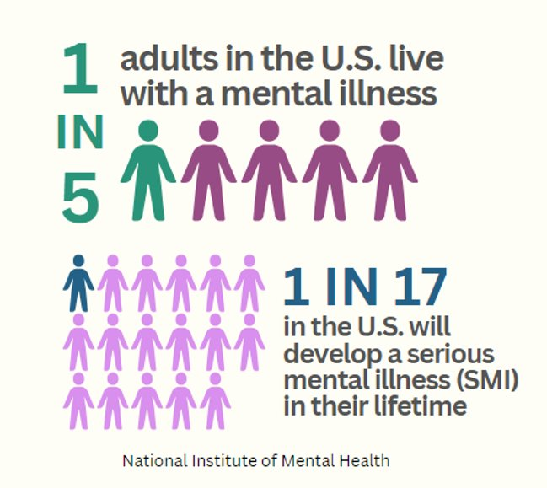
Prevalence of Mental Illness
Notes:
Let’s take a moment to consider how widespread mental health challenges are in our society. Approximately 1 in 5 or 20% of adults in the U.S. live with Mental Illness - it’s possible that the number is higher given that individuals may be underdiagnosed or misdiagnosed. 1 in 17 people in the US will develop what is considered a serious mental illness (SMI) which typically refers to diagnoses such as bipolar or schizophrenia.
Given the prevalence of mental illness in society, it’s likely that you are already working with survivors who have a diagnosis, whether they disclose this information or not. In fact according to the National Institute of Health “Sexual violence has been identified as a major determinant of poor mental health, with victims of sexual violence exhibiting higher rates of depressive disorders, PTSD, general anxiety disorders and eating disorders.” So another reminder that your work as an advocate is critical to support survivors with mental health diagnoses both in and out of custody.
Prevalence and risk of sexual violence victimization among mental health service users: a systematic review and meta-analyses - PMC
Adult Data: Mental Illness - National Institute of Mental Health (NIMH)
Whitney DG, Peterson MD. US National and State-Level Prevalence of Mental Health Disorders and Disparities of Mental Health Care Use in Children. (JAMA Pediatr. 2019)

Slide 12
Pathologization of People of Color
Common for youth of color to be under-, over-, and misdiagnosed ¹
The prevalence of adults with severe mental illness is highest for people of 2 or more races, followed by Indigenous people ²
Ai Generated Image
Sources: [1] Liang J, et al. Mental Health Diagnostic Considerations in Racial/Ethnic Minority Youth. (J Child Fam Stud., 2016) [2] National Institute of Mental Health: Mental Illness Statistics 2022
Notes:
To pathologize means to unfairly and wrongly treat someone and/or their thoughts and behaviors as psychologically abnormal or unhealthy. In the field of mental health, it is the practice of seeing symptoms as an indication of a disorder, rather than understanding and accepting certain behaviors as a different kind of normal. This practice has real consequences for incarcerated survivors whose behavior often leads to their under-, over- or misdiagnosis
There are a number of factors which lead to the disproportionate pathologization of people of color, including systemic racism, mental health staff which do not reflect the communities that they serve, and lack of understanding of diverse emotional responses, experiences and even cultural practices which do not reflect the norms of the dominant society. Communities of color experience barriers in accessing culturally informed mental health treatment and face additional stigma and discrimination when seeking support services, leading to distrust of service providers. Psychological testing tends to reflect white - Eurocentric values leading to the over pathologization of minority groups. Additionally, racial oppression is itself a contributing factor to psychological distress. Statistics show that “Black communities are diagnosed with schizophrenia-spectrum disorders at a rate that is three to four times higher than White communities.” The onset of severe psychiatric symptoms often propels Black and Brown people into interactions with law enforcement which may lead to forced hospitalization, incarceration or even death by police violence.
Communities of color are more likely to experience criminalization of mental health symptoms, rather than treatment or care. The disparities continue when in custody -
Among incarcerated people with a mental health condition, non-white individuals are more likely to be held in solitary confinement, be injured and stay longer in jail (NAMI).
The weaponization of medicine: Early psychosis in the Black community and the need for racially informed mental healthcare - PMC
https://www.nami.org/wp-content/uploads/2023/10/NAMI_CriminalJusticeSystem-v5.pdf

Slide 13
Question:
How can a detention environment amplify trauma symptoms and mental health challenges?
Notes:
Let’s pause here and reflect and ask ourselves: How can detention environments amplify trauma symptoms and mental health challenges? This is an important topic because the environment can play a huge role on mental health -
If needed:
For instance, let's think about isolation. For someone with PTSD, being placed in solitary confinement can feel like reliving their trauma all over again. While structure can be helpful, overly rigid systems with no room for autonomy can trigger feelings of powerlessness, especially for individuals who have already experienced control and abuse in their lives.
Another example, can include a lack of privacy. Lack of privacy can be a big issue because imagine being in a space where you can’t let your guard down. For incarcerated people with anxiety and depression, this can significantly worsen their symptoms.
Now I would like to open this up to our group today. What are some of your thoughts or examples from your own work experience you can share?

Slide 14
Prevalence of Mental Illness in Detention
2 in 5 incarcerated people have a history of mental illness.
Between 25% - 40% of people with mental illness will be incarcerated at some time in their lives.
Image: CDCR
Source: The National Alliance on Mental Illness : Criminal Justice Factsheet 2023
Notes:
People with mental illness are drastically overrepresented among people who are behind bars. But why is this? Contrary to widespread belief, most people who have a mental disorder are not violent and only 3%–5% of violent acts can be attributed to individuals living with a serious mental illness. Rather than violent crimes, many people with MI are locked up for minor offenses, like theft, drug use, or disturbing the peace. It is often the case that a person's offense is related directly to their mental illness. For example, studies have found that people with paranoid schizophrenia are frequently arrested for trespassing, disorderly conduct, and other nonviolent charges that encompass behaviors associated with their condition.​
Like many of your responses indicated:
There is also evidence that the conditions of carceral environments may lead to emerging or worsening of psychiatric disorders. Overcrowding, lack of privacy, 24 hour lighting, threat of violence from peers and staff and constant surveillance can all have damaging impact on mental health. Incarceration increases the odds of 12-month major depression by nearly 50%. Individuals in custody are also at dramatically heightened risk of suicide. An international study including data from the US found that incarcerated men are three times more likely to die by suicide and incarcerated women are nine times more likely to die by suicide than individuals outside of custody. Why the Incarcerated Are More Likely to Die By Suicide | Psychology Today
This data is certainly alarming to hear and critical for us to remember the impacts that custody itself can have on the incarcerated survivors we support.
​

Slide 15
Trauma in Detention
About 4 times the rate of childhood adversity (ACES) than the general population. ¹
Among incarcerated men 62%−87% have been exposed to past trauma. ¹
The lifetime prevalence of PTSD among incarcerated women was 53%. ²
One third of youth in detention suffer from PTSD. ³
Source: [1] Ervin, Jagannath, Zweig, Willison, Jones, Maskolunas, Cajarty, Agha; Addressing Trauma and Victimization in Women’s Prisons, The Urban Institute, October 2020
[2] Morrison M, Pettus-Davis C, Renn T, Veeh C, Weatherly C. What Trauma Looks Like for Incarcerated Men: A Study of Men's Lifetime Trauma Exposure in Two State Prisons. J Trauma Stress Disord Treat. 2019 Mar;8(1):192. Epub 2018 Dec 21
[3] Mendel, R. Why Youth Incarceration Fails: An Updated Review of Evidence. (The Sentencing Project, 2023)
Notes:
In any discussion of detention, it's crucial to understand that the majority of incarcerated people are survivors of significant trauma including chidlhood abuse, neglect, physical and sexual abuse. There is evidence that incarcerated populations have experienced high rates of adverse childhood experiences - which does not take into account the impacts of systemic racism, other forms of identity based oppression, and exposure to community violence including over-policing.
We want to note that most incarcerated women have experienced sexual and/or domestic violence prior to incarceration and that youth in custody are also disproportionately impacted by trauma as well.
As we continue to consider these facts, it's clear that trauma-informed care practices are essential to have. Without TIC, we risk re-traumatizing clients and perpetuating cycles of harm. Our role as advocates and supporters is to ensure that the systems around them offer safety, understanding and healing.

Slide 16
Lack of Treatment in Detention
About 3 in 5 people with mental illness go untreated while in state and federal prisons.
Over 50% of those taking psychiatric medication at admission did not continue to receive their medication once in prison.
Only 45% of people with mental illness receive treatment in jails.
Source: he National Alliance on Mental Illness : Criminal Justice Factsheet 2023
Notes:
Despite the high numbers of people living with mental illness in custody, detention environments routinely provide inadequate mental health services. An alarming number of incarcerated people with mental health diagnoses are not being treated or have their treatment interrupted in jails and prisons. It may take time and repeated “sick slips” or medical requests for incarcerated people to be able to meet with mental health staff. Psychiatric prescribers may only meet with incarcerated clients once a month or every few months and only for brief visits. Mental health providers in custody often have large caseloads and difficulty meeting the needs of the population. Additionally, incarcerated people may be reluctant to seek mental health services due to the lack of confidentiality and lack of trust of providers.
This lack of appropriate treatment can exacerbate mental health conditions among the incarcerated population, potentially leading to additional disciplinary action as well as leaving them at increased risk of sexual victimization.
Mental Health Treatment While Incarcerated | NAMI

Slide 17
Mental Illness and Sexual Abuse in Detention
Notes:
So let’s take a look at how often incarcerated people with mental illness are targeted by their peers. ​
In a 2013 study by the U.S. Bureau of Justice Statistics, we found that in adult facilities, individuals showing symptoms of severe psychological distress are nine times more likely than someone with no such symptoms to be sexually abused by their peers. We also know that 80% of incarcerated people with a severe mental illness who were assaulted by a peer are assaulted more than once. ​
Not only are the rates of sexual abuse by other prisoners higher for survivors with one or more mental illness, but research has confirmed that incarcerated people with a mental illness are five times more likely to be abused by staff than peers who do not have a mental illness. ​

Slide 18
Challenges to Reporting
Widespread staff perception that incarcerated people with mental illness lack credibility ​
Communication and reporting ​
Medication management​
Criminalization of trauma reactions
Notes:
Unfortunately, there are persistent beliefs that those experiencing mental illness won’t be taken seriously if they report sexual abuse. For example, if a survivor begins to tell their story of abuse, but the story is hard to follow, changes over time, and includes delusions, facility staff are less likely to believe their experience. It’s important that we advocate for survivors when this occurs. ​Lack of trust and concerns of being believed can deter an incarcerated survivor with mental illness from reporting entirely.
As we’ve mentioned, folks in detention who have one or more mental illnesses often receive minimal treatment and that treatment usually involves medication that may impact whether they have a clear mind and memory. Medication causing sedation and other side effects can also leave those with mental illness at risk of targeted abuse. (Mention CCWF?)
The criminalization of trauma reactions is all too familiar to survivors in detention. Survivors with mental illness may behave in such a way that violates rules and regulations of the facility. Loud yelling, fighting, and behaviors towards staff perceived as disrespectful may result in disciplinary action. Because survivors with mental illness are less likely to report their abuse, staff certainly aren’t aware of the story behind their behavior, which often results in the criminalization of their trauma reactions. ​
Advocates play an important role in advocating for survivors with mental illness and must be mindful of the patterns of misunderstanding held by facility staff.

Slide 19
In Their Own Words
“People look at me strange. I’m suicidal but refuse to say so due to the institution doing nothing to help but take my clothes and isolate me. So I’m not suicidal, I just think of it a lot more. My panic attacks are severe, my hallucinations and voices are more scary and my psych meds have been increased.”​
— A survivor who was sexually assaulted by an officer in a CA state prison. He told multiple staff in the facility, but they covered it up. He was placed in segregation and told that no policies were broken. ​
Notes:
This survivor said, “People look at me strange. I’m suicidal, but refuse to say so due to the institution doing nothing to help, but take my clothes and isolate me. So I’m not suicidal, I just think of it a lot more. My panic attacks are severe, my hallucinations and voices are more scary and my psych meds have been increased.”
I want to pause a moment here and acknowledge this survivor’s experience is quite heavy - but unfortunately not uncommon.
The typical response to self harming or suicidal thoughts in custody is not a trauma informed response and does typically involve placing the individual in isolation, removing clothing and bedding and other items which may be considered a safety risk. In some facilities individuals placed under psychiatric observation are provided only a literal horse blanket to cover themselves. We can imagine how traumatic this might be to a survivor of sexual abuse - and why the incarcerated survivors we are working with may be wary of reaching out for help in the facility.

Slide 20
Exploring the Approach:
Mental Wellness
Notes:
I know that was a lot of challenging information in that last section, I want to acknowledge that before we transition to talking more about the Mental Wellness Approach.
So on the topic of wellness, let’s pause here and take a couple of deep breaths together - and think about what our roles can look centering wellness, while not ignoring the difficult realities incarcerated survivors dealing with mental illness experience.

Slide 21
Question:
What does mental wellness
mean to you?
Notes:
First, we’d like to get a sense of what mental wellness means to you. Maybe this is the first time you’ve heard the concept of mental wellness, as opposed to mental illness, and that is totally fine. There are no wrong answers here and we can craft a definition together.
So please feel free to come off mute or share in the chat what mental wellness means to you - and it could be just a word or two that comes to mind - at the individual level, social level - there are so many ways to think about mental wellness. It could be something personal, like what gives you a sense of wellness. It could be something you’ve experienced in your work with survivors.
Reflect on responses.

Slide 22
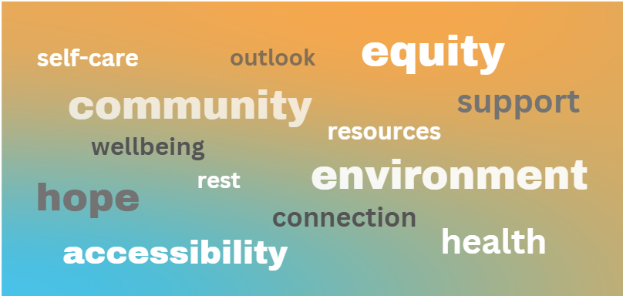
Defining Mental Wellness
Notes:
So just as many of you shared with your wonderful responses - mental wellness is something we are actively working to define. Traditional mental health systems do not have a clear cut definition for what mental wellness means, despite having extensive knowledge and labeling for mental illness. Certainly mental wellness is the goal in mental health treatment, but there are so many social, economic and environmental factors which are crucial to overall wellbeing. Knowledge of what mental wellness is is something that we can work towards together - in conversations such as these and the advocacy work that we do.
Thank you again for joining us in developing this evolving definition of mental wellness - and lets keep some of the words and definitions we’ve considered in mind throughout this presentation and in the work that we do with incarcerated survivors

Slide 23
Pathways for Advocates
Agency culture
Wellness for advocates
Modeling wellness in advocacy
Notes:
Now we can focus on incorporating a wellness lense into your agency’s culture and your work with survivors. This can take many forms - including how an agency views survivors with mental health diagnoses or strong trauma responses - are they seen just as a diagnosis, or as a whole, complex person navigating trauma?
It’s also critical for agencies to center wellness for advocates. This too can be reflected in your agency’s overall approach to wellness. How does your agency ensure advocates are taking care of themselves as they navigate this emotionally challenging work? How does your agency address secondary trauma advocates might experience working with survivors? Many rape crisis centers are underresourced and understaffed, putting added pressure on advocates to work longer hours and take on multiple roles within an agency.
We can think back about how we defined mental wellness earlier, how we might have defined that for ourselves as individuals. Think about whether your agency culture and work-life balance reflect mental wellness. What steps can you take organizationally, within your role as and advocate, and within your personal life? Embodying mental wellness as best as we can - we are after all complex human beings living in a challenging world - helps us stay present in the work that we do. Seeing how we can shift our agency culture and our advocacy towards a mental wellness framework is crucial to approaching our work with survivors as a whole. In this way we can lead by example, practicing wellness tools that we can bring to our clients.

Slide 24
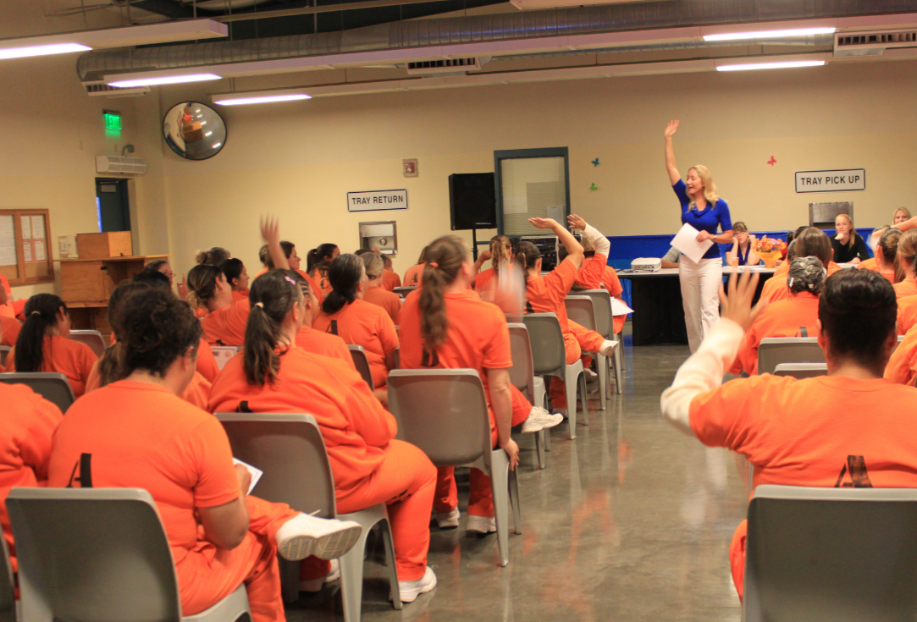
Possibilities for
Wellness in Detention
Relationship with facility
Detention culture
Available resources
Staff wellness
Image: Shutterstock
Notes:
And then as we turn to work with survivors in detention, we must examine our relationship with the facility in how we can best implement a mental wellness approach. How is our agency’s relationship with the detention facilities in our service area? If our agency has established relationships, how can we build on these existing relationships to implement more of a mental wellness approach? What barriers might there be to achieving this? Given the culture of corrections facilities, we may need to be strategic in how we integrate a mental wellness approach - maybe it’s just the approach our advocates take in providing services, or maybe with receptive staff members, we can have productive conversations on how to improve mental wellness for all facility residents. We can think creatively on how mental wellness considerations can improve safety in facilities, and how our services and approach are an asset.
It may seem difficult to imagine mental wellness in a facility which may be isolating and traumatizing in itself, and we must keep this challenge in mind. We don’t want to promote a picture that incarcerated survivors can easily access a sense of wellness in facilities if they work hard enough or do “all the right things.”
However, we can examine what positives do exist and how we can help build a mental wellness approach from there. When we do think about available resources that can help promote wellness in the facility - we want to take a look at what mental health services are already available, as well as programming such as classes and support groups and options for recreation, physical activity and creative Access to these resources can also look different depending where a person is housed in the facility, their security level and accessibility needs.
Detention staff wellness may be overlooked in assessing opportunities for mental wellness at the facility. Facilities may be understaffed with staff working long hours. Building your agency relationship with the facility can include opportunities to introduce cross-training and wellness practices that support detention staff. Detention staff who have tools for self regulation will be better equipped to promote overall mental wellness within facilities.

Slide 25
Agency Readiness
Agency readiness in working with:
Men and boys
People of color
LGBTQ+ people
People with disabilities
Photo by Sasha Konnov on Unsplash
Notes:
It’s important to assess agency readiness in working with populations you may not typically serve when working with incarcerated clients living with mental illness. We must be careful as advocates in positions of authority: we have the power to either reproduce or reduce existing inequalities.
We’ve already noted that communities of color are disproportionately pathologized through a mental illness lens. It’s also important to mention that members of the LGBTQ+ community are subject to having their identities pathologized as mental illness or deviance. Additionally, LGBTQ+ individuals experience higher rates of psychological distress and higher rates of mental health diagnoses than the non-LGBTQ+ population. Individuals living with disabilities, such as physical or cognitive, face additional stigma of having their mental health scrutinized as well. According to the CDC, Adults with disabilities report experiencing frequent mental distress almost 5 times as often as adults without disabilities. We want to note that marginalization in all forms can lead to “minority stress” and presents a barrier to seeking and accessing support services.
Additionally we want to name that men and boys, especially men and boys of color, are more likely to be perceived as violent and aggressive, even more so when experiencing mental illness. This is where we as advocates must examine the intersections of biases towards those living with mental illness and our perceptions of the incarcerated male survivors we are working with.
We can first examine our own biases through self-reflection, learn about the differences in the populations we work with, and work to develop ongoing knowledge of supporting differences, practicing cultural humility and responsiveness. It’s usually affirming when advocates are able to reflect the identities of the populations they serve. Due to systemic oppression, multiply marginalized incarcerated people may experience mistrust and feel more comfortable working with advocates who represent their identities. Representation and connection matters - but we recognize that advocates are unable to reflect the identities of all clients. That’s where it can be helpful for rape crisis centers to consult with, receive training from and partner with organizations lead by communities of color, LGBTQ+ organizations, and disability rights organizations to prepare for your work with incarcerated survivors as a whole and incarcerated survivors living with mental illness specifically.

Slide 26
Core Values of Advocacy

Slide 27
Question:
How does your agency respond to survivors with mental health diagnoses?
Notes:
We’d like to get a sense of how your agency responds to survivors with mental health diagnoses - with any survivors you serve (not just those incarcerated). We’ve heard some agencies avoid working with survivors with mental health diagnoses or refer these survivors back to mental health services rather than continue services.
Again - no judgment here - we’d just like to hear how your agency approaches survivors with mental health diagnoses. So please come off mute if you like or share in the chat -
Reflect on responses
Thank you all so much for sharing your responses. It’s really helpful for us to see how advocates are working with survivors with diagnoses, and we will take a deeper look at different approaches you might consider in this section.

Slide 28
Core Values of Advocacy
Be present
Be a compassionate witness
Believe survivors of trauma are knowledgeable
Listen, reflect back, and validate
Notes:
It may seem daunting to work with a survivor with mental illness if you haven’t previously. Perhaps you feel like you don’t have the experience or qualifications to do so, but remember that there are essential skills that you bring to your clients in the work you do on the day-to-day that help them heal. Similarly, with this population, you are seeing clients as survivors and to support them in the aftermath of abuse. It is not your job to treat people or diagnose them, but it is up to you to support them through their survivorship.
Sometimes what we hear from advocates is that a person has mental health issues so we’ve referred them to mental health and that advocacy stops there.

Slide 29
Core Values of Advocacy Cont’d
Meet people where they are
Be patient
Get creative in finding solutions
Engage in problem-solving
Notes:
As advocates we must meet survivors where they are - whether they are displaying mental health symptoms, acting out behaviorally or just not opening up to your support - we want to be present with whatever they are feeling and experiencing. Rather than asking or thinking of the survivor we are working with as difficult or problematic, asking what’s wrong with you - we have the opportunity to ask - what have you been through? What happened to you? You might be the first person to ask them that. And maybe they are in a place where they can answer that or maybe not. Maybe the question is more “how has what you’ve been through impacting you today?”
Explore what feels safe together ie: non-verbal engagement, having a code word for when they’d like to pause the conversation, checking in regularly about taking a break,
One of the most important things to keep in mind, is that building trust may take time. Folks who are incarcerated may have had negative experiences with advocates or other service providers before. (power dynamics)
Engaging in problem solving when possible and appropriate, and working together to find solutions whenever possible

Slide 30
Voices from the Field:
Validate Experiences
“Would it be really frightening if that was happening [delusion]? Don’t engage with the delusion, but say, ‘that sounds scary – it sounds like you are feeling afraid.’ Join them in empathy, that’s the most powerful thing you can do.”
Linda McFarlane, MSW, LCSW JDI’s Executive Director
Notes:
Similarly, we can validate the experiences a person with mental health symptoms is having, without minimizing the impact of their experience. Here JDI Executive Director Linda MacFarlane, describing working with a client in an altered state, shares that:
[referring to delusional thinking and beliefs of persecution]
“....Would it be really frightening if that was happening? Don’t engage with the delusion, but say “that sounds scary – sounds like you are feeling afraid.” Join them in empathy, that’s the most powerful thing you can do.”
Linda stresses the importance of centering empathy and reflecting back the experience of a person dealing with altered states of consciousness we might have difficulty relating to. We don’t need to be mental health professionals ourselves to recognize that someone describing paranoid thinking might be feeling afraid and unsafe. Even if their thinking does not appear to align with reality, it may be very real and overwhelming to them.
We do not have to engage with a survivors altered state of thinking - but it can be really grounding to offer validation.
It also may be that a story of abuse hidden in what appears to be a survivor’s altered state. By offering our empathy and listening even when things may not make sense, we may build the trust that can help the survivor share more about their abuse in the future.

Slide 31
Actionable Strategies and Helpful Skills
Notes:
As an advocate, you can support the mental wellness of survivors in custody through various ways. We’ll spend this next section highlighting a few examples, but we encourage you and your agency to brainstorm what that could look like for you.

Slide 32
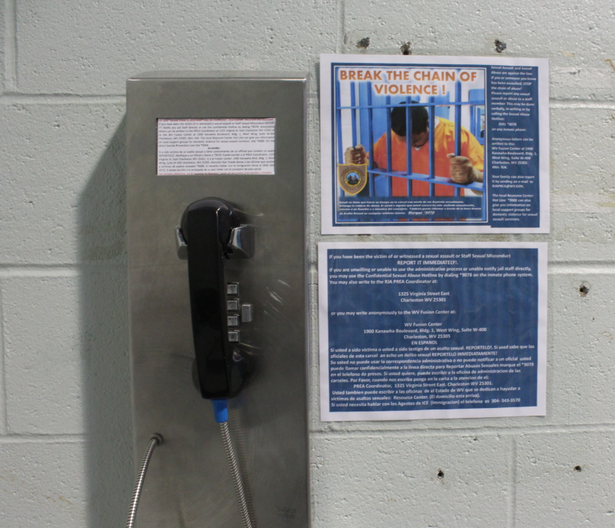
Ways Advocates Can Help
Know what you can provide and how to talk about your services
Create a sense of stability
Develop partnerships in and outside a facility
Image Credit: RJA
Notes:
First, it is important that you know what you can provide to survivors and learn how to speak to those services – both so that you can explain the services you provide and the unique assets of your programming to facility staff at different stages in your partnership, also so that survivors can learn about how exactly you can support them and what they can expect from you and your agency. It can feel kind of silly at first, but practicing an elevator pitch goes a long way! Being able to describe your approach in a concise, clear, and practical way is crucial.
Secondly, there are many ways to keep people well, including by creating a stable space for survivors through check-ins via 1:1 in-person counseling, via hotline, or via chat if that is an option your agency makes available. Regular, consistent group programming can also help survivors stay well and build community.
Lastly, one way to support survivors in custody is to build meaningful partnerships in and outside a facility.

Slide 33
Helpful PREA Standards to Know
§115.16 Ensures information of rights under PREA are accessible to those with disabilities and/or with limited English proficiency.
§115.341 Screens residents for mental illness/disability as a risk factor for sexual abuse
§115.382 Affirms initial access to emergency medical and mental health services and ongoing care for sexual abuse victims and abusers
Notes:
Before we jump in, here are a few helpful PREA Standards to keep in mind.
Source:https://www.prearesourcecenter.org/sites/default/files/content/preafinalstandardstype-juveniles.pdf
Note on .341: Agency should use this information to make determinations around housing, programming,e education, and work assignments
Note on .382: Treatment services shall be provided to the victim without financial cost and regardless of whether the victim names the abuser or cooperates with any investigation arising out of the incident.
Note on abuser treatment, if asked: “The facility shall attempt to conduct a mental health evaluation of all known resident-on-resident abusers within 60 days of learning of such abuse history and offer treatment when deemed appropriate by mental health practitioners.:

Slide 34
Difference between Advocates and Mental Health Staff
ADVOCATE | MENTAL HEALTH STAFF
Reports to rape crisis center | Typically reports to detention facility
Has satisfied state requirements for sexual assault counselor status and provides trauma-informed emotional support | Licensed to provide clinical mental health therapy or medication management
Often takes a creative, grassroots, community based approach to advocacy and support | Creates longer-term treatment plans that may include psychiatric medication
Helps survivors to identify coping skills they already have and offers new ones | Helps facility identify survivors of abuse, helps clients process trauma and abuse
Provides confidential emotional support to incarcerated survivors, regardless of reporting status | Mandated reporter of sexual abuse and sexual harassment that happens in a detention facility
Notes:
Part of the reason that it is important for you to know the breadth of your services and how to speak to it is that it’s not uncommon for people to be confused about the difference between an advocate and mental health staff. If a survivor isn’t wanting to talk to mental health staff, and they think that YOUR part of mental health staff… they could be reluctant to reach out to you for support.
READ LIST DEPENDING ON TIME
Even though an advocate and a mental health staff are two seperate things, they can both help a survivor in their journey.
An advocate is a person who supports a survivor, who may also be a person with mental health challenges; while a mental health staff may be supporting a person with mental health challenges, who is also a survivor. The skills you bring to your everyday work with clients is vital. Both entities have the potential to .

Slide 35
Question:
What barriers might prevent incarcerated survivors from seeking support through the mental health services provided by the facility?
Notes:
[Ask: On that note, what barriers might impede incarcerated survivors from seeking support through the mental health services provided by the facility?]

Slide 36
Barriers to Seeking MH Support
Lack of:
Knowledge about services available
Culturally-relevant services
Services, in general
Confidentiality concerns
Fear of stigma and real life consequences
Distrust in system
Notes:
Some of those barriers include:
Lack of:
survivor may be unaware of the services available to them or unclear about how they work
culturally-relevant services: Mental health support often doesn’t take into consideration different cultural considerations or may not even be available in their specific language
lack of services in general, we hear all the time how little services are available for survivors due to how overwhelmed the system is
Confidentiality concerns: Staff are often required to report more extensively and therefore, a survivor may be unwilling to share any information they perceive may put them at any kind of risk.
Fear of stigma and real life consequences: as we know, sexual abuse survivors experience stigma for their experience, but survivors with mental health challenges can sometimes be even more at risk of experiencing that stigma, and may also be at risk for real life consequences and retaliation
Lastly, a survivor may not trust the system as a whole, making it difficult for them to reach out for support

Slide 37
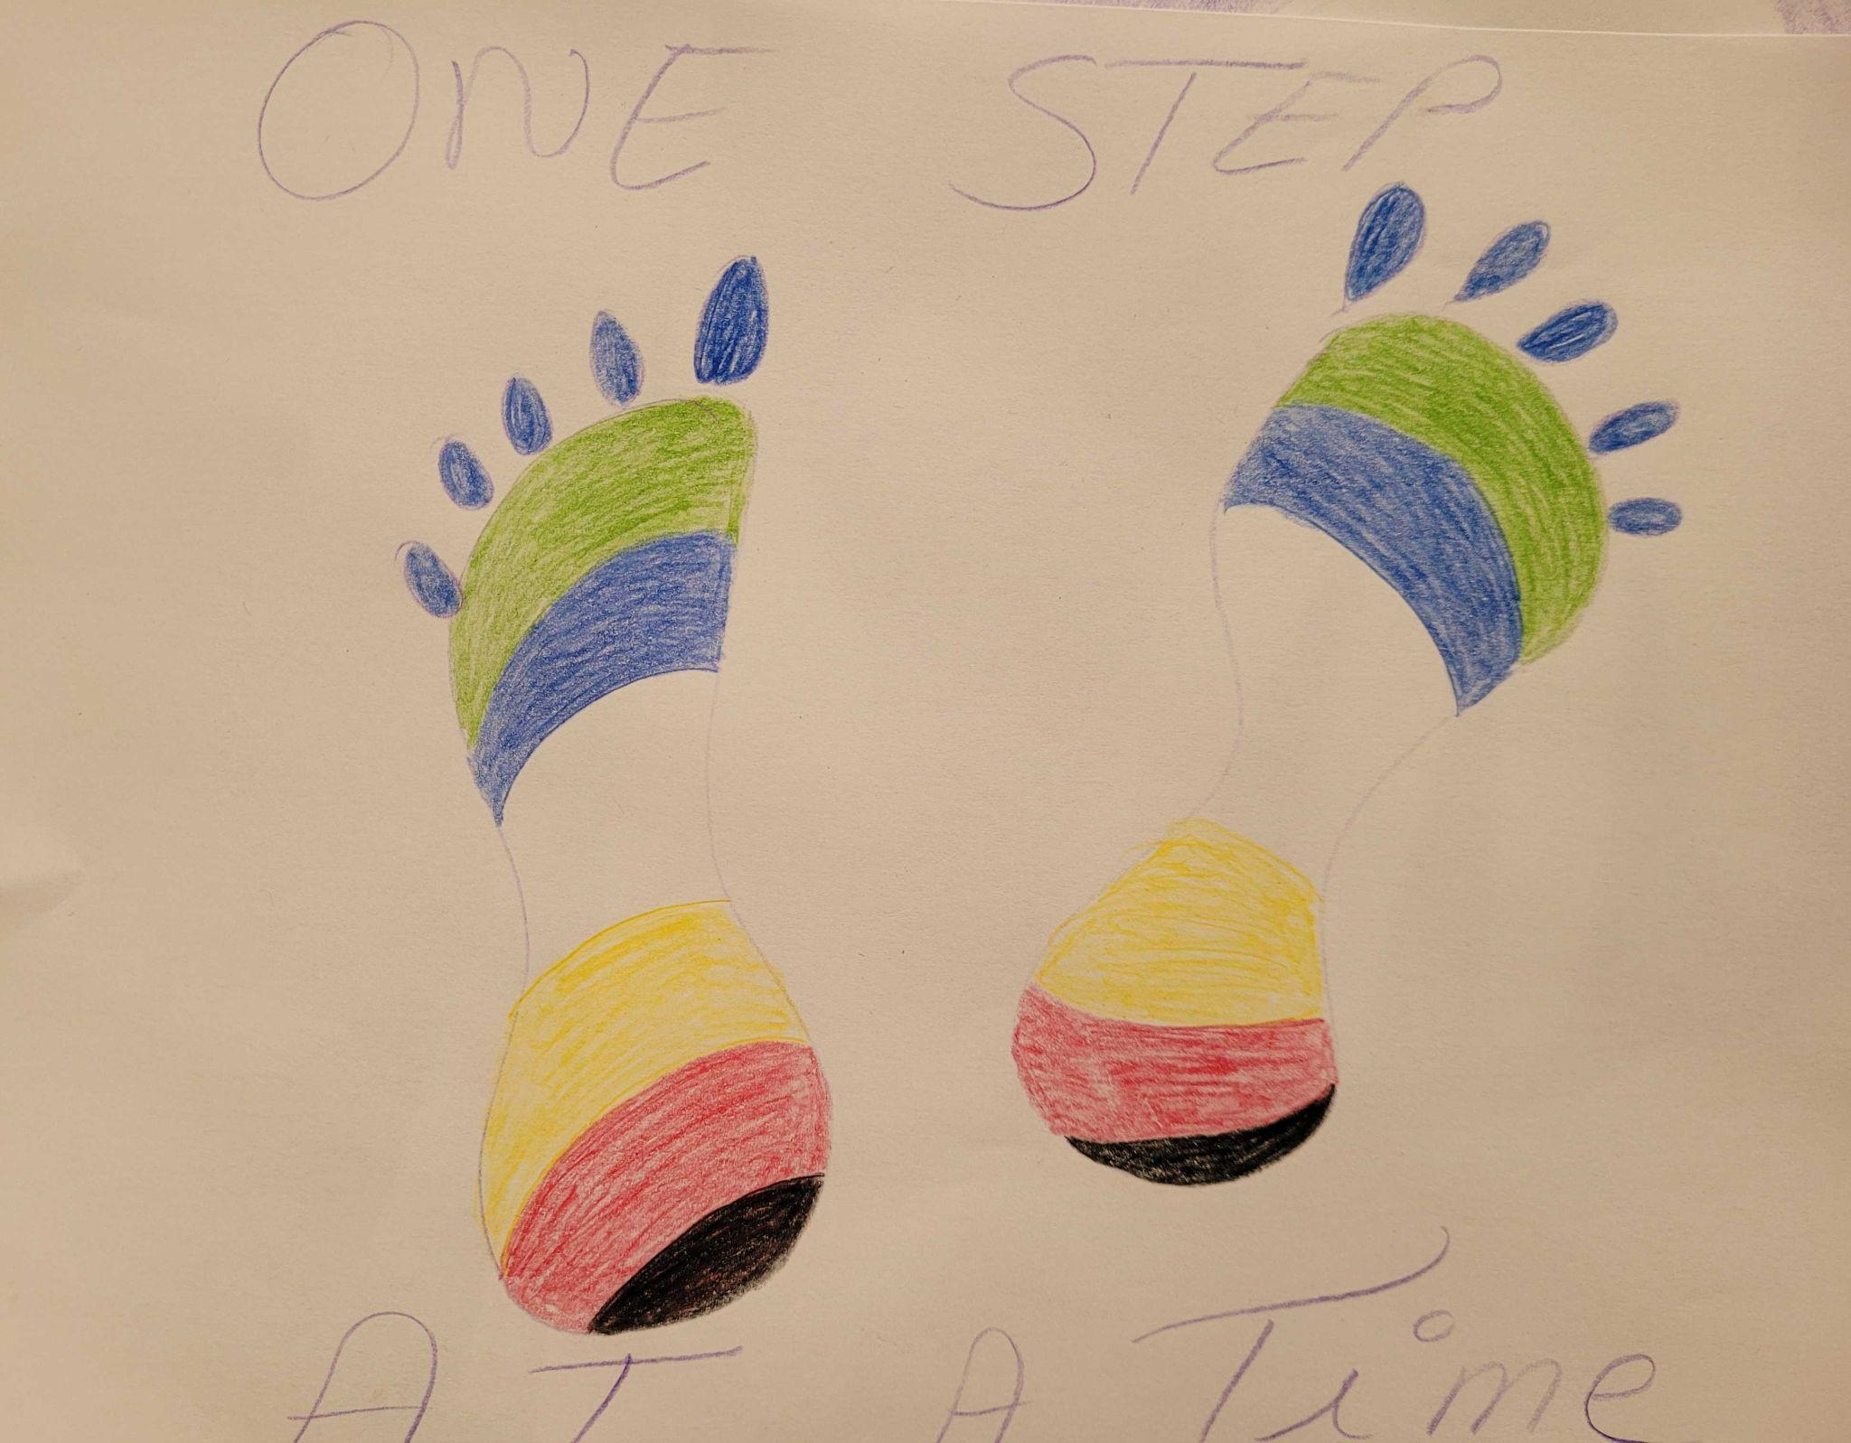
Create Stability
Be consistent
Be creative and collaborative
Provide journals, art supplies, etc
Allow for stillness or movement
Art Created by Participant at Disability Pride, CIW 2024, shared with permission.
Notes:
Like we mentioned, another way advocates can help clients feel well is by creating a stable space for survivors through check-ins via 1:1 in-person counseling, via hotline, or via chat if that is an option your agency makes available. Regular, consistent group programming can also help survivors stay well and community. Creating stability is about consistency, but that doesn’t mean you can’t be creative in your approach to creating that sense of stability for your clients. For example:
You can encourage survivors to express themselves through creative means, like poetry, journaling, and drawing.
When possible and if approved by the facility, you can offer to provide fidgets, toys, and art supplies that can help someone feel safer.
You can allow for movement and even provide opportunities for mindful movement, such as guided meditations, visualizations, breathing and stretching exercises. Alternatively, you can allow for stillness and silence as well.

Slide 38
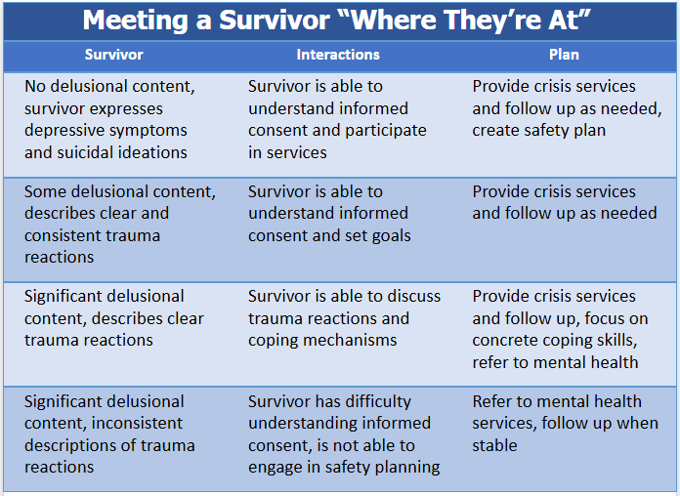
Notes:
let's talk through a few ways that it can be helpful for advocates to work with a survivor depend on where they are at: ​
If you are working with someone on the hotline, in a letter, at an exam or in person that is not expressing any delusional content in what they are saying but is perhaps expressing depressive symptoms and suicidal ideations, generally survivors who are expressing in this way can understand informed consent and participate in services. In this case you would provide provide your standard crisis services and follow up services as needed as well as create safety plan specific to their SI. ​
If you are working with someone who is expressing some delusional content with what they are saying but describes clear and consistent trauma reactions it is likely that they are also are able to understand informed consent and set goals to work with you. You would want to provide crisis services and follow up as needed.​
Some survivors we work with have a significant delusional content with what they are sharing however they may still be able to describe clear trauma reactions. Even with the large amount of delusion content, if the survivor is able to discuss trauma reactions and coping mechanisms then you should be able to provide crisis services and follow up while focusing on concrete coping skills. In this case you may want to discuss referring them to mental health if they aren’t already engaged with those services
If you are working with a survivor who has significant delusional content and is only able to provide inconsistent descriptions of trauma reactions it is likely that survivor may have difficulty understanding informed consent and if they are not able to engage in safety planning you may have to wait until you can provide comprehensive services to this survivor. (emphasis) IN this case if they are a threat to themselves or others you may need to make a referral to mental health without their direct permission, however you will still want to follow up with them and to try to fully engage them in services when they are more stable.

Slide 39
Encourage Agency at Every Opportunity
Review consent forms to ensure simplest language
Discuss limits to confidentiality
Conduct knowledge checks
Notes:
Part of creating a sense of stability and safety for a survivor is promoting and encouraging their agency at every step. In practice, this includes:
taking a look at your consent forms and (and all other written materials) to ensure that you are using the simplest language possible so that the survivor knows how and what to share.
when first meeting the survivor, you want to explain your limits to confidentiality as clearly and as concisely as possible.
checking in throughout your sessions/interactions to ensure that the survivor understands the limits to your confidentiality. “We’ve been meeting for x amount of sessions now, I like to review confidentiality with folks around this time. Would you mind if we went over some of that information?”

Slide 40
Communication Tips
Speak slowly and give the survivor time to respond​
Move slowly and avoid quick or expansive gestures​
Use a calm, even tone of voice​
Use simple sentences​
Watch/listen for signs of distress
Notes:
When working with a survivor that may have a mental illness, it’s important to keep in mind the way we communicate with folks. These tips can also be helpful for working with survivors in general!
Be sure to speak clearly and slowly, and give survivors time to respond.
You will also want to be sure to use a calm, even tone of voice and limit expansive gestures or quick movements. Watch and listen for signs of agitation, frustration, or distress. Remember, even if what someone is sharing may be confusing or be partially delusional content, it doesn’t mean they cannot understand what you are saying or that every single thing they say has delusional content. Be sure to take any signs of abuse seriously. ​
Keep in mind, people with severe mental illness may also be taking strong medications that impact their memory, speech, and the way that they engage with you during your time together. Be patient with folks as they try to navigate their session with you. If someone is making all that effort to engage in services with you, there’s a strong likelihood that they really need it.
​

Slide 41
In Their Own Words
“It’s a safe place to express myself. It’s another outlet. It was kind of an experiment for me. Coming here is our choice – that’s different. We have confidentiality. The counselor is not with the department of corrections – that’s the best part, the most important is that we know it’s not going in our file.”
- Patty, Paths to Recovery participant
Notes:
Here’s a quote from Patty about her experience with a services in a group setting

Slide 42
Develop Partners on the Inside
Connect with relevant stakeholders
Understand how you can supplement work done by MH staff
Reiterate confidentiality
Notes:
As we mentioned, another way to enhance the mental wellness of survivor is to create partnerships on the inside and outside. Often, as an advocate, your point of contact may be the PREA Compliance Manager, but it is equally important that you develop working relationships with mental health staff, line-staff, security staff, program staff, and others who are allies to survivor in the facility, and who are invested in the wellbeing of incarcerated folks at the facility.
That being said, we know that folks have varying degrees of trust with facility staff and the system as a whole. Even as you build and hold relationships with other partners, be sure to have an open discussion with the survivors you’re working with about what that looks like. Remind them of your commitment to their confidentiality or when necessary, discuss a ROI.

Slide 43
Develop Partners on the Outside
Create safety and continuity for when clients return to community
Examples:
LGBT, substance abuse organizations, housing programs
Notes:
Partnerships that you create outside of the facility are just as important as the ones you create inside the facility. Since many of the survivors you're working with will ultimately be returning to the community, it's crucial that they have your support while making that transition. Having an advocate there to provide a warm hand off and to help them engage in services upon release can make a huge difference in their overall success. Best practice and with the survivors permission, would be to obtain an ROI and help advocate for the clients you work with. But if you’re limited to providing referrals only, it’s crucial to vet (and re- vet on a regular basis) organizations to ensure they support formerly incarcerated folk prior to providing that referral to your clients. Nothing is more discouraging than being brave enough to reach out to a resource, just to have them shut you down.

Slide 44
Experiences in Advocacy
Credit: Just Detention International #PrisonersToo Campaign
Notes:
Vanessa to share on her experiences, specifically surrounding past quotes
CIW Wellness Council
Video of Alexus
Additional slides?

Slide 45
Background
Twenty years of experience as a sexual assault counselor
Lead JDI’s direct service work at the California Institution for Women
Help develop national models for trauma informed programming that support incarcerated survivors

Slide 46
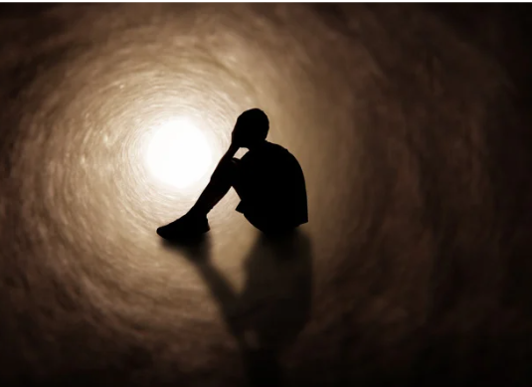
Why is the Mental Wellness Approach Important?
Stigma
Misinformation
Trauma responses
“Referrals only” approach
Notes:
Since we want to move forward in a mental wellness framework in our work with survivors, it’s important to recognize and challenge biases we may have as advocates. We want to acknowledge our own relationship with the conventional mental illness approach we described earlier. There is tremendous stigma attached to those with mental health diagnoses. Our society views those with diagnoses as erratic, irresponsible and even dangerous and violent. Although people experiencing mental illness may act unpredictably, most are much more likely to be victims of violent crime, including sexual abuse, themselves.
There is also tremendous misinformation about what mental health diagnoses mean or what symptoms may look like. We may have assumptions that someone with a mood disorder is always cycling through ups and downs or that someone with a psychotic disorder is always experiencing delusions. However many with these conditions act and behave normally unless experiencing an onset of symptoms. It’s also the case that someone with a diagnosis expressing a valid emotional response may have their response needlessly pathologized through an illness lens.
It is also important to note that trauma responses may mimic symptoms of mental illness. We can examine this within the framework of mental illness which often asks - “what’s wrong with you?” Or we can look through the frame of mental wellness which asks, “what happened to you?” In his book The Myth of Normal, Dr. Gabor Mate explores research which correlates trauma, especially childhood trauma, with experiences labeled as mental illness in adulthood.
When we view those with diagnoses only through a pathologizing lens, making it difficult for us to see them as whole, complex individuals and certainly impacting our advocacy work. Some agencies take a “referrals only” approach when working with survivors with diagnoses, referring them to out to mental health professionals who often have little to no training to support survivors of sexual abuse. Naturally we want the advocates joining us here today to be able to feel safe serving their clients and to abide by agency policies - however we want to invite consideration of working with survivors with a range of mental health experiences.
And remember, you as an advocate do have the tools to build rapport with and support incarcerated survivors with mental illness!

Slide 47
Intersection of Mental Health and Advocacy
Provide resources and opportunities where mental health cannot
Advocates have opportunities to engage people in more meaningful ways then mental health staff
Advocacy and mental wellness includes people who are incarcerated as well as staff

Slide 48
Services at California Institute for Women
Individual counseling
Therapeutic art workshops
Mindfulness
Group Therapy
PREA Peer Education
Pilot Programs
Wellness Council
Image: CIW by JDI

Slide 49
CIW Wellness Council
Comprised of members who are incarcerated at the facility
Peer led and supports fostering sexual safety within the prison
Represents diverse cross section of the community beyond typical demographics:
History of discipline issues
Multiple prison terms
New to prison combined with LWOPS, etc.

Slide 50
Services at California Institute for Men
Requested as a result of relationships established with other California prisons
Services are not gendered
Men in detention have less opportunities to explore deep feelings and trauma
Paths to Recovery Support Group

Slide 51
Keep in Mind
You are an invaluable resource
You have the skills needed to support incarcerated survivors with mental illness
You have support and there are opportunities to continue learning
Notes:
[read slide]

Slide 52
Questions?

Slide 53
Additional Resources
Mindfreedom
Mad in America
NAMI
Fireweed Collective
Wildflower Alliance
National Empowerment Center
Painted Brain
Notes:
https://www.nami.org/
https://wildfloweralliance.org/
https://www.hearingvoicesusa.org/
https://mindfreedom.org/
https://fireweedcollective.org/
https://www.madinamerica.com/
https://power2u.org/

Slide 54
For More Information
For additional information, please visit:
Just Detention International’s Advocate Resources: www.justdetention.org/advocate-resources
ValorUS’ Advocate Resources: https://www.valor.us/category/prea/
Direct questions to:
JDI - advocate@justdetention.org
ValorUS - jsinor@valor.us

